Slide 1
Simple, high-performance, isolated power supply design with PSR (no-opto) flyback
Marshall Beck
Applications Engineer
July 2021

Slide 2
Agenda
Isolation in industrial applications
PSR flyback:
  PSR vs conventional flyback, control/operation, and TI offerings
PSR flyback simple design flow
TI supporting content on PSR flyback design

Slide 3
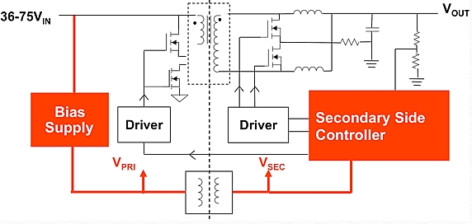
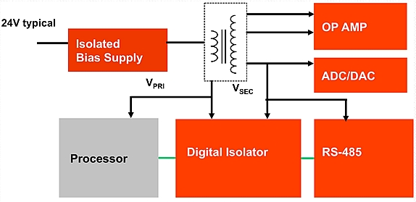
Industrial – Isolation everywhere
IP Phone
IP Surveillance
Sensors
PLC
E-Meter
Solar
Telecom
Wide V_{IN}
24 VDC (15-42V)
PoE (36-57V)
Isolation
Isolation
Notes:
Need to update, change to TI colors

Slide 4
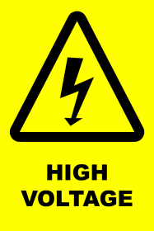
Isolation
Where to use isolation?
Safety
  Mandatory by safety standards to isolate the user from the hazardous voltage of a power supply. Protect user from ESD and surge events.
  Typical applications: IP camera, solar inverter, factory automation – field site
Break ground loop, mitigate noise
  Installed to break the ground loop interference for noise-sensitive applications
  Typical applications : PLCs, solar inverters, building automation (ie. RS232/485, etc.)
Inversion, level shifting & multiple rails
  Isolated output voltage can be conveniently configured as multiple isolated outputs, as a negative voltage rail or as a level-shifted voltage rail.
  Typical applications : test and measurement, medical, e-bike, HVAC, motor drives
Electrical isolation
Isolated power
+16V / -8V
VIN
Isolated power

Slide 5


Isolated power – Simplify signal integrity!
Typical communication protocols: RS422/485, RS232, RS285, LVDS, Ethernet
Long cabling causes transient voltage differences and possible errors!
Solution: Isolate the TX and RX power!
Bit sequence goes in
Goal: Same bit sequence out!!
VDD
V_{T}
TX
RX
TX
RX
Noise
GND
GND
Ground bouncing!
Loose noise margin!
Bit errors!
Eliminate ground bouncing!
Improved noise margin!
Improved effective bit rate!

Slide 6
Isolated power – Simplify your power tree!
Isolated output voltages can be conveniently configured as multiple isolated outputs, as a negative voltage rail or as a level-shifted voltage rail.
Example use cases: Positive/negative rails for differential digital communications, op-amp, isolated bias supply for gate driver
Differential RX/TX Power
Signal conditioning
(Op-amp, ADC/DAC)
Isolated bias supply
VDD1
VDD2
VDD1
TX
RX
Amplifier
-VDD1
-VDD2
-VDD1

Slide 7
Conventional PSR flyback vs. Aux-less PSR flyback
PSR
Feedback
Tertiary Feedback Winding
TL431
Opto-Coupler
Feedback
Conventional PSR flyback advantages:
Increased design flexibility with external compensation and tertiary winding or opto-coupler feedback
Operates in CCM (fixed frequency) or DCM mode
Aux-less PSR flyback advantages:
Eliminates opto-coupler or tertiary winding with only one component crossing isolation barrier
Extremely tight load regulation (±1%)
Operates in DCM or Boundary Mode
DCM and zero current switching enables high efficiency
Notes:
In isolated topologies the biggest concern is to relay the isolated output information back to the IC in order to accurately regulate the output. In a conventional flyback the output is fed back to the IC using either an opto-coupler based solution or a tertiary winding that reflects the output voltage back to the IC. In both cases, the component count and the solution size is fairly large. In fact, reliability can be a concern with opto-coupler based feedback and an additional winding for tertiary winding based feedback adds to the cost of the transformer. The PSR flyback topology eliminates the need of an opto-coupler or tertiary winding and provides extremely tight load regulation using the feature of the resonant ring caused by the Magnetizing inductance and the SW node capacitance. It operates in DCM or Boundary conduction Mode in turn eliminating any errors from the transformer DCR or secondary side diode to provide tight regulation.

Slide 8
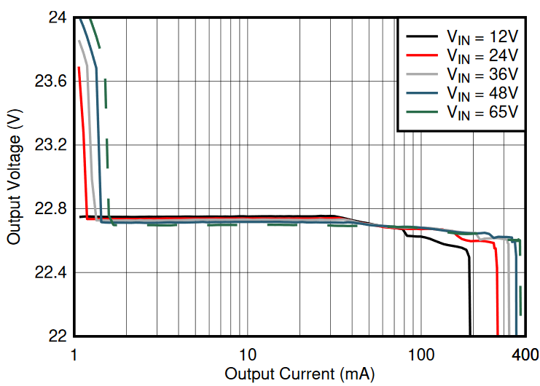
PSR flyback converter – no opto, no aux winding
PSR sensing – output voltage sampled using the primary-side SW voltage
Load regulation – sum of V_{OUT1} and V_{OUT2} with symmetrical loading
No aux winding → easier magnetic design
No optocoupler → higher temperature operation, longer lifetime
Accurate output regulation → ideal for SiC gate drivers
Leakage inductance tolerant → manage reinforced isolation creepage spacing
Notes:
Leakage inductance managed by power fet rating

Slide 9
PSR flyback DC/DC family overview
PSR Flyback DC/DC Converter | Input Voltage Range | Peak Switch Current | Maximum Load Current V_{OUT} = 12 V, N_{PS} = 1, V_{IN} = 13.5V | Package Option
LM5181 | 4.5 V to 65 V | 0.75 A | 180 mA | WSON-8
LM5180 | 4.5 V to 65 V | 1.5 A | 360 mA | WSON-8
LM25180 | 4.5 V to 42 V | 1.5 A | 360 mA | WSON-8
LM25183 | 4.5 V to 42 V | 2.5 A | 600 mA | WSON-8
LM25184 | 4.5 V to 42 V | 4.1 A | 1 A | WSON-8

Slide 10
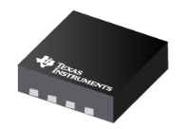
LM25183/LM25184
Highest power density 42V, 2.5A/4A primary side regulated (PSR) flyback converter with 65V integrated power MOSFET
AEC-Q100
Grade 1
Features
Benefits
Highest Power Density 42V PSR with tightest Output Regulation in its class
65V, 2.5A/4A internal power MOSFET
4.5V–42V wide V_{IN} range (abs max 45V)
  3.5V minimum V_{IN} after start-up
  V_{OUT} accuracy ±1% achievable
  V_{IN} = 6V–42V, V_{OUT} = 5V, 2% load to full load
  T_{A} = –40°C to 125°C
Boundary mode, quasi-resonant operation
Internal loop compensation, adjustable input UVLO
External V_{CC} bias option for improved efficiency
Adjustable or fixed internal 6ms soft-start
Optional V_{OUT} temperature compensation
4 mm × 4 mm WSON-8 WF package, 0.8mm pitch
AEC-Q100 grade 1 ⇒ 125°C operating ambient range
No opto-coupler or transformer auxiliary winding needed
Accurate V_{OUT} regulation performance with sensing at zero current
Low I_{Q} operation and external BIAS rail option enable high efficiency at light loads
Applications
Factory automation, PLC
Motor drive, telcom, solar, IP

Slide 11
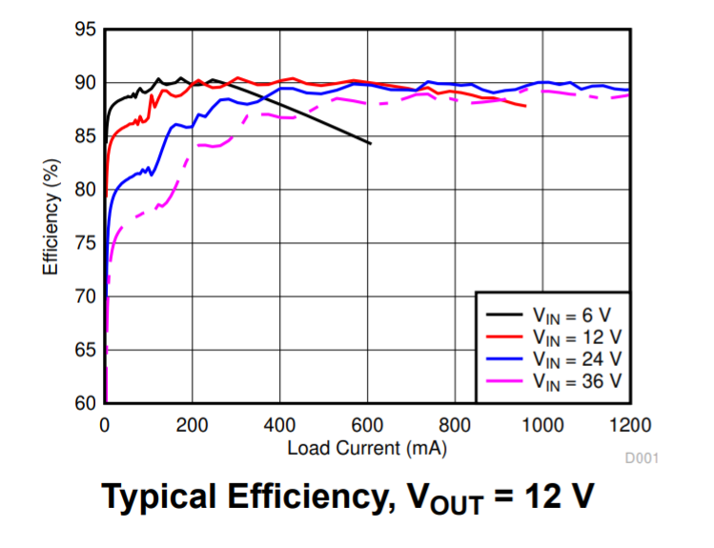
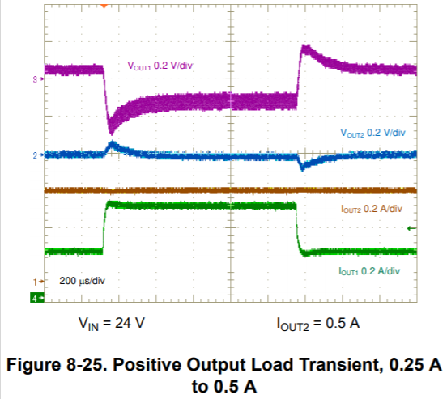
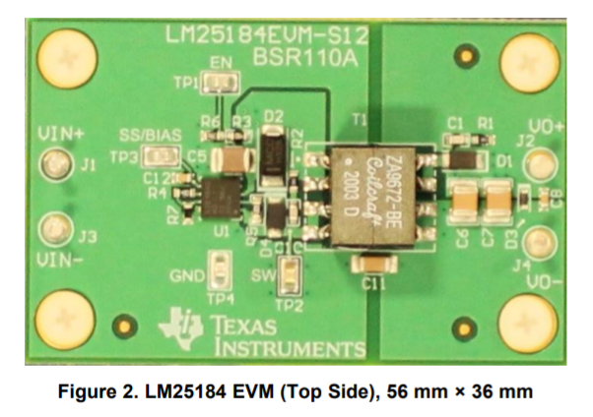
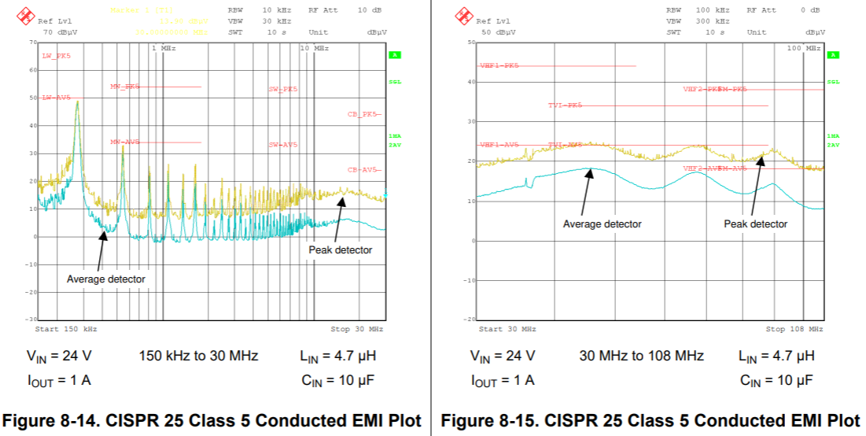
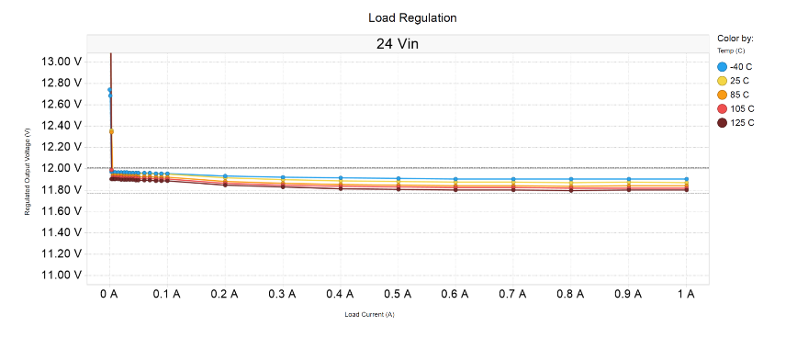
LM25184 performance curves
Low-heat generation
Modest F_{SW} enables good transient performance and small magnetics
Passes stringent EMC standards with only differential filtering
<1.7% variance from -40degC to 125degC

Slide 12
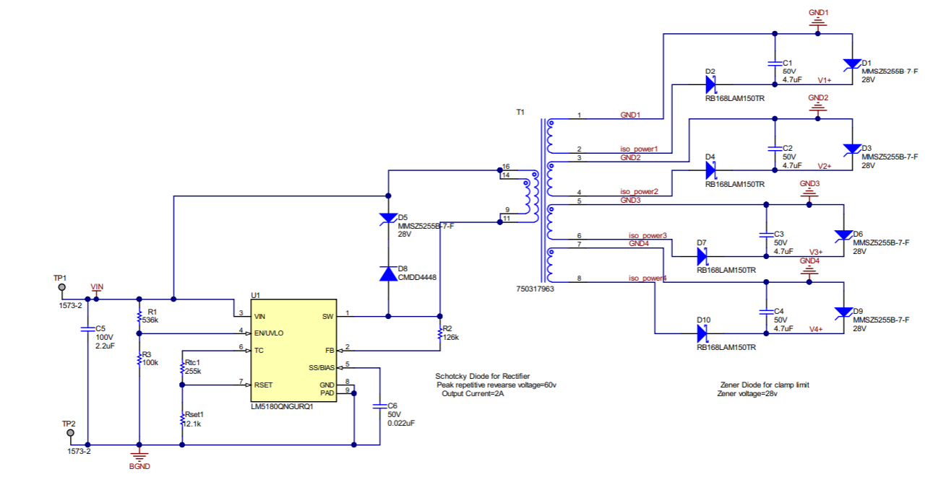
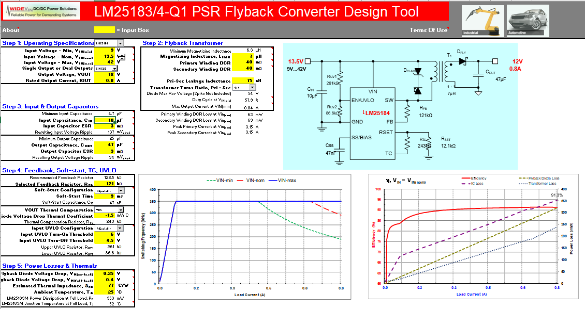
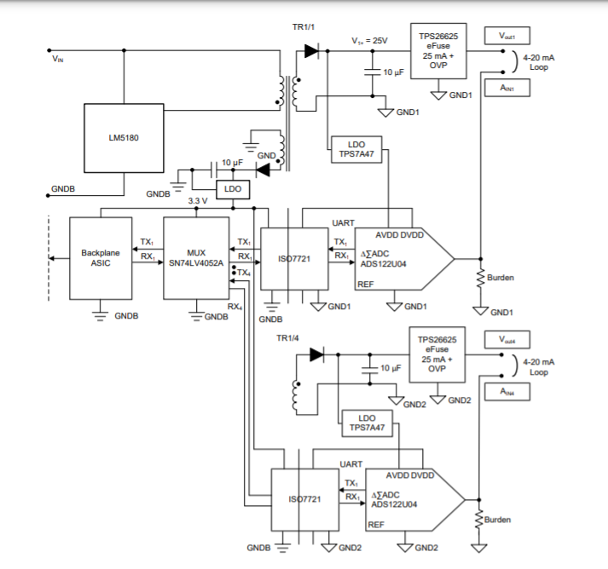
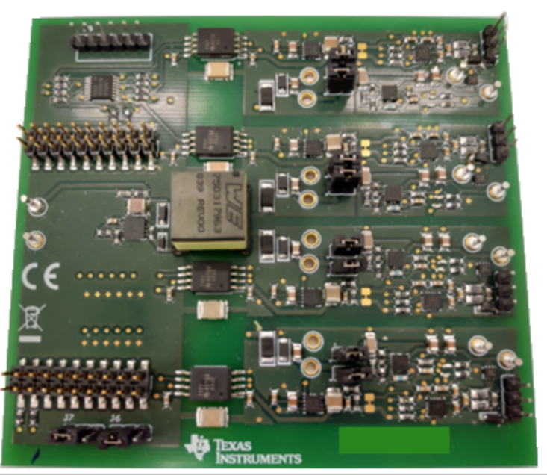


TI’s simple design flow

Slide 13
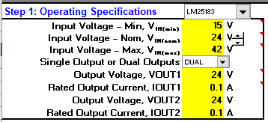
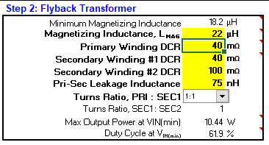
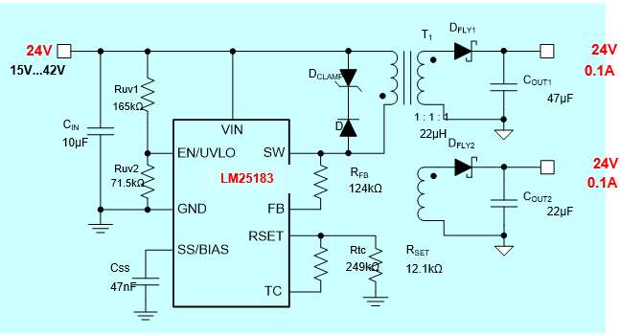
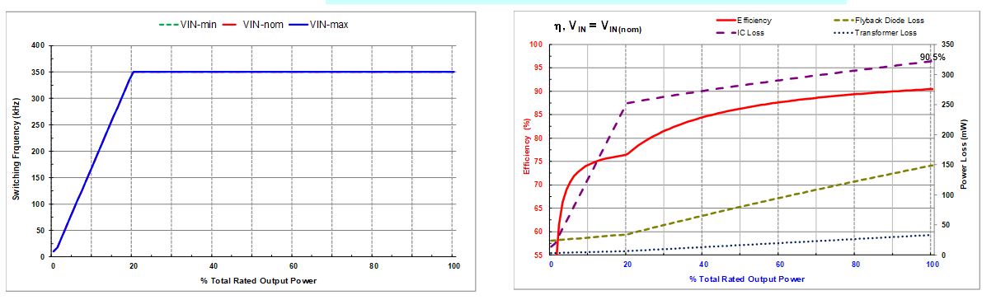
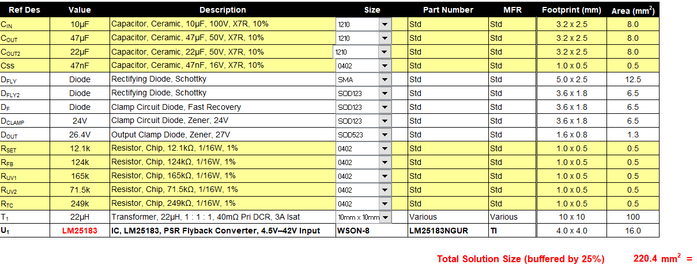
Design calculator tool
Calculator
Input power conditions
Input xfm spec
Get SCH and BOM
Evaluate performance

Slide 14
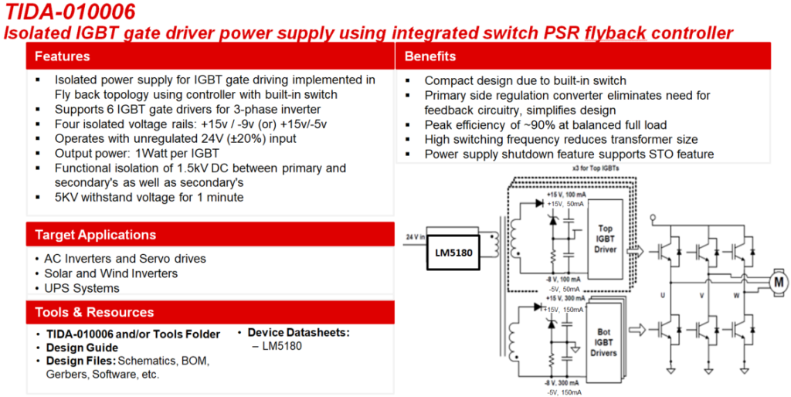
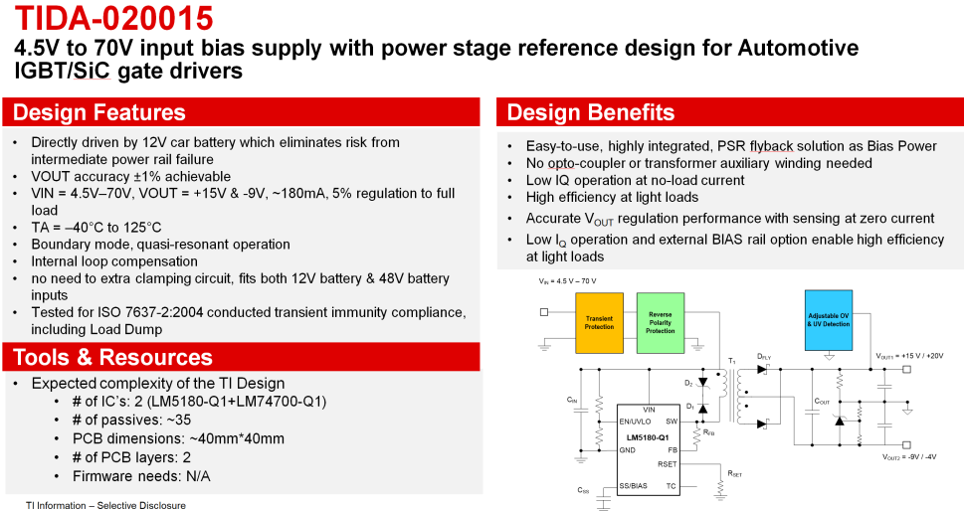
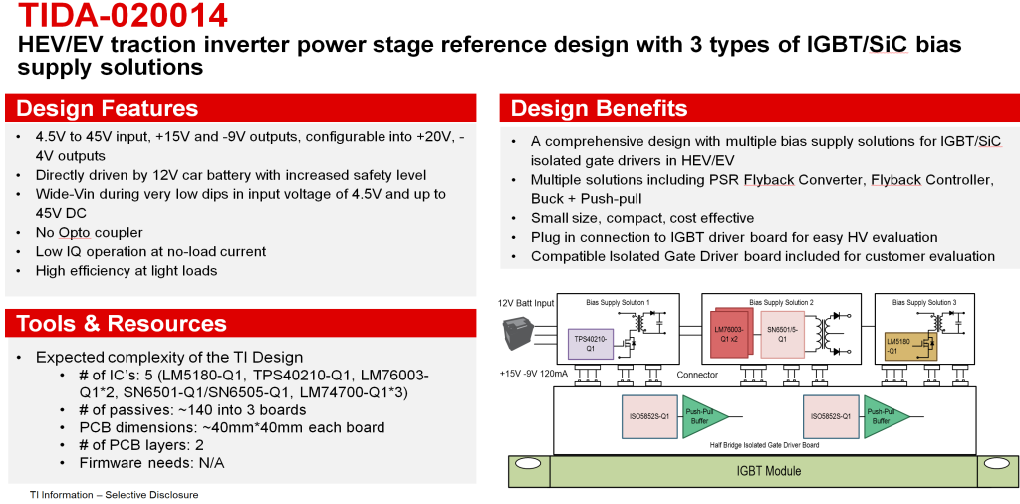
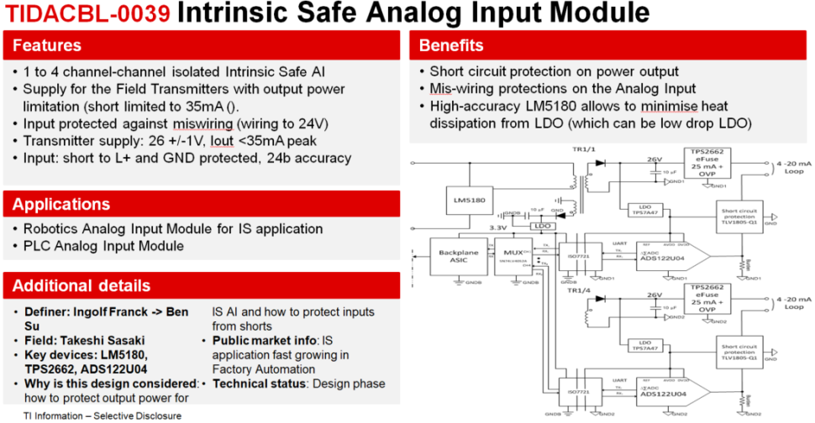
Released reference designs

Slide 15
PSR flyback references
LM25184 Single-Output EVM User's Guide
LM5180 Single-Output EVM User's Guide
LM5180 Dual-Output EVM User's Guide
How an Auxless PSR Flyback Converter can Increase PLC Reliability and Density
Why Use PSR-Flyback Isolated Converters in Dual-Battery mHEV Systems
PSR Flyback DC/DC Converter Transformer Design for mHEV Applications
Flyback Transformer Design Considerations for Efficiency and EMI
Under the Hood of Flyback SMPS Designs

Slide 16
Conclusion
Isolated power is needed in industrial applications
  Split rails for signal conditioning circuit (ie. op-amp, DAC/ADC)
  Signal intergrity for communication and sensors
  Gate driver requires isolated gate bias.
PSR Flyback
  Enables application isolation requirements to be fulfilled without:
    Large BOM cost, strenuous design cycle, or sacrificing performance
  Please reference TI PSR flyback offerings and design resources

Slide 17
Thank you!

Slide 18
PSR flyback converter – magnetic design considerations
Notes:
As we have seen in previous slides the leakage inductance, turns ratio, DCR of the transformer affects schematic decisions significantly. In the next section we will list out the key specs of the transformer that need to be addressed when in discussion with transformer vendors such as wurth and Coilcraft. Sometimes, customers build transformers in-house and we have to educate them on the important specifications to consider when building these transformers.

Slide 19
Engaging with the magnetic component vendor
Key Specification | Symbol
Turns ratio | N_{PS}
Switching frequency | F_{SW}
Magnetizing inductance | L_{MAG}
Saturation current (at 20°C) | I_{SAT}
Primary and secondary DCRs (at 20°C) | R_{PRI}, R_{SEC}
Winding arrangement – interleaving, # of layers
Leakage inductance | L_{LEAK}
Interwinding capacitance | C_{P-S}
Hi-pot test limits (dielectric withstand) | V_{ISO(PRI-SEC)}
Insulation rating – functional / basic / reinforced | IR
Operating temperature range | T_{AMB} + T_{RISE}
Mechanicals – pinout, footprint, height | L × W × H
 | Purpose
 | Optimize flyback duty cycle range
 | Control core loss
 | Set PSR flyback mode boundaries
 | Prevent magnetic saturation
 | Reduce copper loss
 | Minimize R_{AC} and L_{LEAK}
 | Reduce power loss & voltage spikes
 | Mitigate common-mode EMI
 | Provide a robust design
 | Comply with safety requirements
 | Ensure reliability
 | Minimize size and cost
Notes:
Hi-pot testing can be made between primary to secondary and primary to core. Standards state that production hi-pot testing should not exceed 1,500VAC, or its DC-rectified equivalent of 2,121VDC, from input to output or input to ground.

Slide 20
Flyback transformer losses
Copper loss
  DC resistance – depends on the wire cross-section and length (N, MLT)
  AC resistance – depends on choice of wire diameter vs. F_{SW} and construction (layer stackup, proximity effects, gap effect)
Core loss
  Related to core material characteristics, B_{DC}, B_{AC}, F_{SW}
External loss
  Leakage inductance energy
    Large percentage of this power dissipated in external clamp circuit or RC snubber
    Magnetizing energy also dissipated – depends on clamp level and leakage inductance
Notes:
The Flyback transformer is probably responsible for the biggest portion of the total converter losses – it’s important to break down and understand the causes of the various losses.
Note that “Transition Loss” is the loss associated with the transition interval, when the primary current commutates to the secondary. During this interval, both primary and secondary current flow simultaneously, and the di/dt’s can be very fast, with lots of high freq harmonic content. Some papers claim that the loss in this interval is very significant, however it is very hard to prove objectively, or to separate this loss from the others. This loss mechanism is beyond the scope of this presentation and is not explored. This paper talks about it, but in my opinion the conclusion is very underwhelming. “Optimization of a flyback transformer winding considering two-dimensional field effects, cost and loss”, Charles Sullivan, Tarek Abdallah, Toru Fujiwara, 2001.

Slide 21
Flyback transformer – impact of leakage inductance
Leakage inductance affects:
Conversion efficiency
Voltage spikes during commutation
  clamp circuits and snubbers
Current slew rate & loss of volt-seconds
H-field radiated EMI
Cross regulation in multi-output designs
Notes:
[Ref] “Under the hood of flyback SMPS designs,” TI PSDS 2010

Slide 22
Flyback transformer design – impact on efficiency / x-reg
Guidelines to optimize efficiency
  Choose the transformer turns ratio for best efficiency and duty cycle range
  Minimize leakage inductance from primary to main (high-current) secondary
    Interleave primary around secondary (or vice versa if N_{P} < N_{S})
    Reduces voltage spikes and power dissipation
    Locate highest power secondary closest to primary (multi-output designs)
  Minimize transformer high-frequency conduction loss
    Use bifilar or multifilar wires when necessary to reduce AC resistance
    Interleave primary and secondary windings
    Select core shape for minimum number of layers (wide bobbin width)
Guidelines to optimize cross regulation
  Minimize leakage inductance between secondary windings as it impacts cross regulation and secondary current wave shapes
    Wind two highest power secondaries bifilar for best coupling
    Consider DC or AC stacking for same polarity outputs that share common GND

Slide 23
Dual-output transformer construction #1 14 : 28 : 7
Primary winding 50/50 parallel split
Parallel primary windings is a more convenient construction, but the high dv/dt (noisy) SW node voltage appears both on the inner and outer layers

Slide 24
Dual-output transformer construction #2 14 : 28 : 7
Primary winding 50/50 series split
Wind first half of primary on inside layer nearest the bobbin and the other half on the outside
Noisy node (SW) shielded on inside & quiet node (VIN) connects to outside layer
Place windings with similar dv/dt adjacent to each other to reduce interwinding capacitance
→ Better common-mode EMI performance

