Slide 1
Package CTE:
V73333PQDRVRQ1 (WSON/6DRV)
Tianyi Luo
08/03/2020

Slide 2
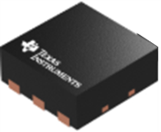
Summary Report
Device: V73333PQDRVRQ1
Package: WSON-6DRV
Total Package CTE*:
CTEX |  | CTEY
α1 (-40 to 89°C) | 11.7 ppm/C | α1 (-40 to 89°C) | 11.7 ppm/C
α2 (89 to 150°C) | 22.9 ppm/C | α2 (89 to 150°C) | 22.9 ppm/C
Z
Y
X
*CTE values are estimates and may differ depending on the application due to non-uniform thermal expansion and package warpage

