Slide 1
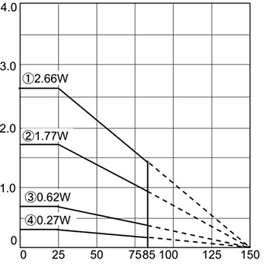
Power Dissipation vs Heatsink Aria
Power Dissipation(W)
Heatsink Aria(mm²)

