Slide 1
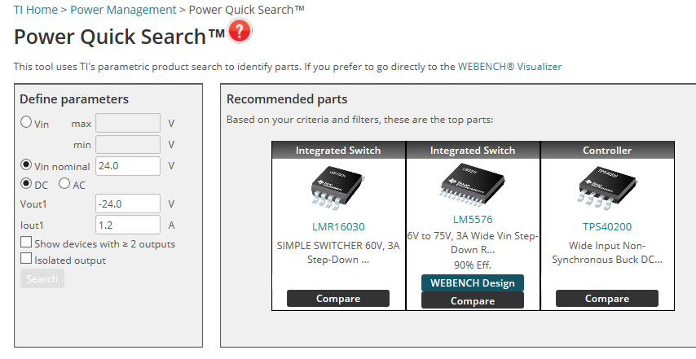
Power Quick search → Webench Design breakdown
I filled out the Power Quick Search tool as shown below. 3 recommended ICs are given, but only the LM5576 has a WEBENCH design associated with it. But when I try to open the Webench design, I get the error message “We're sorry, we could not find a solution to match these requirements. Please check to make sure your inputs are within the correct corresponding range.” The WEBENCH parameters were Vin Min 24.0 V, Vin Max 24.0 V, Vout1 -24.0 V, Iout1 1.2 A, and Ambient Temp 30 °C. Screenshots of the web pages are attached.
Is there a reason for the breakdown between the Power Quick Search and Webench?

Slide 2
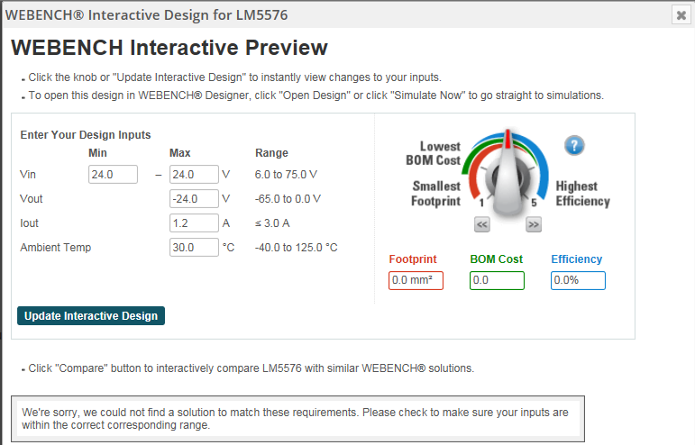
Power Quick search → Webench Design breakdown
This is the problem.
If this is the case – why suggest it at all??

