Slide 1
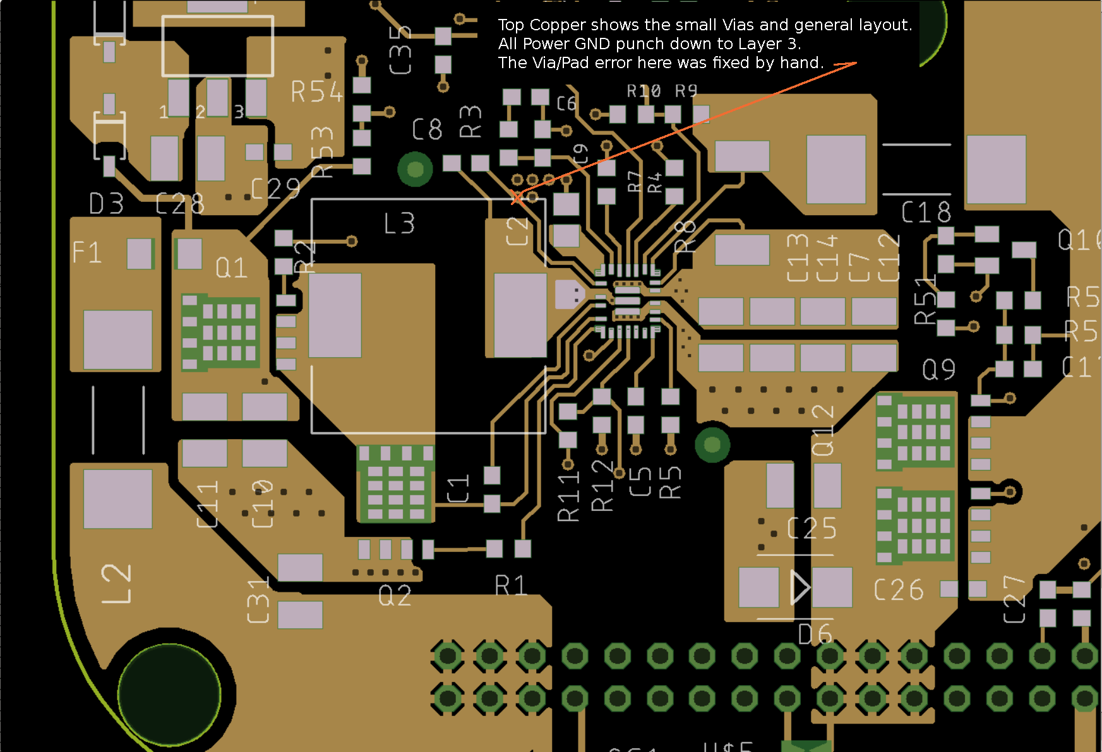
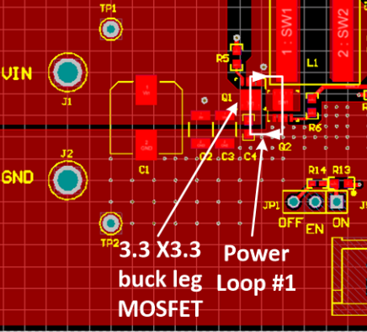
TPS55288 LAYOUT GUIDELINE APP NOTE:
Q1, Q2 could be moved close to each other so that the Buck-leg switching loop area is smaller. This is just recommendation.
Put a 1uF decoupling cap close to VIN pin.

Slide 2
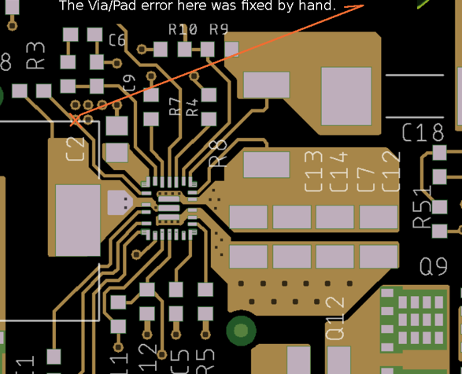
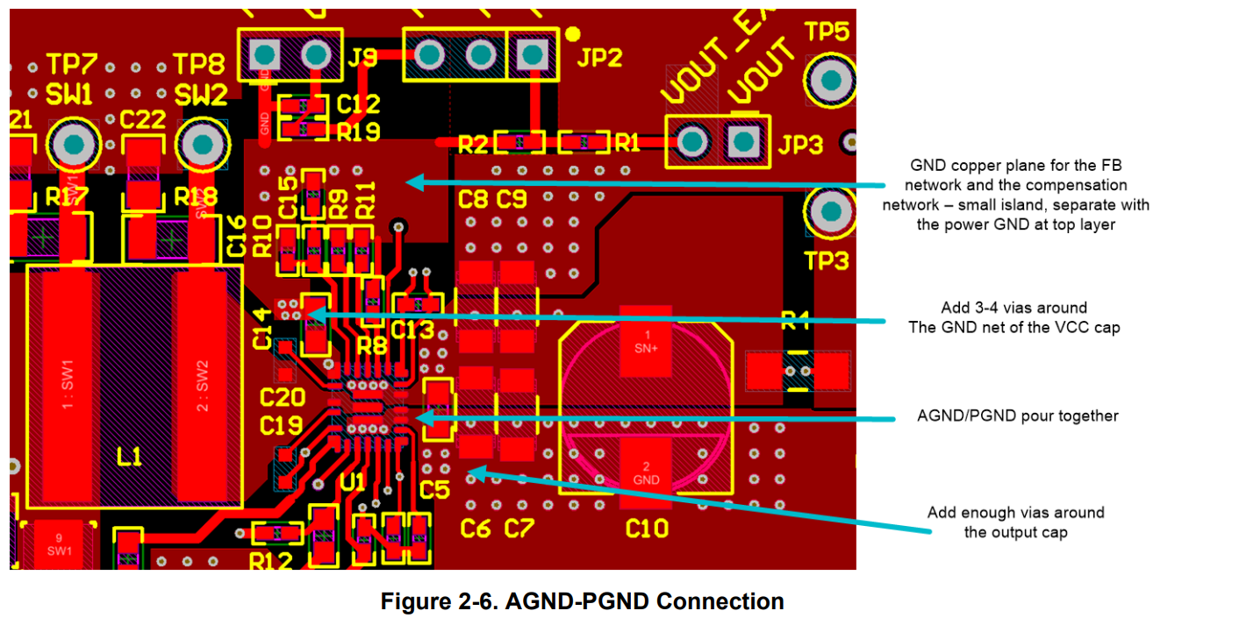
Add a 1uF/0402 package ceramic capacitor close to IC like C5 on below picture. It could help make the Boost-leg switching loop area minimum, reduce the switching spike.
Suggest add more GND vias close to VCC cap negative terminal.
Create a AGND copper for COMP, FB, etc. components and separate with power GND at top layer.

