Slide 1
Question about LMZM23601

Slide 2
Summary
The output of the module is not output.
The Failure Rate is 2/1500
Date Code is 98
The phenomenon
The condition is ,
Vin=24V(typ), Vout=3.3V, Io=80mA/48.5mA(external Resistor)
The output is not correctly about 0.6V.
The board works normally when using the external regulator instead of the NG device.
There is ringing at turn on in OK sample and less ringing at turn on in NG sample.

Slide 3
Schematic

Slide 4
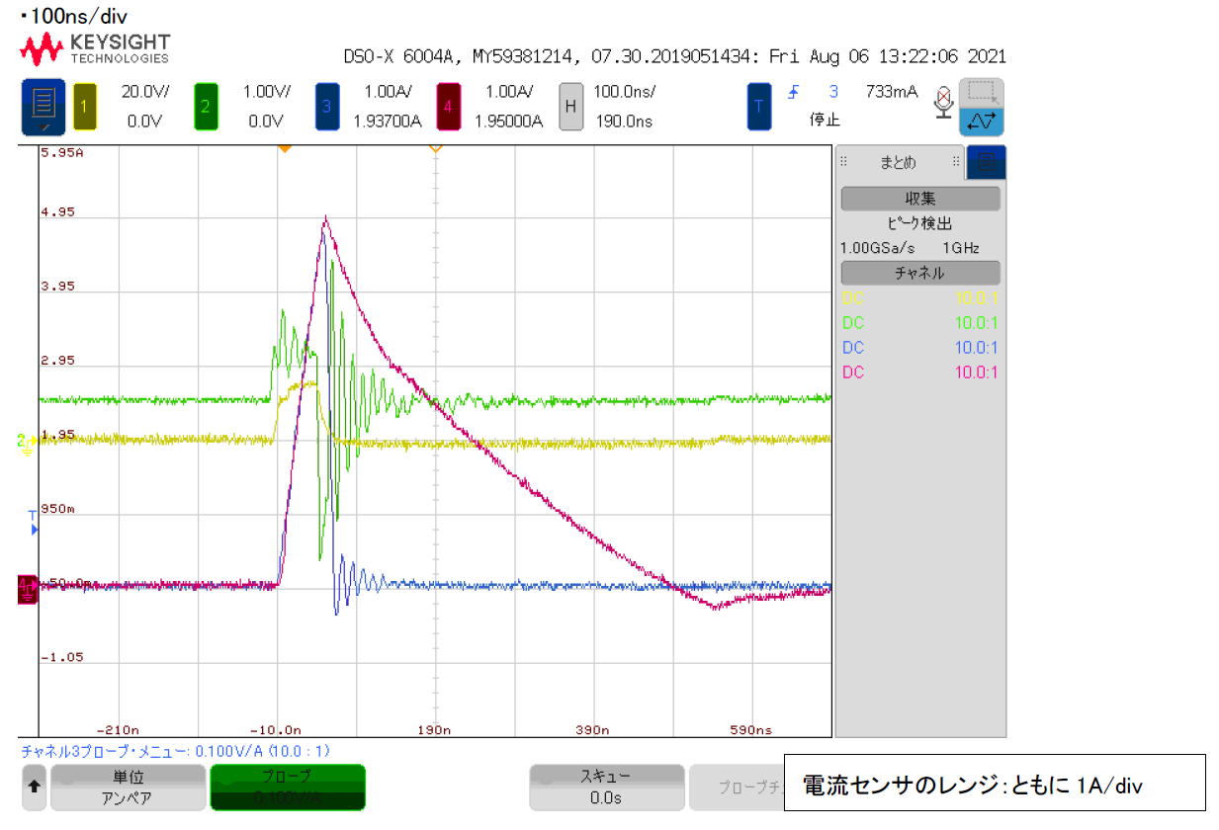
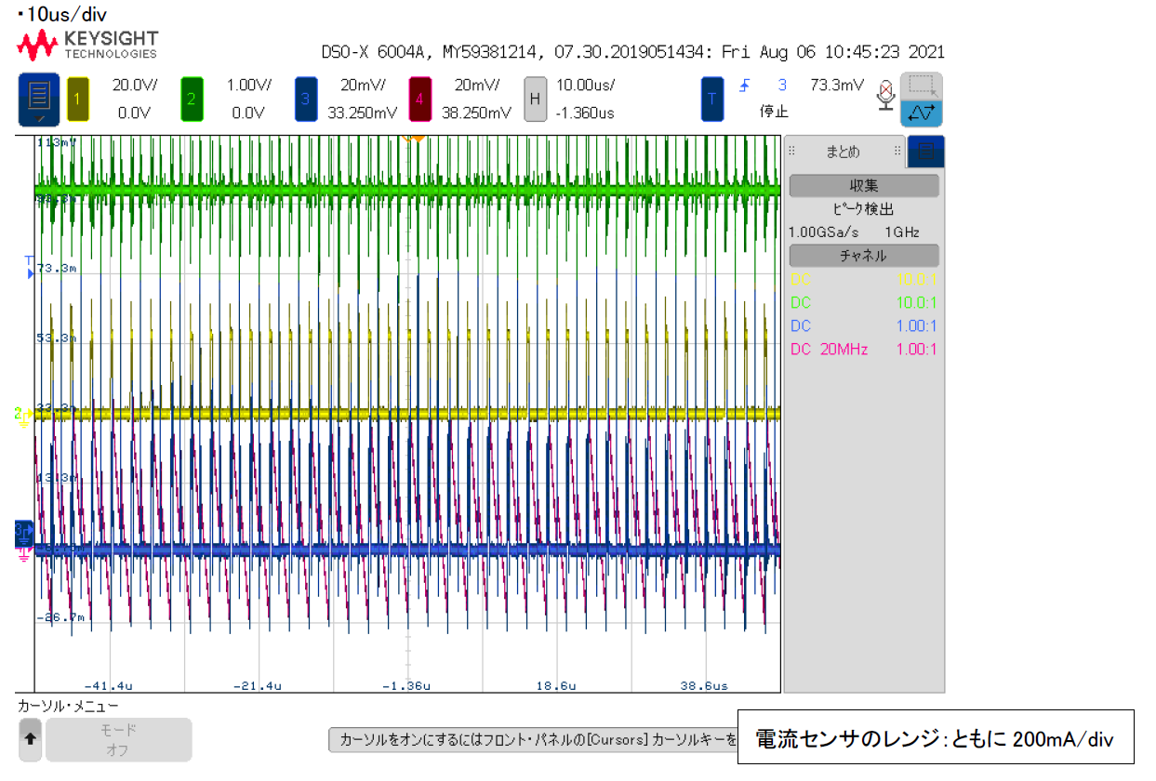
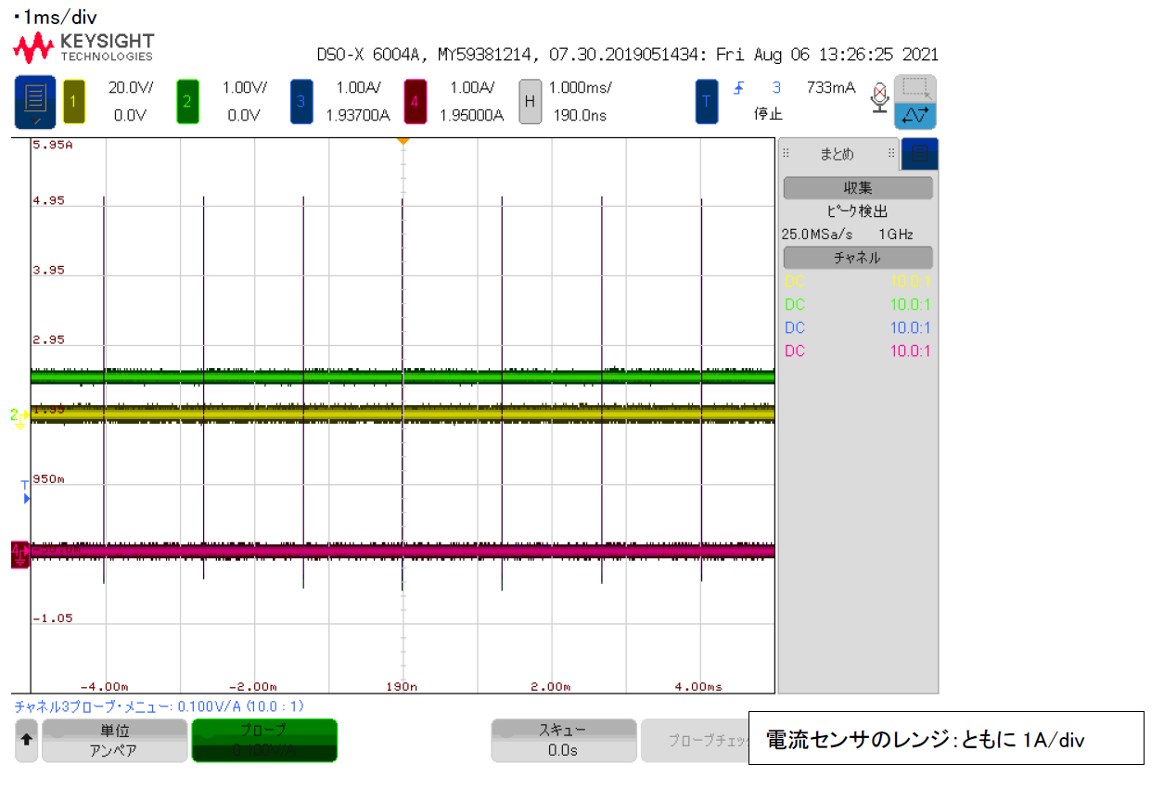
Waveforms
OK
NG
Vout
Vsw
Iin
Iind
Current sensor(Iin and Iind)
200mA/div
Current sensor(Iin and Iind)
1A/div
Vout
Vsw
Iin
Iind
Current sensor(Iin and Iind)
200mA/div
Current sensor(Iin and Iind)
1A/div

Slide 5
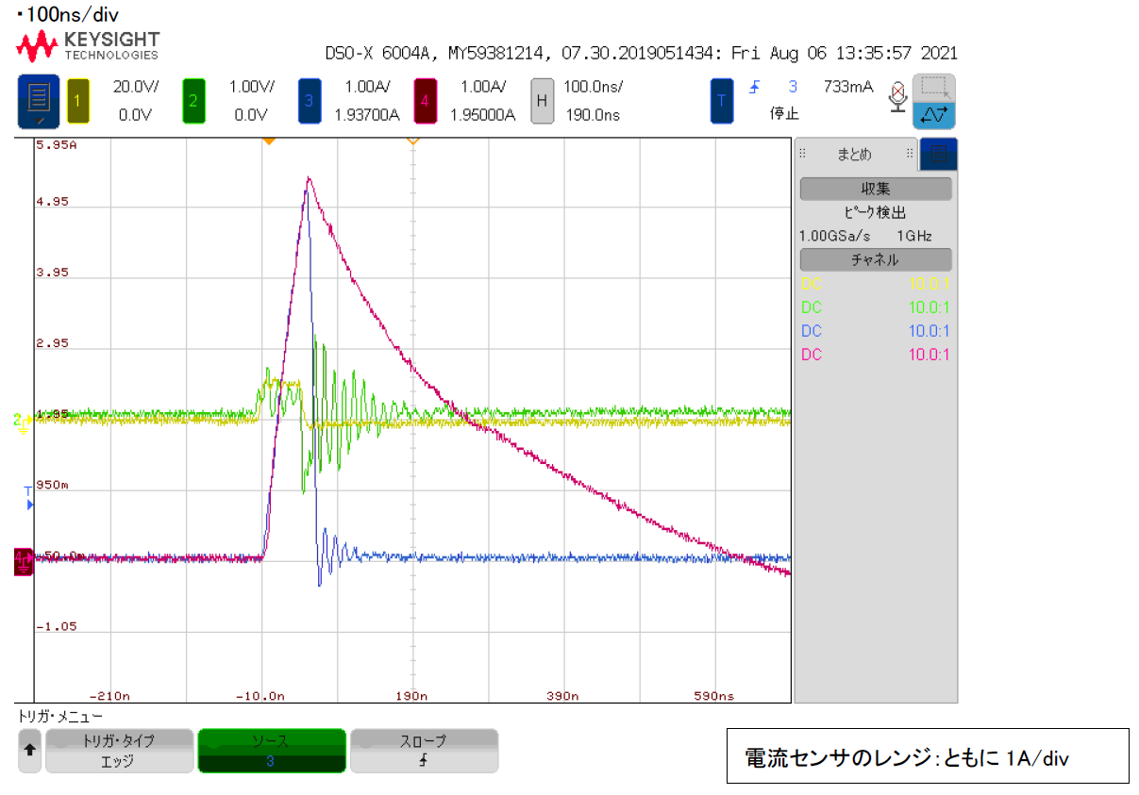
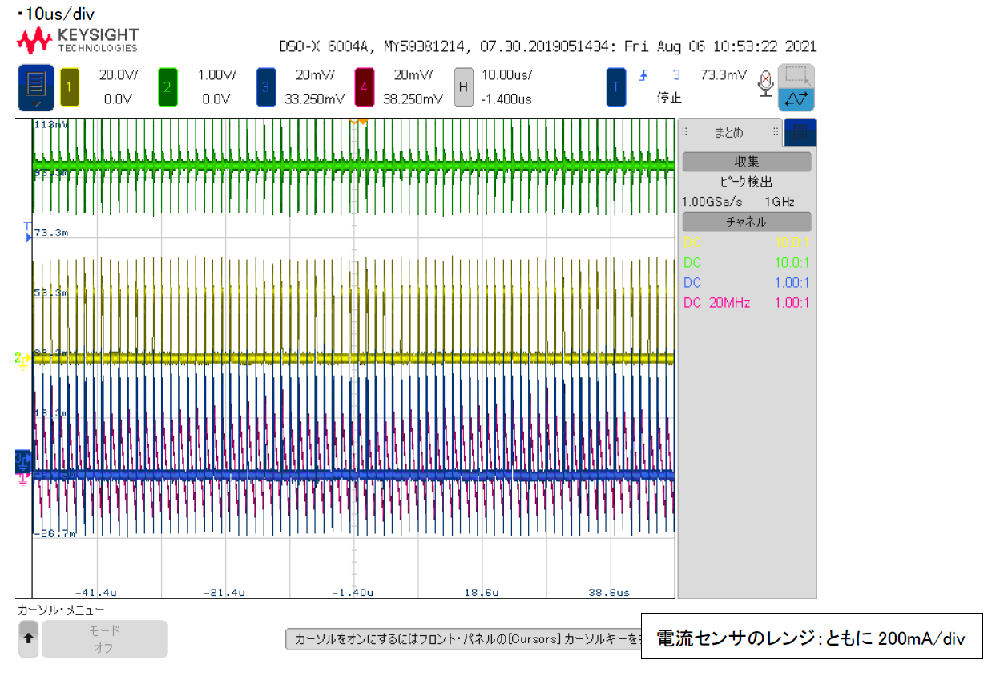
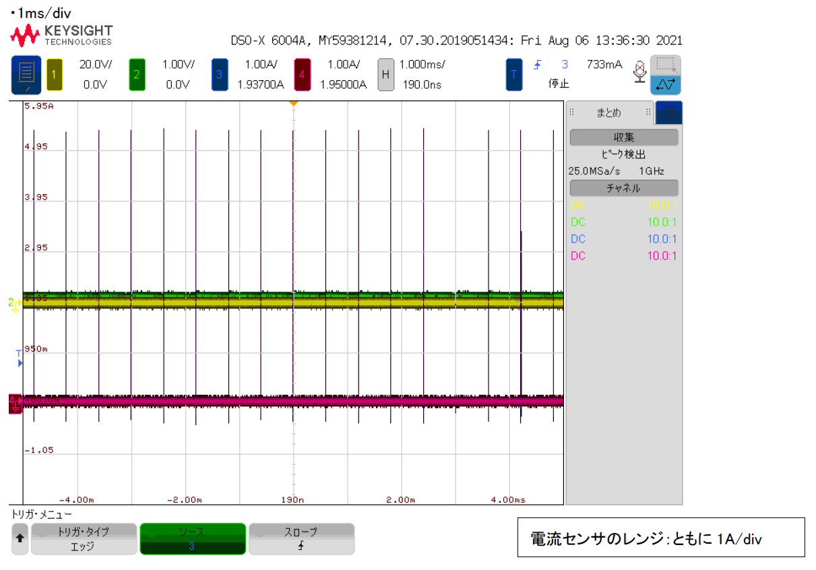
Waveforms-2
OK
NG
Less ringing when the turn on.
Vout
Vsw
Iin
Iind
There is ringing when the turn on.
Current sensor(Iin and Iind)
200mA/div
Current sensor(Iin and Iind)
1A/div
Vout
Vsw
Iin
Iind
Current sensor(Iin and Iind)
200mA/div
Current sensor(Iin and Iind)
1A/div

Slide 6
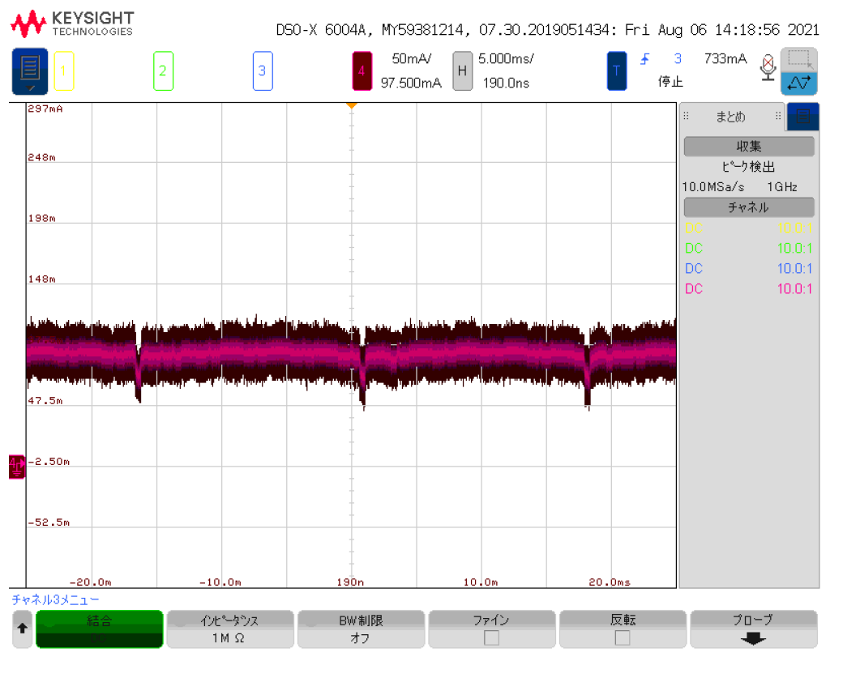
Waveforms-3
The board works normally when using the external regulator instead of the LMZM23601.
OK sample
NG sample

Slide 7
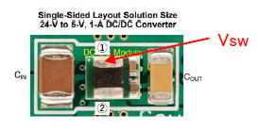
impedance
 | OK (S/N=220115) | NG (S/N= 220222)
7pin(FB)-1pin(GND) | 11.95M | 11.50M
7pin(FB)-１pin(GND) | 369.6K | 362.7K
7pin(FB)-3pin(Vin) | 373.7K | 363.6K
7pin(FB)-3pin(Vin) | 11.51M | 12.46M
(SWpin)-3pin(Vin) | 373.5K | 363.0K
(SWpin)-3pin(Vin) | 13.03M | 12.46M
(SWpin)-1pin(GND) | 11.93M | 11.46M
(Swpin)-ipin(GND) | 369.0K | 361.3K
3pin(Vin)-1pin(GND) | 11.51M | 11.00M
3pin(Vin)-1pin(GND) | 416.0K | 411.3K

Slide 8
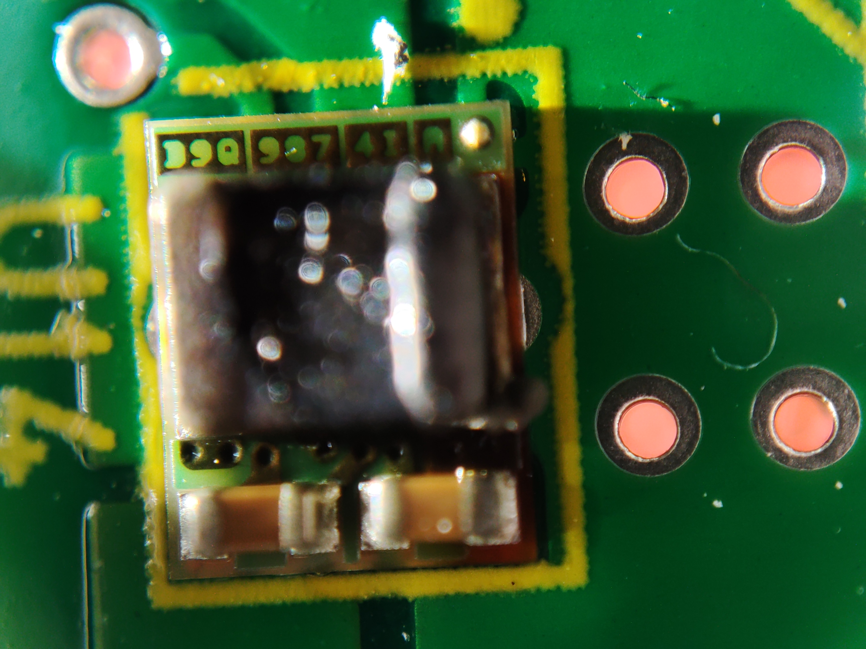
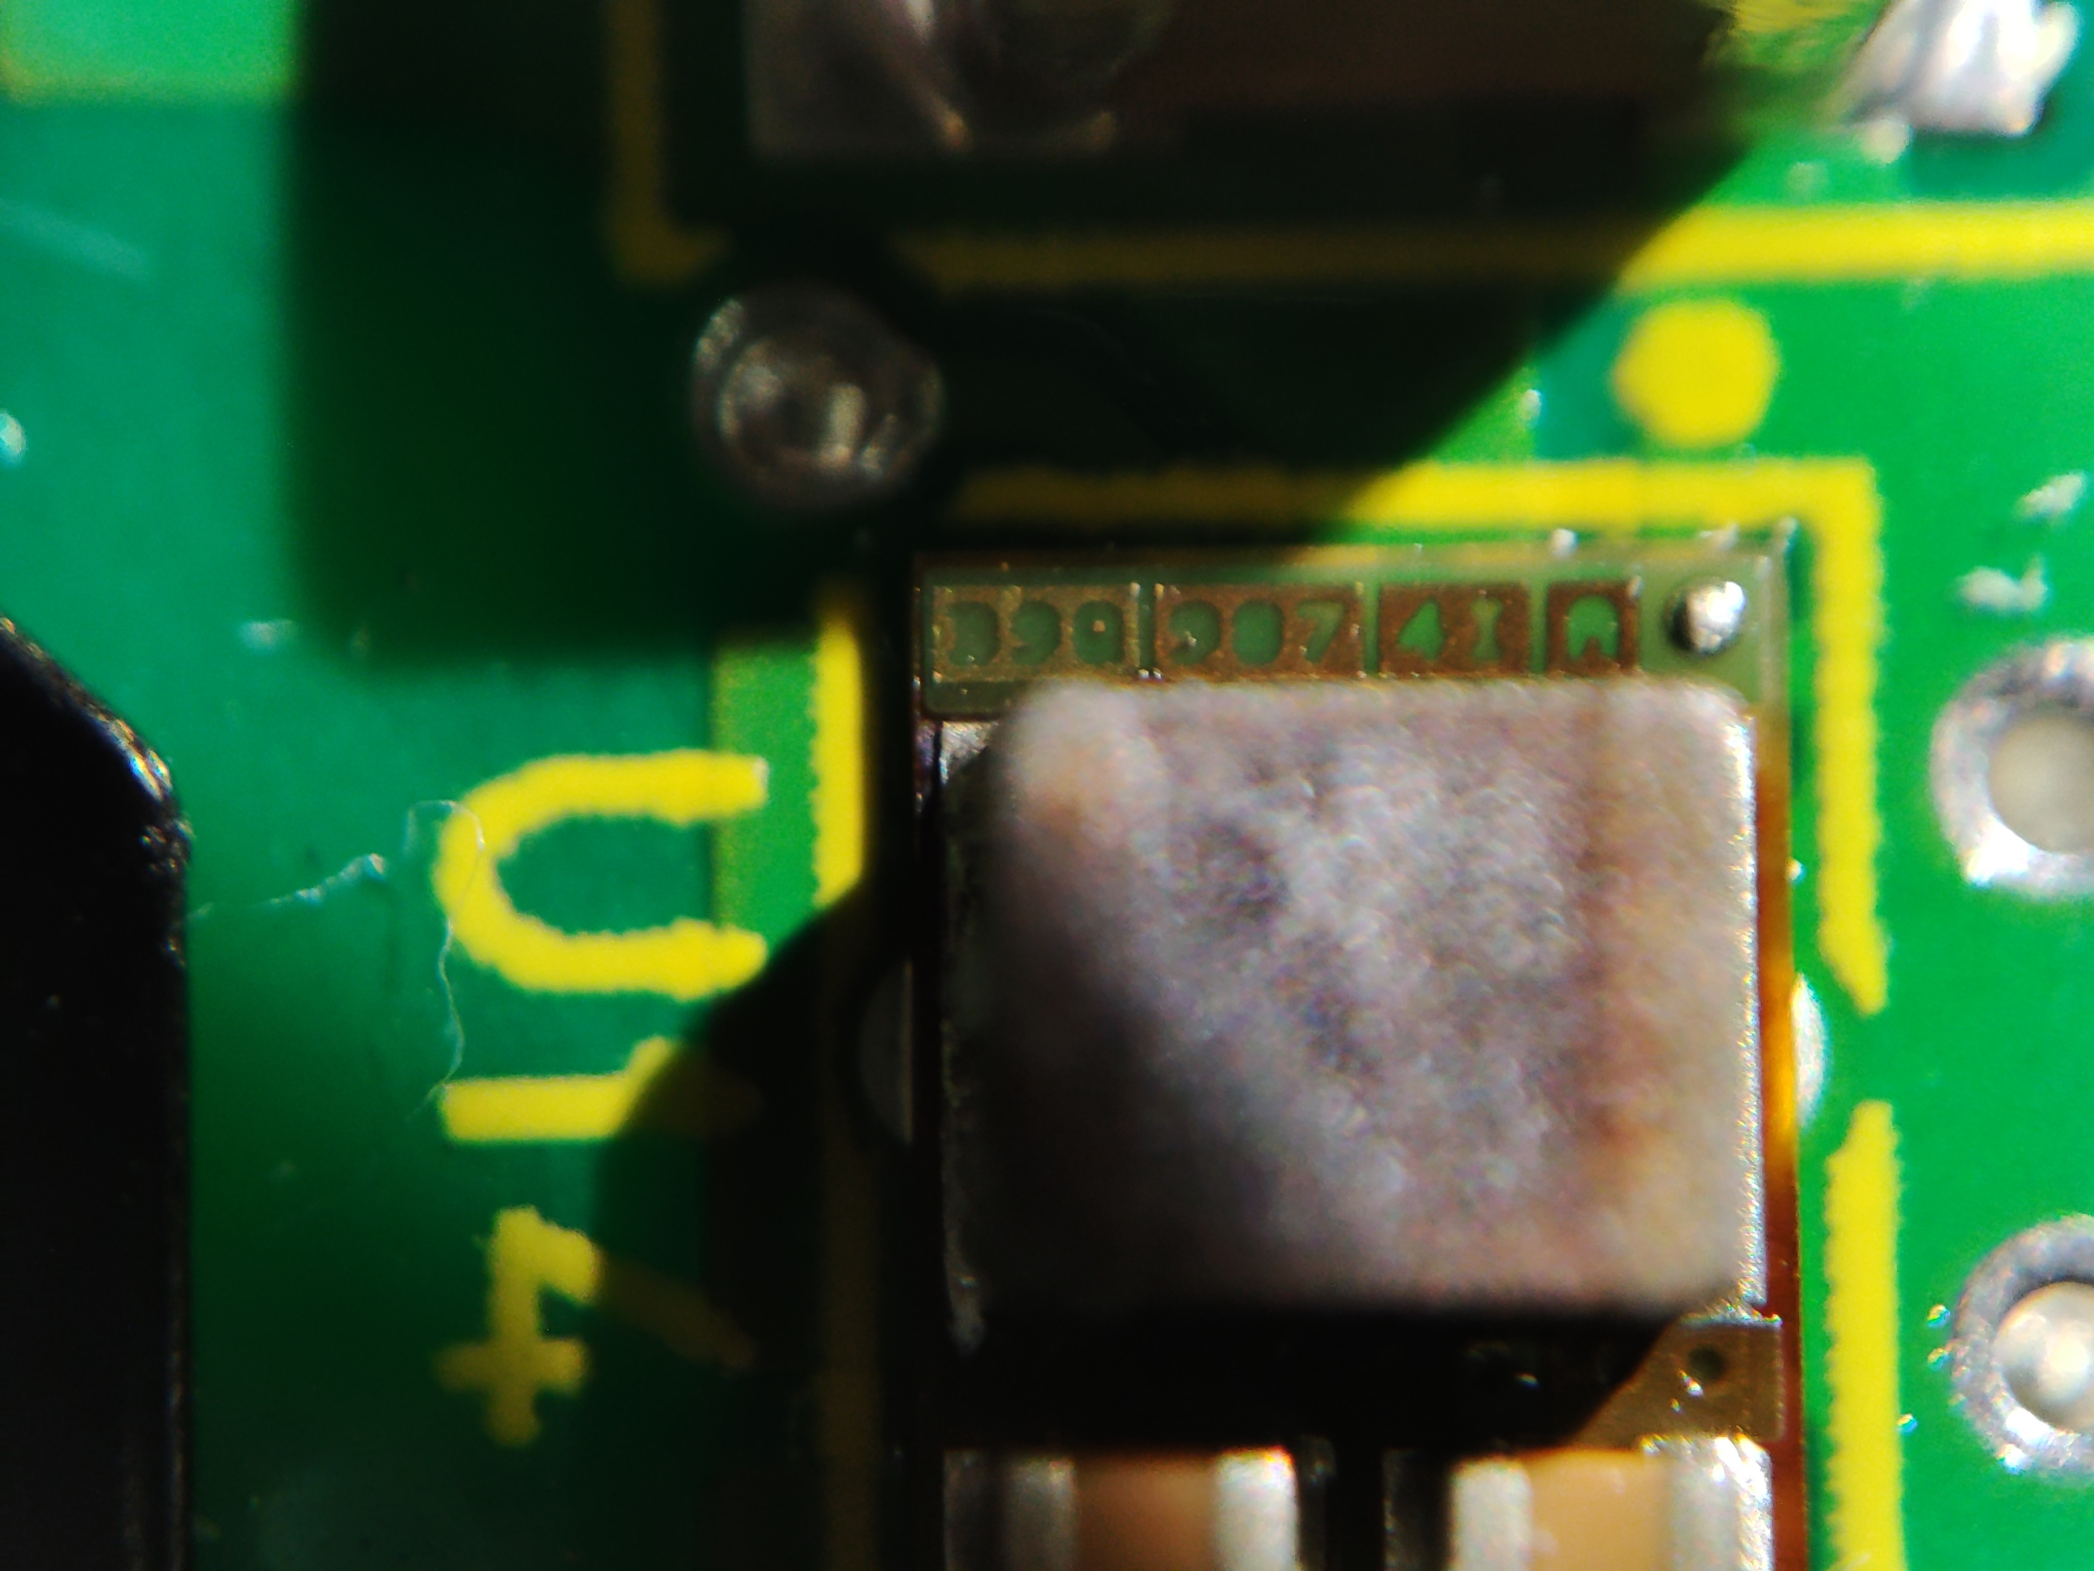
Photo Shot of 2 NG samples
Marking D9Q 987 4I A
Marking D9Q 987 4I A

