Slide 1
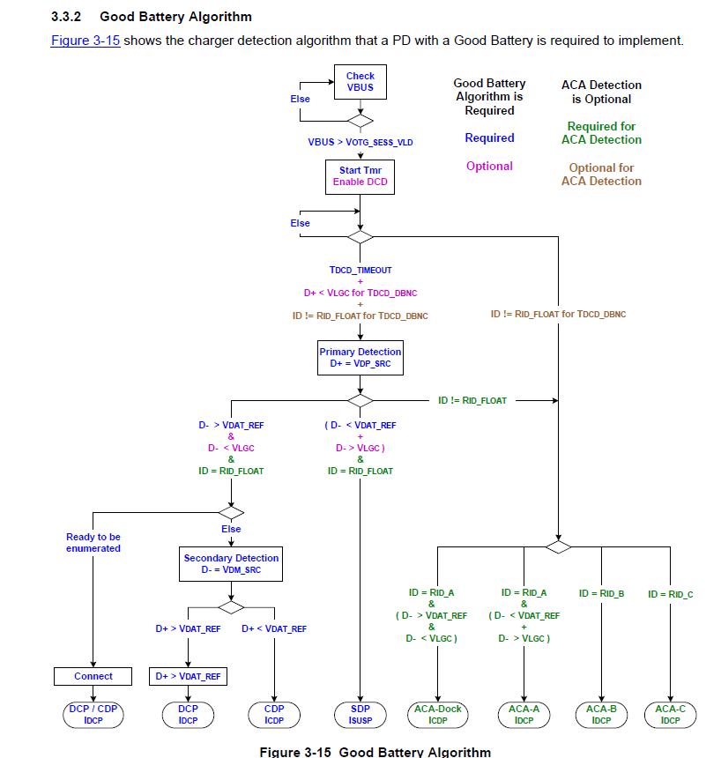
Refer to Battery Charging Specification Rev1.2
QUESTION:
How long time does BQ24160 spend in USB detect process?
(How long time does BQ24160 spend to detect DCP/CDP/SDP.)
I think this process is depend on Charger IC(BQ24160).
And if any error happen, I think the device will re-try the detect process. If it is correct, how many time does the device do?

