Slide 1
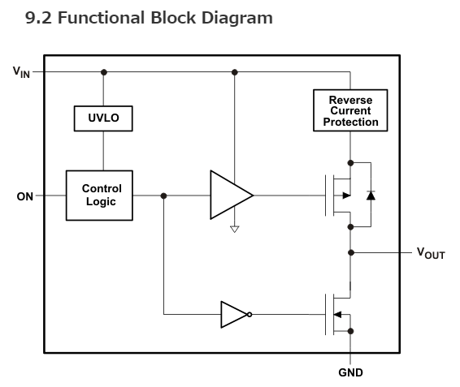
Question about TPS22929D
Lo
(0V)
Question
When the power is up, Vout is rising up faster than Vin.
In this condition,
Does it have any possibility of break?
Also does protection circuit work properly?
Does it have a possibility of flowing through Vin?
Lo
(0V)
Hi
(5V)

