Slide 1
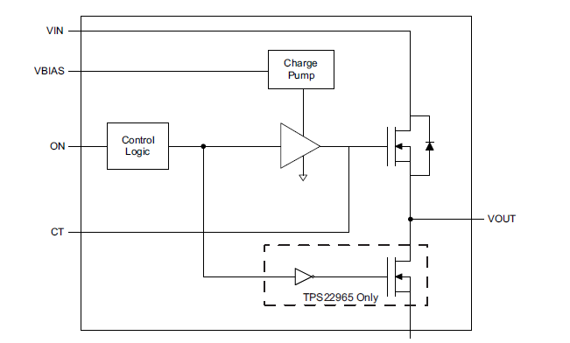
Question about TPS22965N
Reverse Current？
Vin
(0V)
Lo
(0V)
Vout
(3.3V)
Customer uses type of without output discharge circuit
(Question)
・Vin and EN are Low in TPS22965.
When charge remains on the output side, does it have possible flowing through current from the output side?

