Slide 1
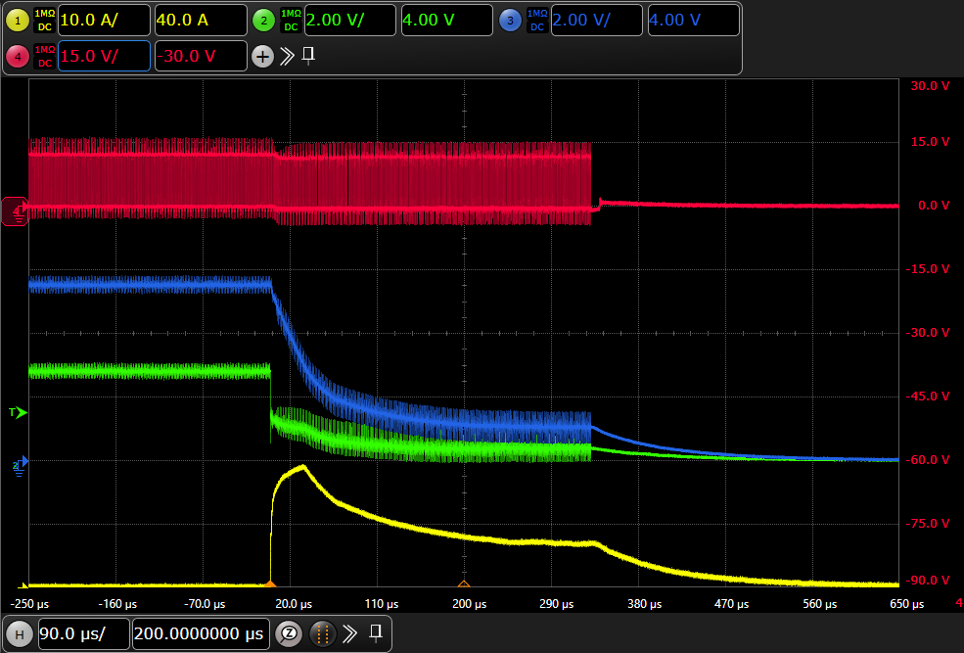









Why doesn’t $V_{DCDC}$ drop to 0V the moment a short circuit occurs?
From the moment the short circuit occur, the output voltage of DCDC gradually drops
And it take 330us to reach 0V. Why is that?
12V
TPS54429
$$V_{SW}$$
$$V_{DCDC}$$
L
$$V_{FB}$$
R:10kohm
5.5V
$$V_{SW}$$
R:1.6kohm
$$V_{DCDC}$$
2.8V
Drain
5.5V
FET
2.8V
$$V_{LDO}$$
Vout
$$V_{LDO}$$
330us
Gate
Source
2.8V
Short!!
GND
$$I_{load}$$
$$I_{load}$$
Discreate LDO
Discreate LDO is very simple circuit
It does not have short circuit protection
If short is occurred on load of LDO, DCDC’s OCP will work.

Slide 2
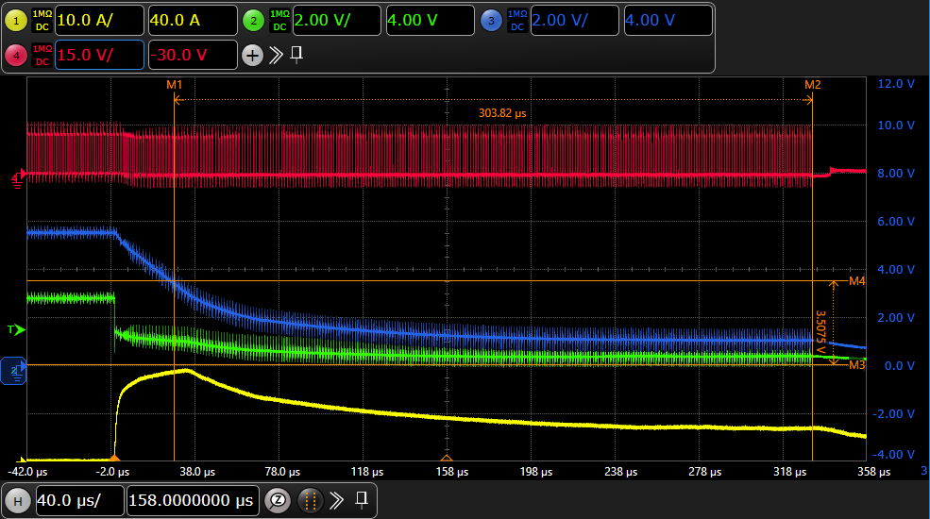





We guess the UVP circuit worked is that correct?
If short circuit occur until $V_{FB}$ becomes 65%, we guess UVP circuit begins working.
You can check the details about that bellow comment.
Page 8 : Over/Under Voltage Protection
Link: https://www.ti.com/jp/lit/gpn/tps54429
------
“When the feedback voltage becomes
lower than 65% of the target voltage,
the UVP comparator output goes high
and an internal UVP delay counter begins.
After 250 µs, the device latches off
both internal top and bottom MOSFET. ”
--------
$$V_{SW}$$
$$V_{DCDC}$$
UVP delay counter is working
$$V_{LDO}$$
65% $V_{FB}$
$$I_{load}$$

