Slide 1
robinW REF3112 issue
EE

Slide 2
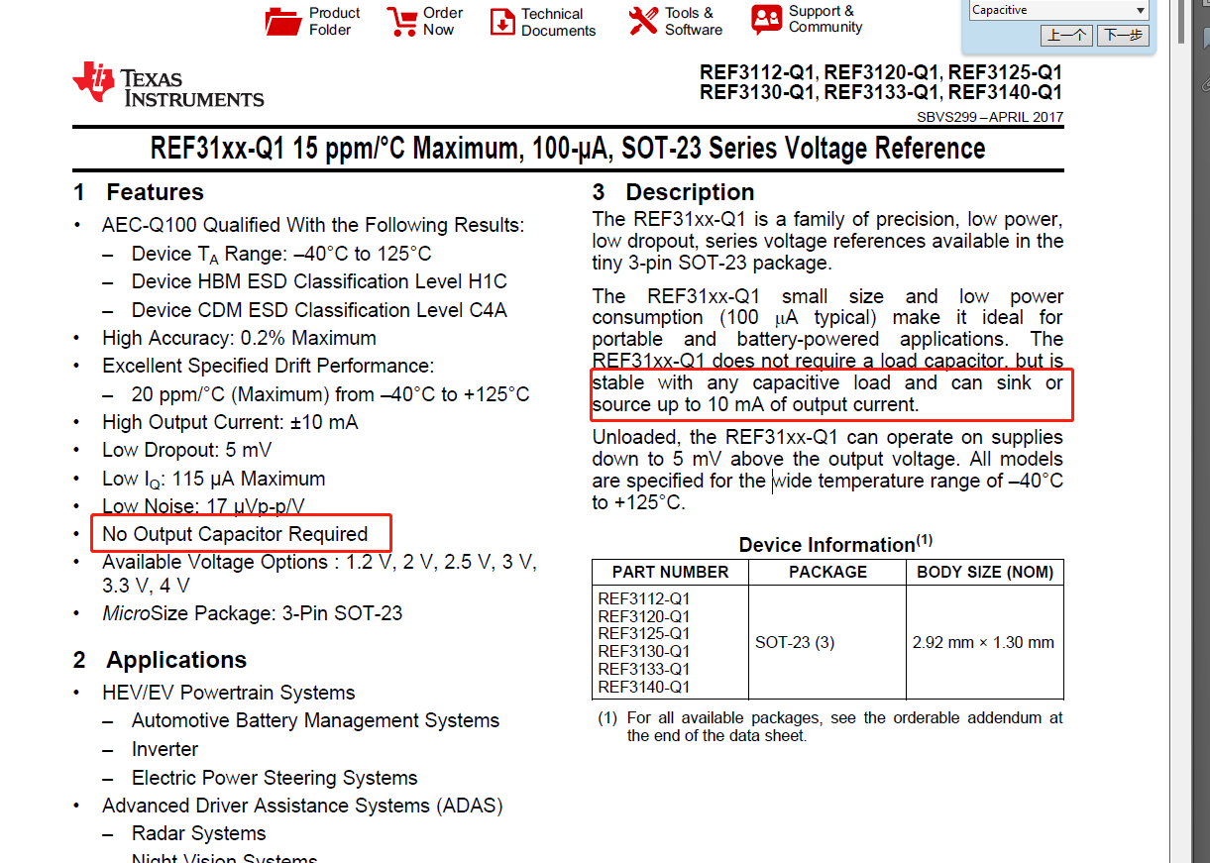
  Conclusion:
  The failed chip (NG) has insufficient load capacitance to drive 10uf capacitance and the output is oscillating, which is not as described in the data sheet.

Slide 3
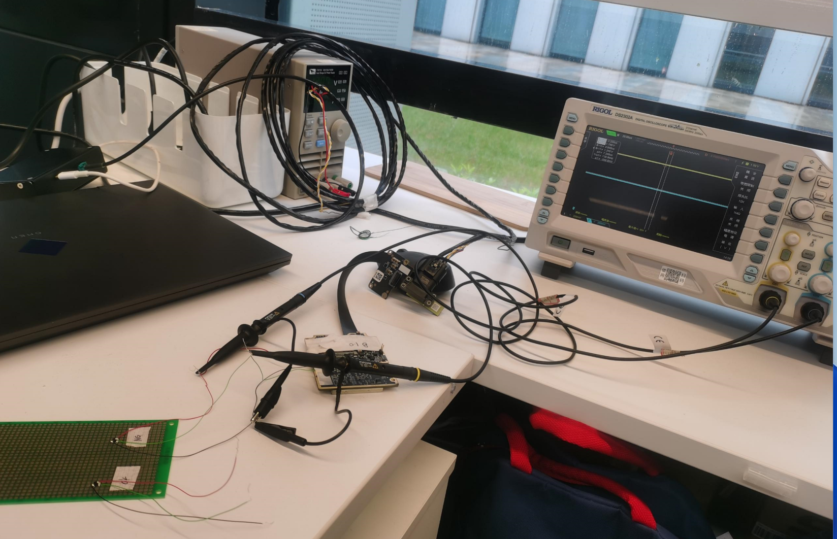
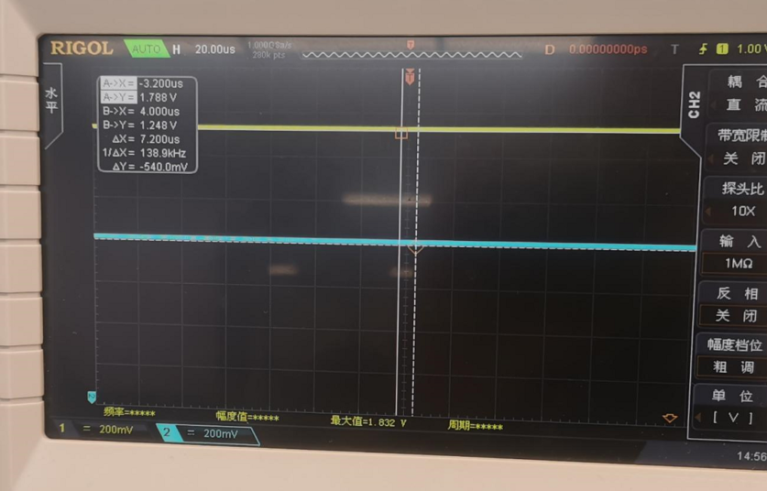
  1. The failed chip (NG) is soldered to the breadboard and is wired to the motherboard (REF3112 is not present on the motherboard) -- the waveform is normal

Slide 4
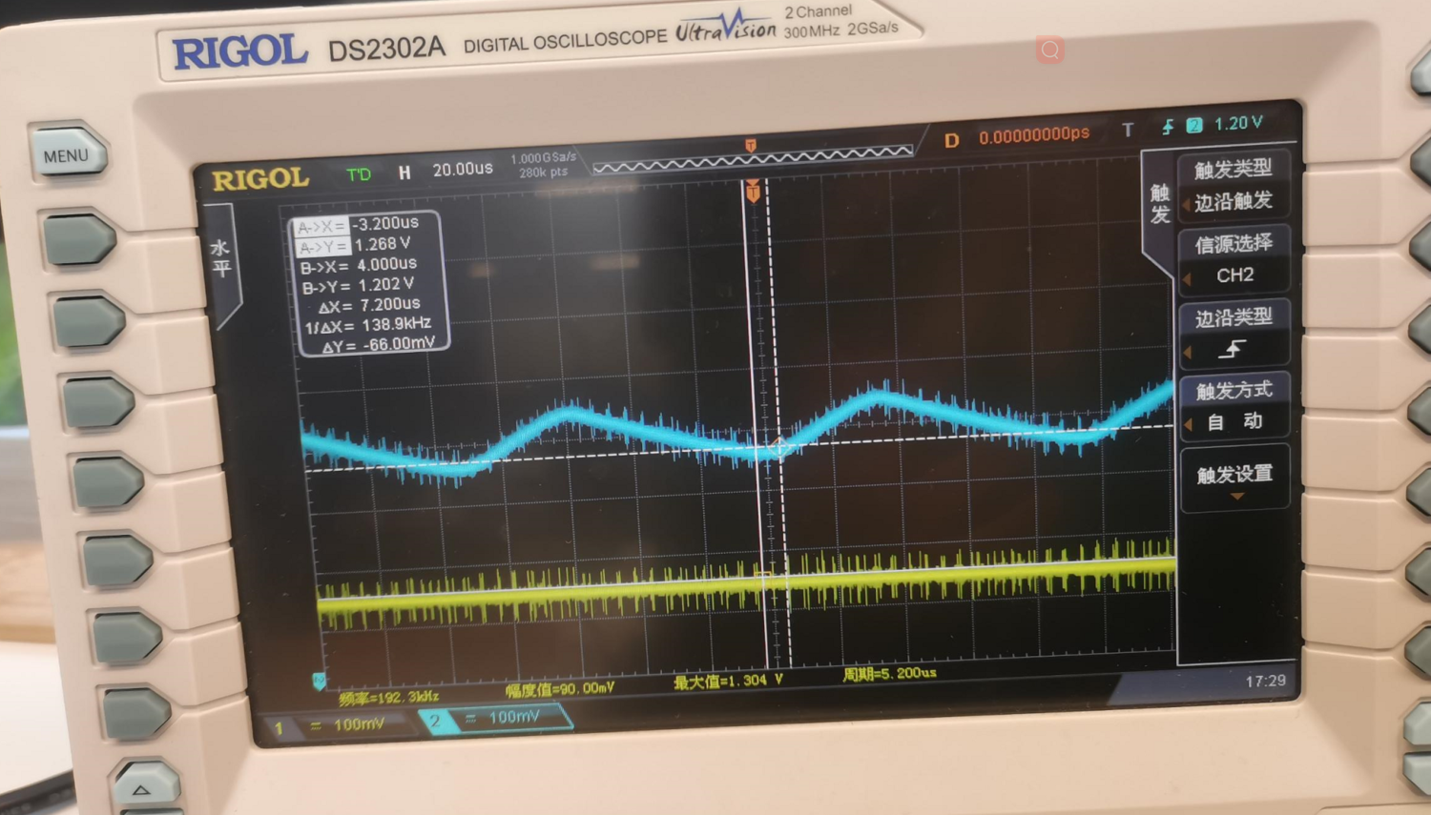
  2.Failed die (NG) Solder Board -- abnormal waveform, output ripple

Slide 5
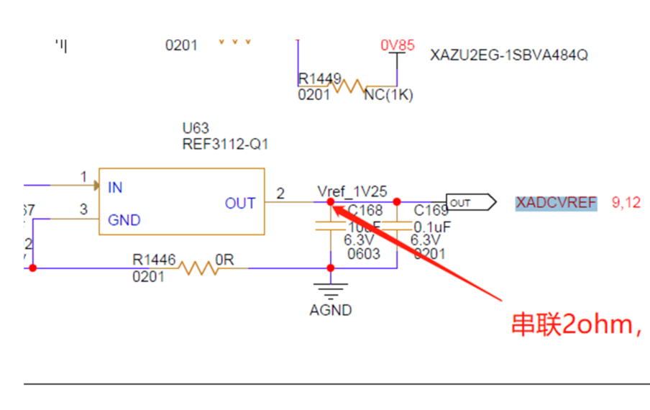
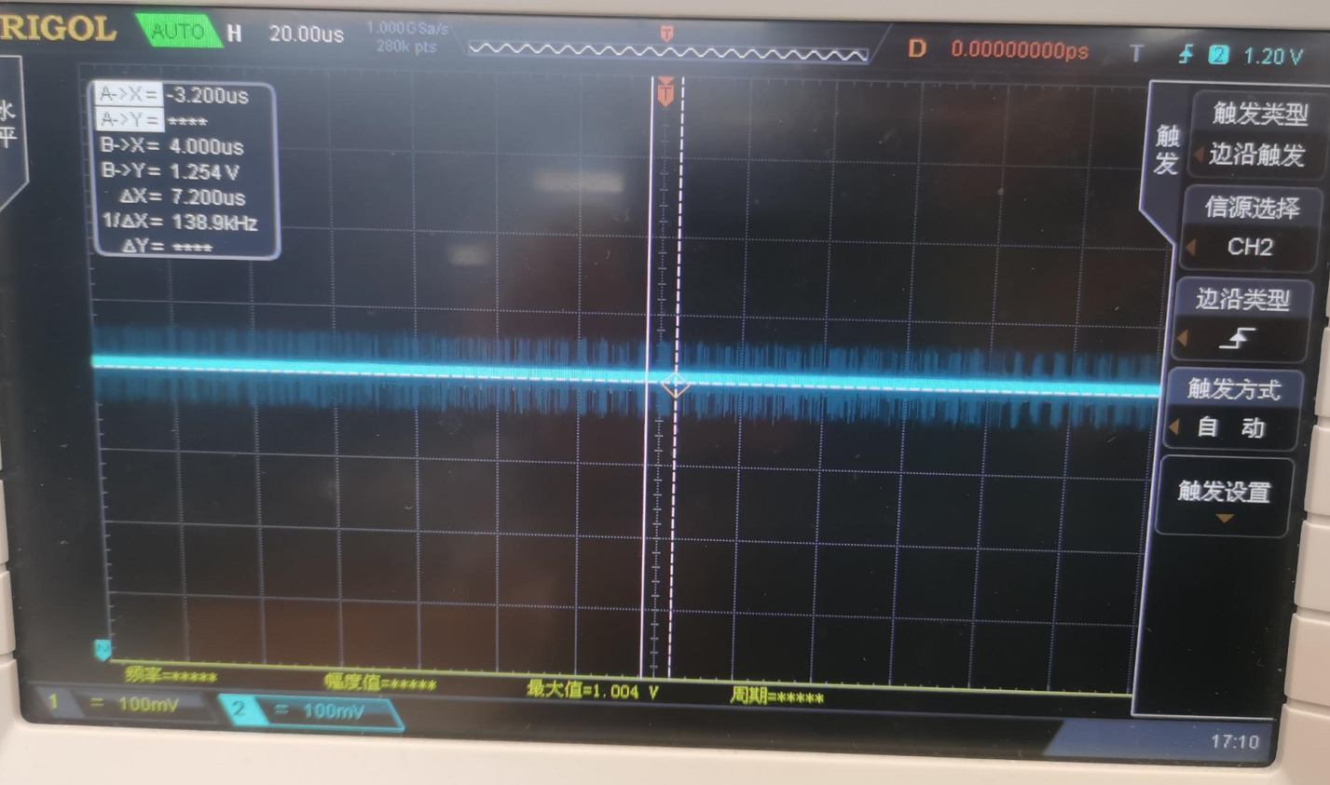
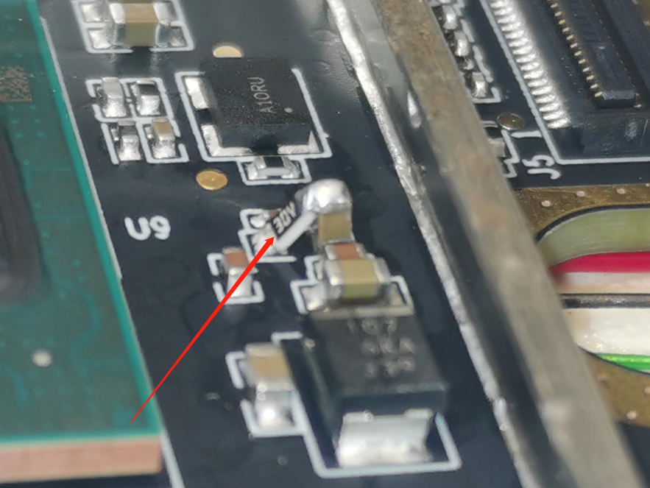
  3.Failed chip (NG) soldered to main board, output capacitor series 2ohm resistor -- waveform is normal.

Slide 6
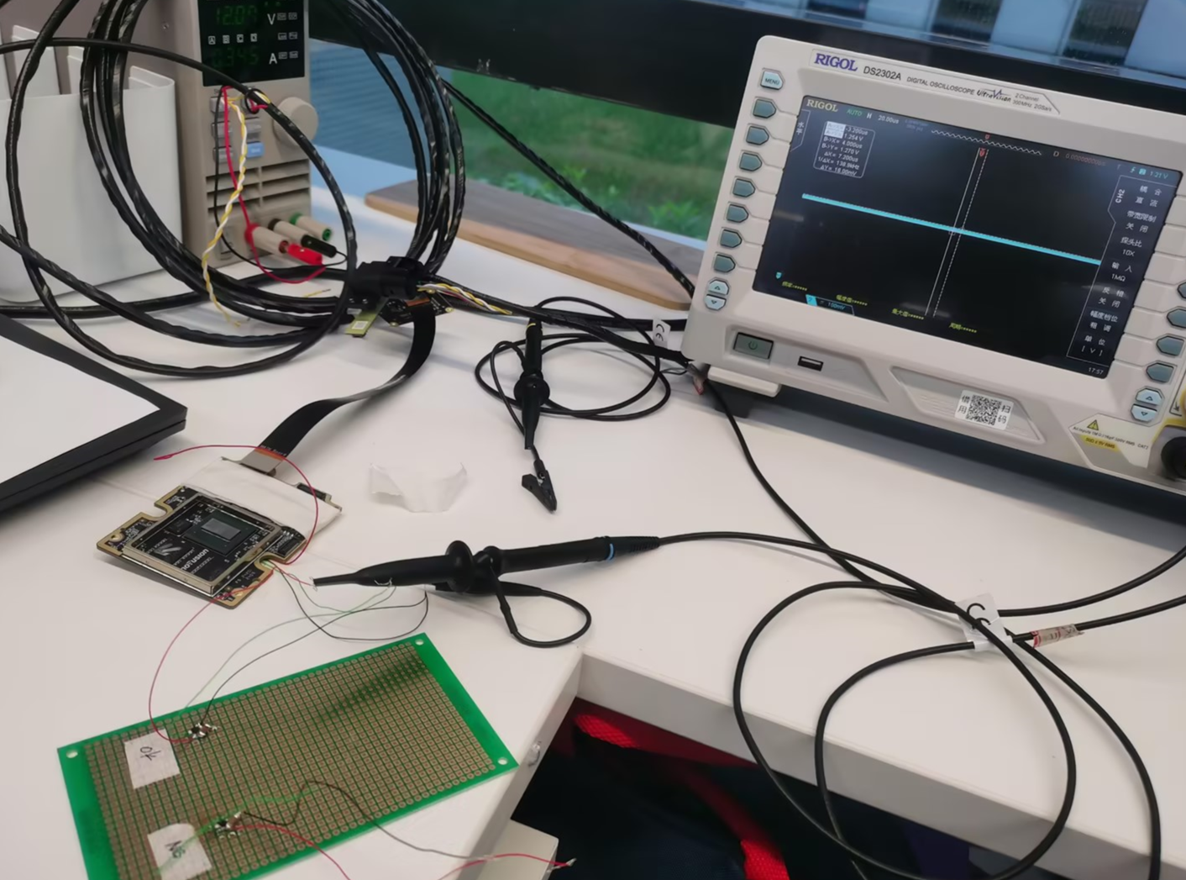
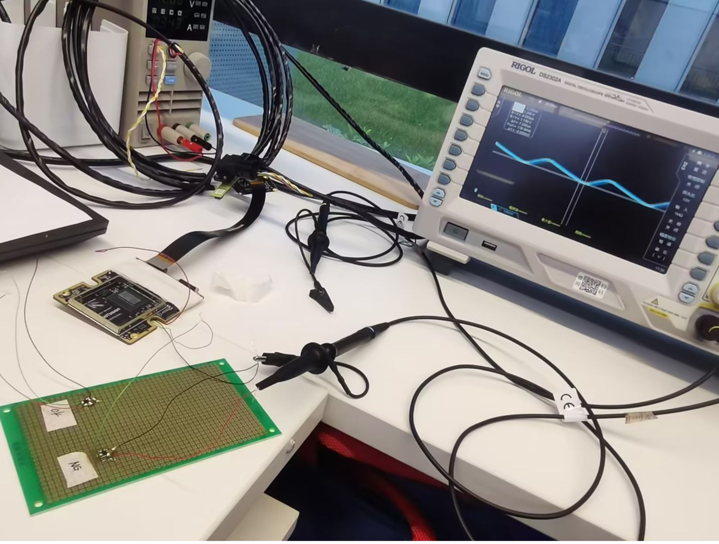
  4. The fail chip (NG) and OK chip drive the 10uf capacitor on the bread board simultaneously
OK part, drive 10uf capacitor is normal
NG device, drives 10uf capacitor, output ripple

