Slide 1
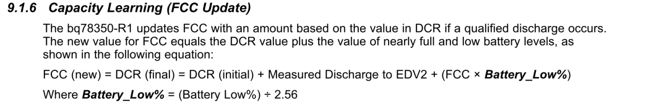
Initial setting
Learned Full Charge Capacity = 730mAh (7.3Ah)
Read current gain : 10A = 1000mA
Dod at EDV2 = 15936
Battery Low % (setting) = 7%
Battery Low % = 7% / 2.56 = 0.0273
Dod at EDV2 = (1-0.0273) * 16384 = 15936

Slide 2
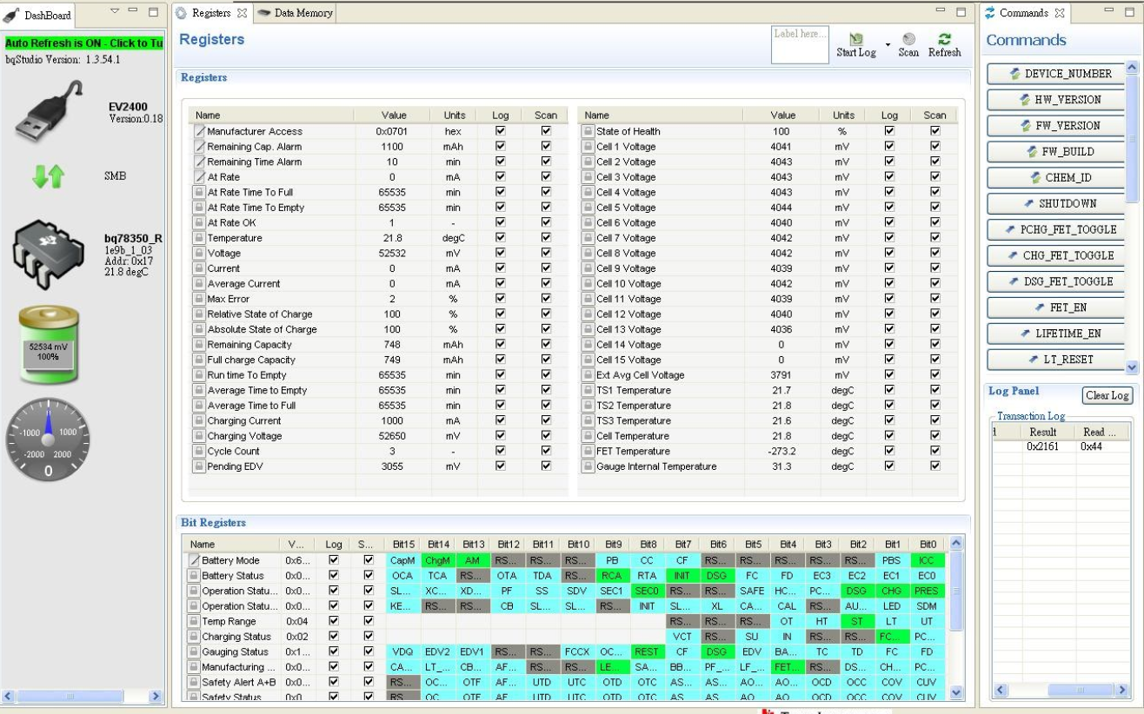
After learning the capacity is updated to 749mAh

Slide 3
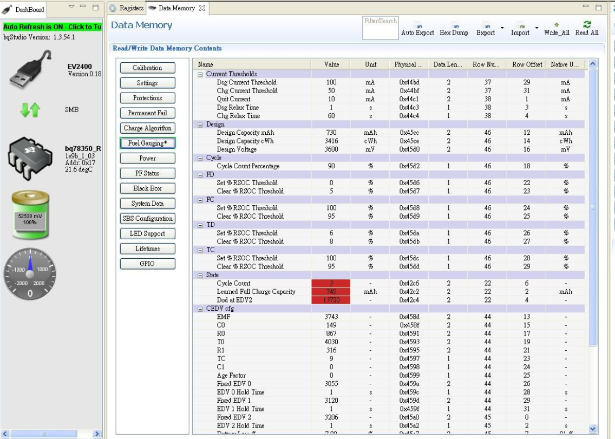
Dod at EDV2 in memory was updated from 15936 to 13720
and Learned Full Charge Capacity updated from 730 to 749mAh

Slide 4
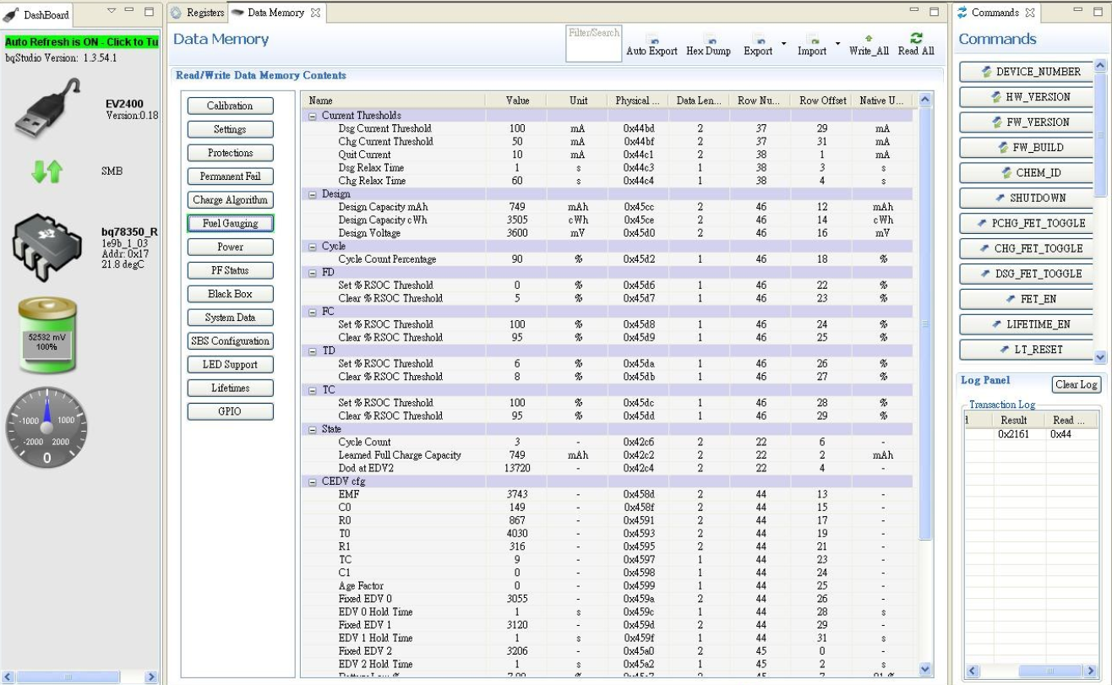
Will learn to complete the parameters, Re-enter the
parameters to the "Dod at EDV2" and "Learned Full Charge Capacity"
field and write to memory.
Re-check current Chemistry ID = 0x2161
(SONY US18650VTC5A)

Slide 5

BQ78350 shutdown and start again.
Issue : I can not get the RSOC and ASOC parameter readings of the previous shutdown again

