Slide 1
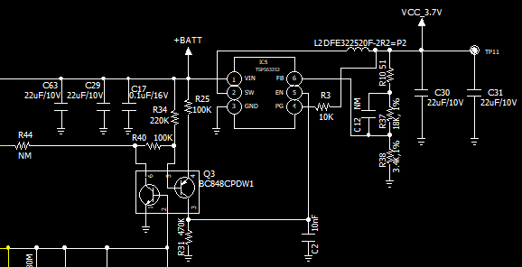
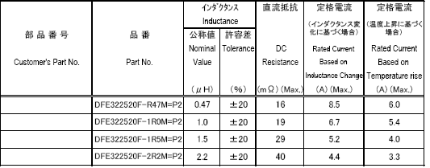
Review of TPS563252 Circuit
Please review below TPS563252 circuit if there is any problem or mis design item.
Please check if the inductor value, 2.2uH is ok or recommend the other appropriate inductor .
- Input voltage : 4.0V~6.5V ( battery voltage input )
- Output voltage and current : 3.7V, 3A (max)
< Inductor spec >
2.2uH
3.7V/3A output
4.0~6.5V Input
R10 : 0 ohm or 51 ohm

