Slide 1
Rigel_PDB_Sequencer (UCD90160A)_Function_Caption_V1_20240130
ZT HW: Paul Lei
PDB Sequencer FW File version
Rigel_PDB_UCD90160A_DVT_Test_Version_20240129
(caption example, but intact setup need to open FW in GUI)

Slide 2
UCD90160A-Sequencer: Power on Function for all main power rail
SW0 sled PRSNT
SW1 sled PRSNT
GPU baseboard PRSNT
Start PWR on SEQ
AND Gate
UCD90160A
Sense P12V_FAN0
EN
P12V_FAN0
P12V_FAN1
P3V3_STBY_PGD
Chassis_Intrusion_N
1.Sense P12V_SW1
2.Detect PVRM123 insertion
3.Sense MOD123_EN
Sense P12V_FAN1
Sense P12V_SW0
P12V_SW0
P12V_SW1
P12V_GPU0
1.P12V_GPU0 convert ok
2.Get PVRM1/2/3 EN
1.P12V_FAN0 OK
2.P12V_FAN1 OK 3.P12V_SW0 OK
4.P12V_SW1 OK
5.P12V_GPU0 OK
6.P12V_GPU1 OK
7.ALL_PVRM_P50V_PGD
8.ALL_CAP SW_PGD
P50V_1
1.Sense P12V_GPU0
2.Detect PVRM4/5/6 insertion
3.Sense MOD456_EN
1.P12V_GPU1 convert ok
2.Get PVRM4/5/6 EN
P12V_GPU1
P50V_2
PDB_PGD

Slide 3
UCD90160A-Sequencer: Power off Function for all main power rail
SW0 sled PRSNT
SW1 sled PRSNT
GPU baseboard PRSNT
P50V_1
P50V_2
Start PWR off SEQ
AND Gate
UCD90160A
P12V_GPU0
P12V_GPU1
P3V3_STBY_PGD
EN
Chassis_Intrusion_N
P12V_SW0
P12V_SW1
P12V_FAN0
P12V_FAN1

Slide 4
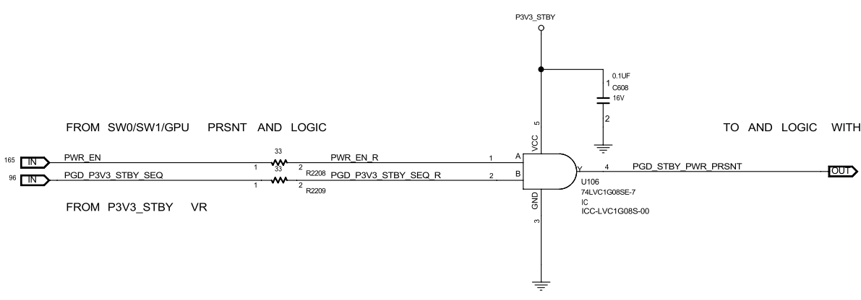
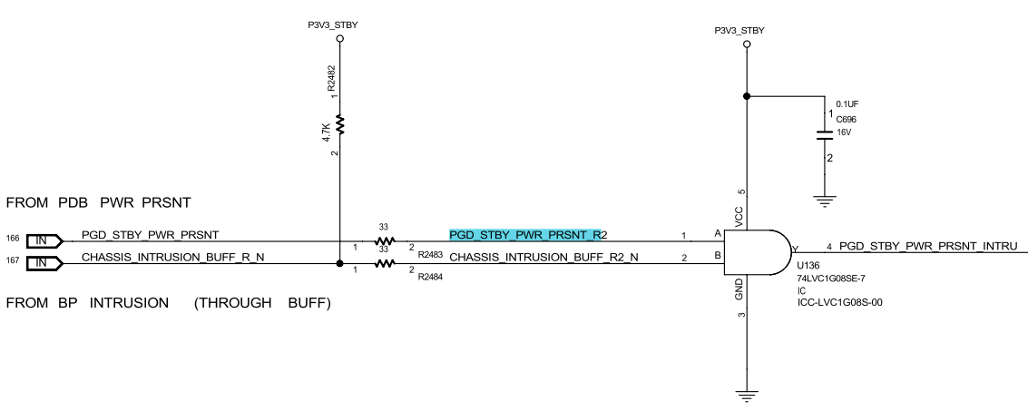
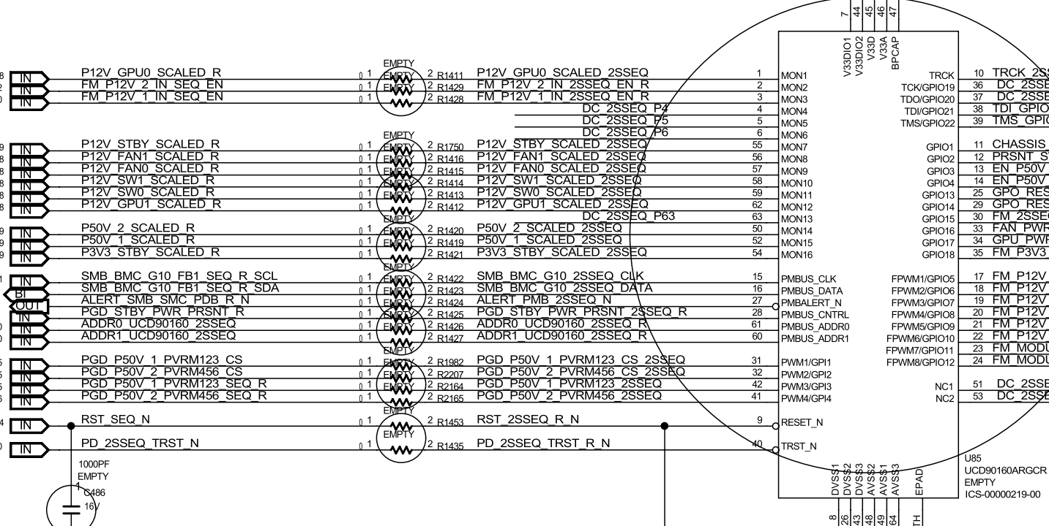
UCD90160A-Sequencer: Main power structure (first stage to start sequence)
1
SW0 sled/SW1 sled/GPU present signal after through AND gate
P3V3_STBY_PGD from P3V3 VR
Sequencer
2
3
Chassis_Intrusion_N
I2C ADDRESS: 0X68h (8BITS)
Note: AND logic output with chassis_intrusion_N is the first stage to enable or disable (PMBUS_CNTRL) sequencer to do following power sequence

Slide 5
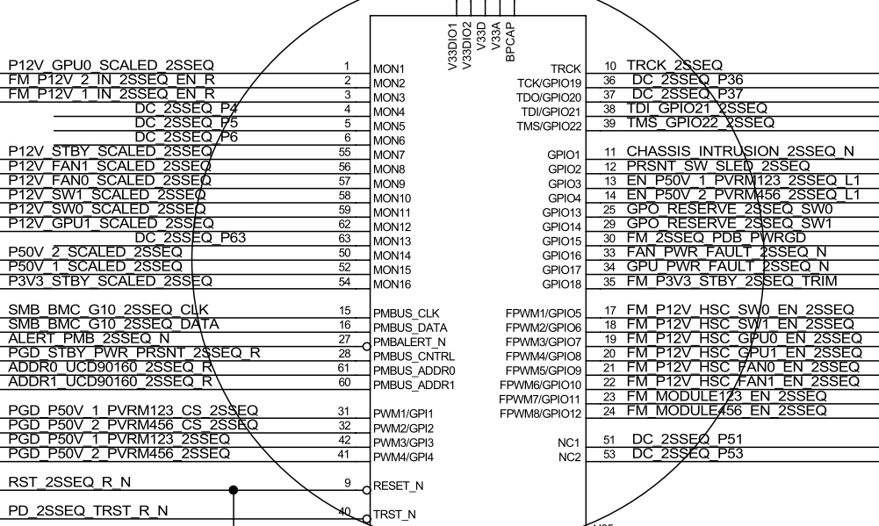
UCD90160A-Sequencer: Main power structure (P12V power on sequence)
(1) Detect Sequencer Enable signal (PMBUS_CNTRL) to start power on P12V_FAN0 (GPIO9) with 200ms delay
(4-1) Detect P12V_SW1 (MON10) to turn on PVRM1/2/3 EN (GPIO11) with 100ms delay
(5-1) Detect P12V_GPU0 (MON1) to turn on PVRM4/5/6 EN (GPIO12) with 100ms delay
(2) Detect P12V_FAN0 (MON9) to turn on P12V_FAN1 (GPIO10) with 10ms delay
(5) Detect P12V_SW1 (MON10) and Detect PVRM1/2/3 EN (MON3) to turn on P12V_GPU0 (GPIO7) with 10ms delay
(3) Detect P12V_FAN1 (MON8) to turn on P12V_SW0 (GPIO5) with 10ms delay
(6) Detect P12V_GPU0 (MON1) and Detect PVRM4/5/6 EN (MON2) to turn on P12V_GPU1 (GPIO8) with 10ms delay
1
(4) Detect P12V_SW0 (MON11) to turn on P12V_SW1 (GPIO6) with 10ms delay
Note: (criteria: Power on sequencing by voltage monitor of each level) (1)→(2)→(3)→(4)→(5)→(6)

Slide 6
UCD90160A-Sequencer: Main power structure (P12V power off sequence)
(1) Detect Sequencer Disable signal (PMBUS_CNTRL) to start power off P12V_GPU0 (GPIO7) with 5ms delay
(Other-1) Detect Sequencer Disable signal (PMBUS_CNTRL) to start power off PVRM1/2/3 EN (GPIO11) with 5ms delay
(2) Detect P12V_GPU0 (MON1) to turn off P12V_GPU1 (GPIO8) with 5ms delay
(Other-2) Detect PVRM1/2/3 EN (MON3) to turn off PVRM4/5/6 EN (GPIO12) with 5ms delay
(5) Detect P12V_SW1 (MON10) to turn off P12V_FAN0 (GPIO7) with 5ms delay
(3) Detect P12V_GPU1 (MON12) to turn off P12V_SW0 (GPIO5) with 5ms delay
(6) Detect P12V_FAN0 (MON9) to turn off P12V_FAN1 (GPIO10) with 5ms delay
(4) Detect P12V_SW0 (MON11) to turn off P12V_SW1 (GPIO6) with 5ms delay
1
Note: (criteria: Power off sequencing by voltage monitor of each level) (1)→(2)→(3)→(4)→(5)→(6)

Slide 7
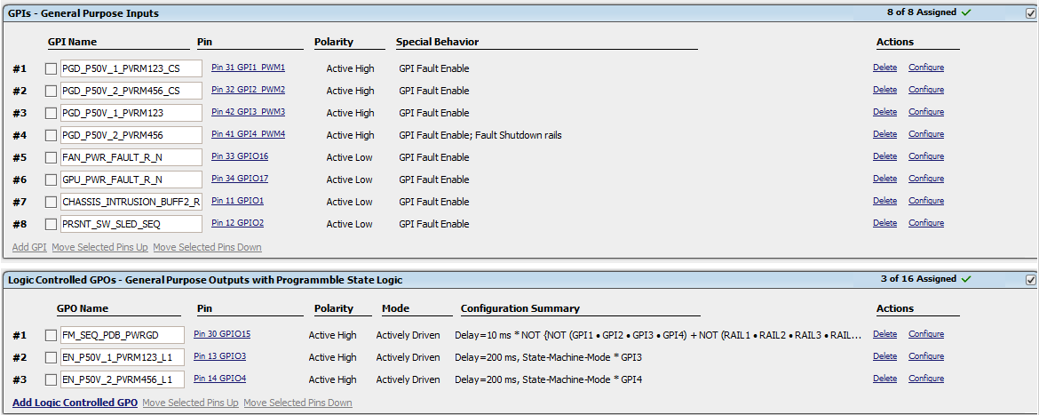
UCD90160A-Sequencer: Main power structure (GPIs and Logic Controlled GPOs)
GPIs:
Tie with “Fault Shutdown rails” function to #1~#4, polarity is active high
#1: PGD_P50V_1_PVRM123_CS (Pin31, GPI1_PWM1)
If it has fault → Turn off rail5 / rail6 / rail7 / rail8 / rail9 / rail10
#2: PGD_P50V_2_PVRM456_CS (Pin32, GPI2_PWM2)
If it has fault → Turn off rail5 / rail6 / rail7 / rail8 / rail9 / rail10
#3: PGD_P50V_1_PVRM123 (Pin42, GPI3_PWM3)
If it has fault → Turn off rail5 / rail6 / rail7 / rail8 / rail9 / rail10
#4: PGD_P50V_2_PVRM456 (Pin41, GPI4_PWM4)
If it has fault → Turn off rail5 / rail6 / rail7 / rail8 / rail9 / rail10
Tie with “Fault pin” function to #5~#8, polarity is active low
#5: FAN_PWR_FAULT_R_N (Pin33, GPI)16)
If rail3 has fault → Turn off rail3 / rail5 / rail6 / rail7 / rail8 / rail9 / rail10
#6: GPU_PWR_FAULT_R_N (Pin34, GPO17)
If rail4 has fault → Turn off rail4 / rail5 / rail6 / rail7 / rail8 / rail9 / rail10
#7: CHASSIS_INTRUSION_BUFF2_R_N (Pin11, GPIO1)
If rail1 or rail2 have fault → rail1 / rail2 / rail3 / rail4 / rail5 / rail6 / rail7 / rail8 / rail9 / rail10
#8: PRSNT_SW_SLED_SEQ (Pin12, GPIO2)
If rail5 or rail6 or rail7 or rail8 or rail9 or rail10 have fault → Turn off rail5 / rail6 / rail7 / rail8 / rail9 / rail10
Logic Controlled GPOs:
Polarity is active high
#1: FM_SEQ_PDB_PWRGD (Pin30, GPIO15)
Tie with GPIs and PWR_GD with 10ms delay when assertion:
PGD_P50V_1_PVRM123_CS (Pin31, GPI1_PWM1)
PGD_P50V_2_PVRM456_CS (Pin32, GPI2_PWM2)
PGD_P50V_1_PVRM123 (Pin42, GPI3_PWM3)
PGD_P50V_2_PVRM456 (Pin41, GPI4_PWM4)
RAIL#1~RAIL#10
#2: EN_P50V_1_PVRM123_L1 (Pin13, GPIO3)
Tie with GPI with 200ms delay when assertion:
PGD_P50V_1_PVRM123 (Pin42, GPI3_PWM3)
#3: EN_P50V_2_PVRM456_L1 (Pin14, GPIO4)
Tie with GPI with 200ms delay when assertion:
PGD_P50V_2_PVRM456 (Pin41, GPI4_PWM4)

Slide 8
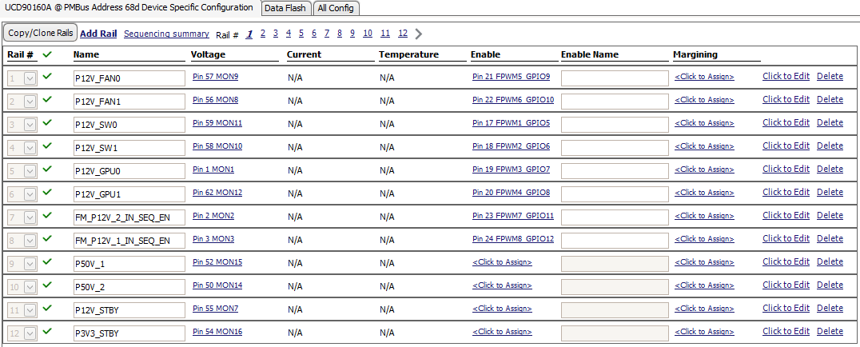
UCD90160A-Sequencer: Fault responses (Rails fault dependencies)
(1) P12V_FAN0 (MON9, rail1): If encountered OV/UV events
→ Turn off rail2 / rail3 / rail4 / rail5 / rail6 / rail7 / rail8 / rail9 / rail10
(6) P12V_GPU1 (MON12, rail6): If encountered OV/UV events
→ Turn off rail5 / rail7 / rail8 / rail9 / rail10
(2) P12V_FAN1 (MON8, rail2): If encountered OV/UV events
→ Turn off rail1 / rail3 / rail4 / rail5 / rail6 / rail7 / rail8 / rail9 / rail10
(7) FM_P12V_2_IN_SEQ_EN (MON2, rail7): If encountered OV/UV events
→ Turn off rail5 / rail6 / rail8 / rail9 / rail10
(3) P12V_SW0 (MON11, rail3): If encountered OV/UV events
→ Turn off rail5 / rail6 / rail7 / rail8 / rail9 / rail10
(8) FM_P12V_1_IN_SEQ_EN (MON3, rail8): If encountered OV/UV events
→ Turn off rail5 / rail6 / rail7 / rail9 / rail10
(4) P12V_SW1 (MON10, rail4): If encountered OV/UV events
→ Turn off rail5 / rail6 / rail7 / rail8 / rail9 / rail10
(9) P50V_1 (MON15, rail9): If encountered OV/UV events
→ Turn off rail5 / rail6 / rail7 / rail8 / rail10
(5) P12V_GPU0 (MON1, rail5): If encountered OV/UV events
→ Turn off rail6 / rail7 / rail8 / rail9 / rail10
(10) P50V_2 (MON14, rail10): If encountered OV/UV events
→ Turn off rail5 / rail6 / rail7 / rail8 / rail9

Slide 9
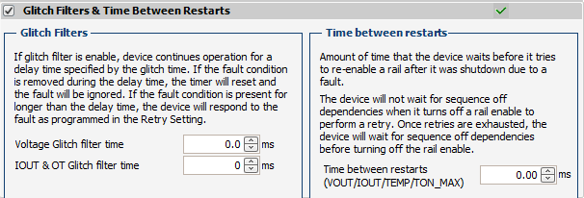
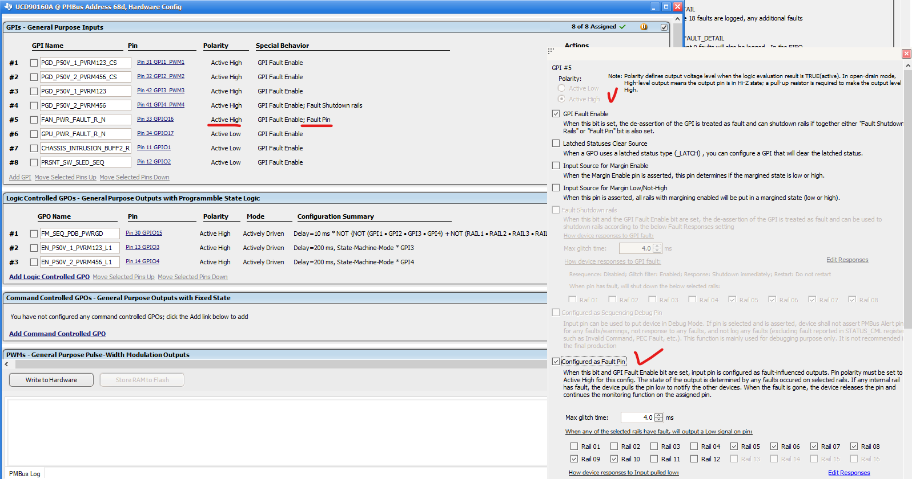
UCD90160A-Sequencer: Function check (Q&A for setup SEQ FW configuration)
Question1: Why does “glitch filters” cannot be set with > 0ms (like 4ms) after function enable ?
Question2: Why does function of “fault shutdown rails” cannot be set in more than one GPI pin (like#1~#4) ?
Question3: Why does function of “fault pin” cannot be set in more than one GPI pin (like#5~#8) and change polarity to active low ?

Slide 10
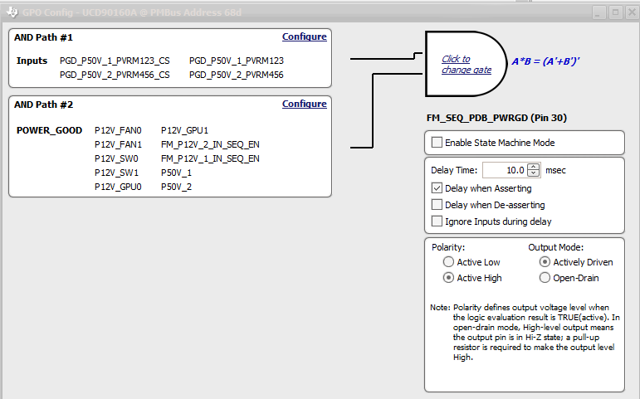
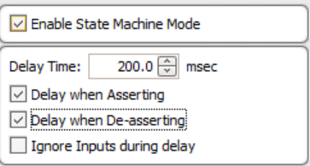
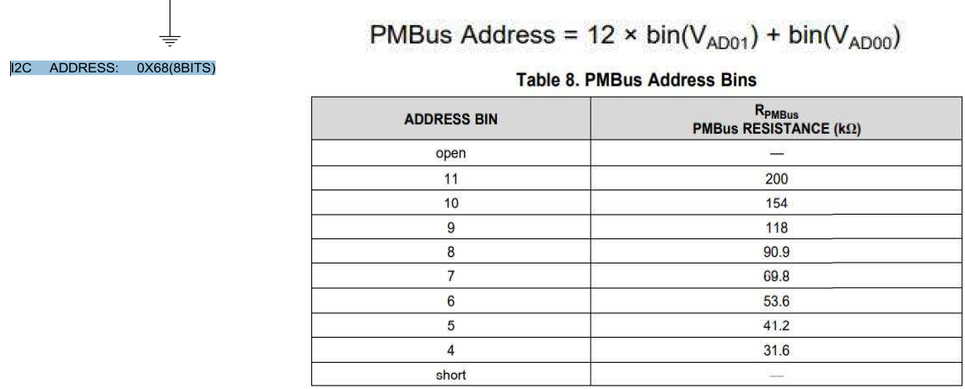
UCD90160A-Sequencer: Function check (Q&A for setup SEQ FW configuration)
Question4: Can we divide “delay time“ of asserting and de-asserting with different setup value in GPO configuration ?
Question5: Can we read “checksum” in offline mode without powering up UCD90160A and connecting with dongle ?
Question6: How can we generate FW file with “hex format” if we need it to apply for online update with SMBus interface ?
Question7: How can we revise “I2C/PMBus address” in UCD90160A GUI to match with my HW design ?

Slide 11
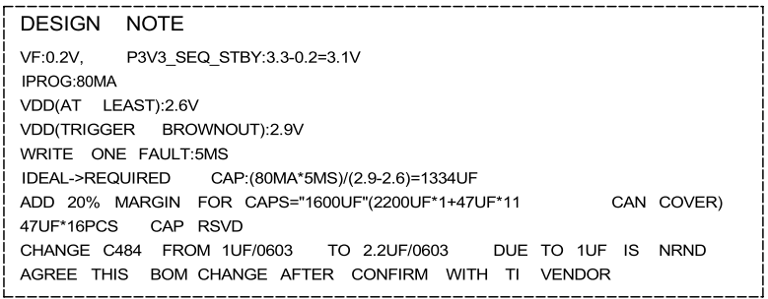
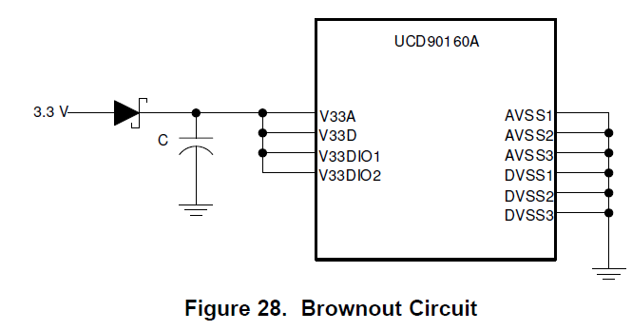
SEQ Brown-out Circuit Function Check with final DVT HW design
Capacitor Value for Keep-alive (MAX34463 data ref.) | Condition | Fault log when loss DVDD
484uF | Original | Data Invalid
2200uF | Test1 | Data Valid
2706uF (DVT HW Design) | Test2 | Data Valid

Slide 12
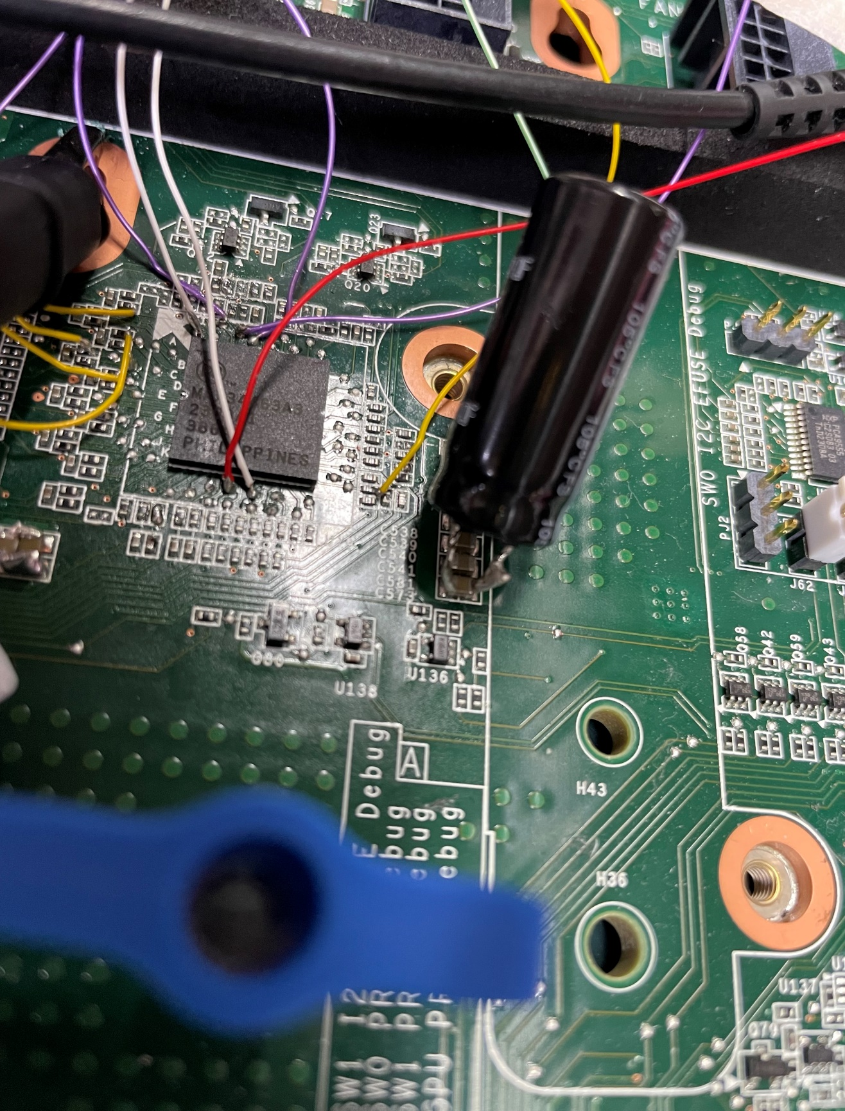
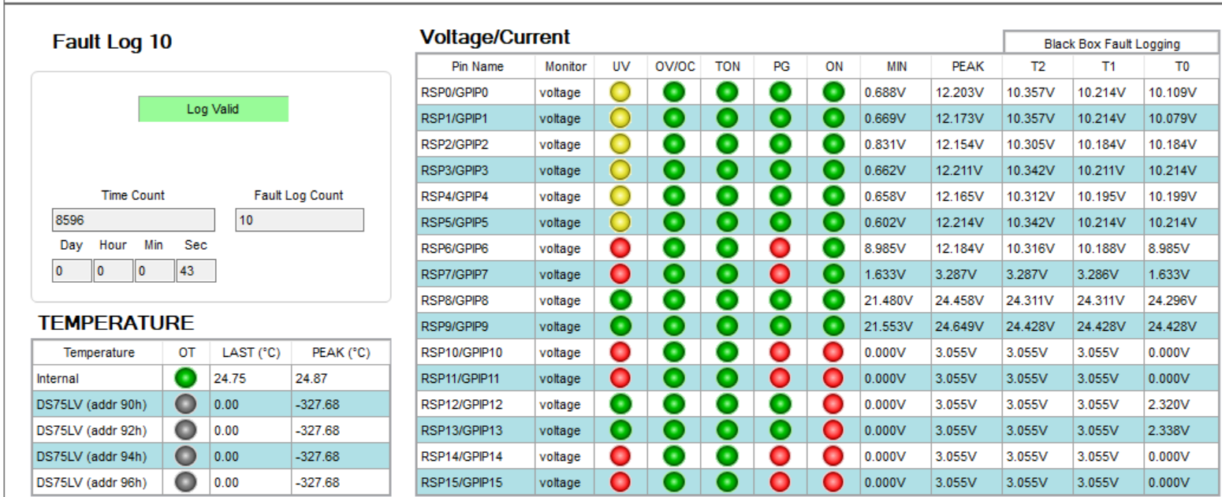
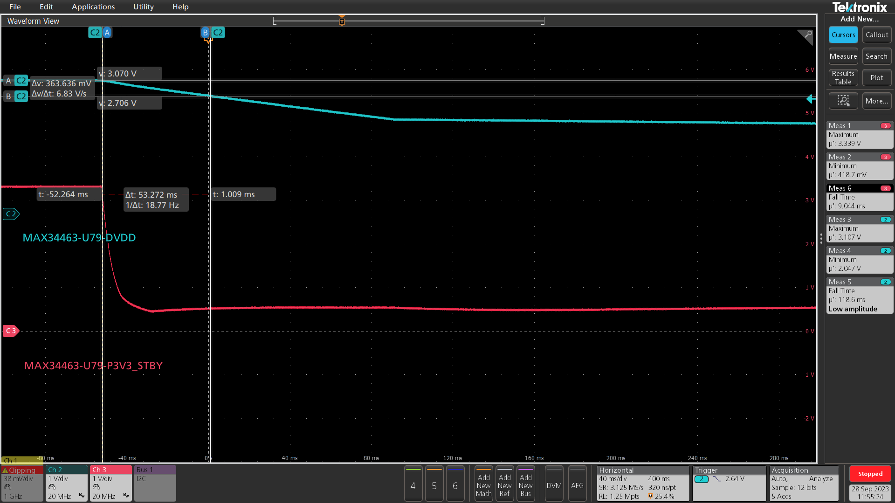
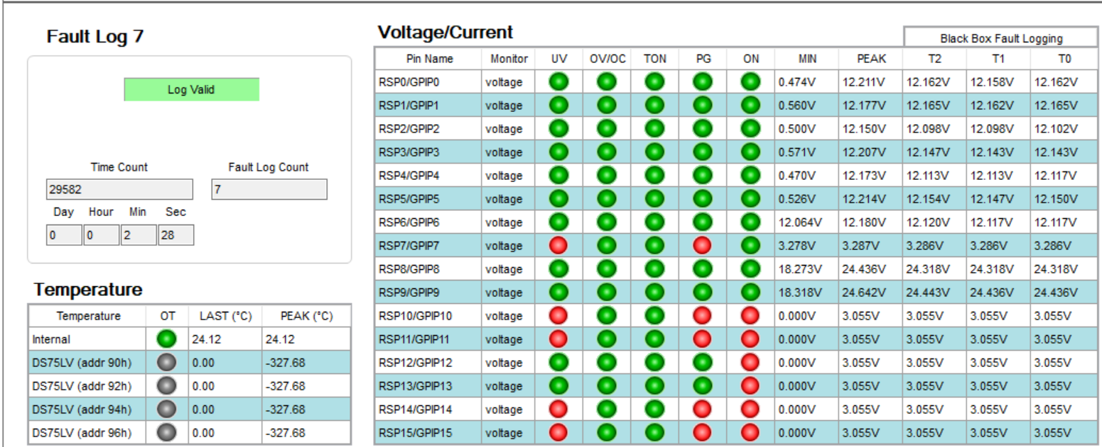
SEQ Keep-Alive Circuit Function Check with different capacitance (Timing specification=11ms)
2200uF*1pc+22uF*23=2706uF (test): Data valid when loss DVDD and Proposed to design at DVT PDB
Power off all busbar power in shelf
Waveform
VPD
Comment:
2706uF capacitance with about 53ms time can record fault log validly
With ~53ms time period from DVDD to 2.7V

