Slide 1
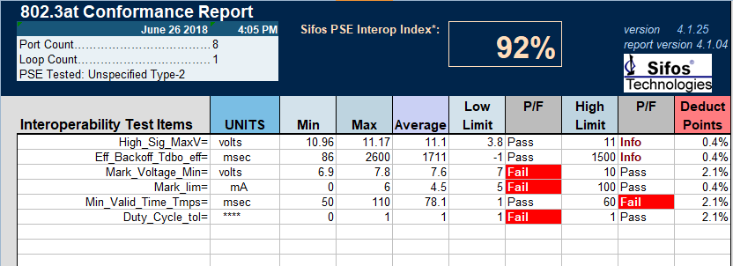
The pass rate is 92 percent。
There is four item failed。

Slide 2
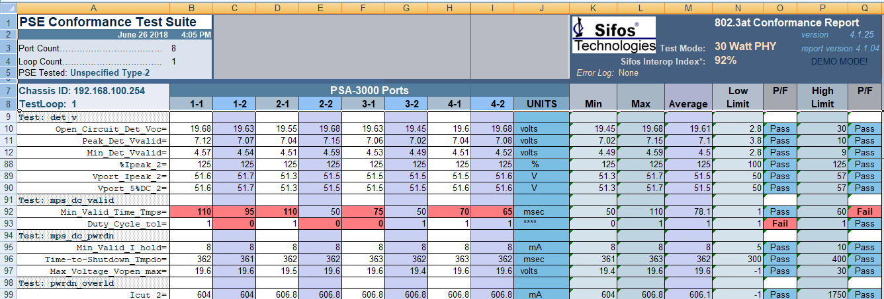
The following is a detailed test record

Slide 3
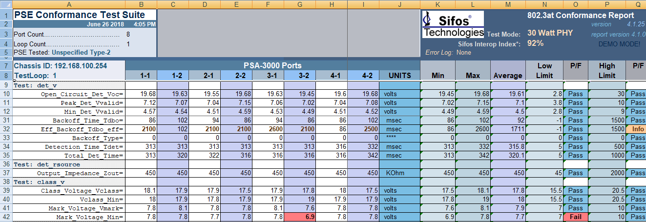
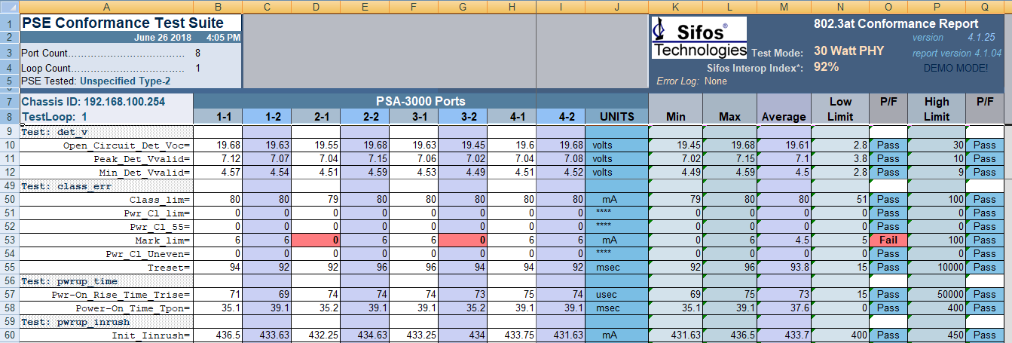

Slide 4
THANKS!

