Slide 1
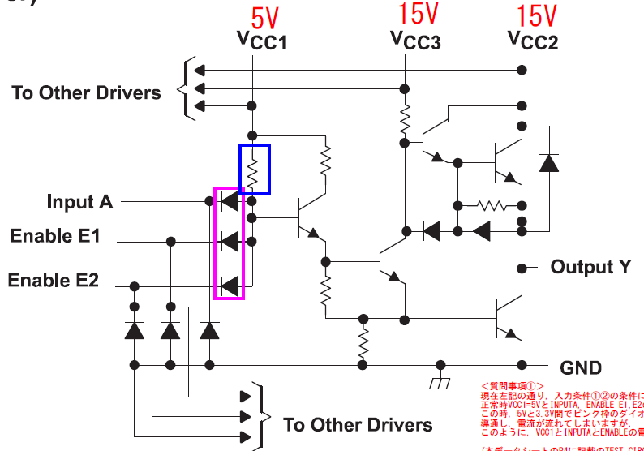
 | condition 1 | condition 2
Vcc1 | 5V | 5V
Vcc2 | 15V | 15V
Vcc3 | 15V | 15V
Input A(pulse) | High 3.3V, Low 0V | High 3.3V, Low 0V
Enable E1 | High 5V, Low 0V | High 5V, Low 0V
Enable E2 | High 5V, Low 0V | High 3.3V, Low 0V
Is it true that current can flow as the figure?
How much current can flow at the condition 1 & 2?

Slide 2
3. Are VIH and VIL are not changed even if power supplies are below?
Vcc1 | 5V
Vcc2 | 15V
Vcc3 | 15V
4. VIH and VIL condition can be applied to Input A, Enable E1 and Enable E2?

