Slide 1
Sakura Preliminary Review
Jimmy Hua
04-06-20

Slide 2
Customer Failure Description

Slide 3
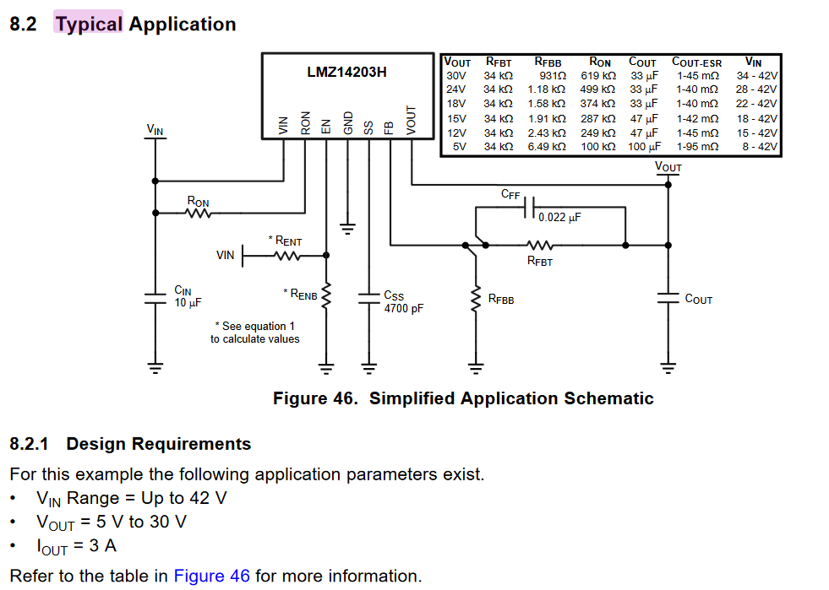
Datasheet Typical Application Recommendation
http://www.ti.com/lit/ds/symlink/lmz14203h.pdf#page=16

Slide 4
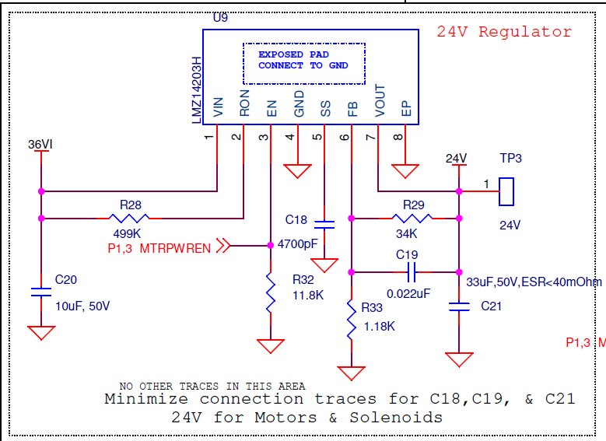
Customer Schematic
Schematic Review Check List
Follows typical schematic listed in previous slide:
CIN (10µF) (√)
Ron (499kΩ) (√)
Css (4700pF) (√)
Rfbt (34kΩ)/Rfbb(1.18k Ω) (√)
Cff (0.022µF) (√)
Comments account for minimizing trace length to keep component positioned as close as possible to respective pins (√)
Schematic follows typical recommendation
Suggestion
Check all connections to 36VI:
Check if U15 (LTC4079) is also shorted to ground or not. Can U9 be isolated and retest for input short by removing U15 input connection.
Check F1 (8A fuse) and see if it is damaged or not
Make sure none of the jumpers J17,J21,J23,J27 have any physical shorts between pin 1|2 and pin 3|4

