Slide 1
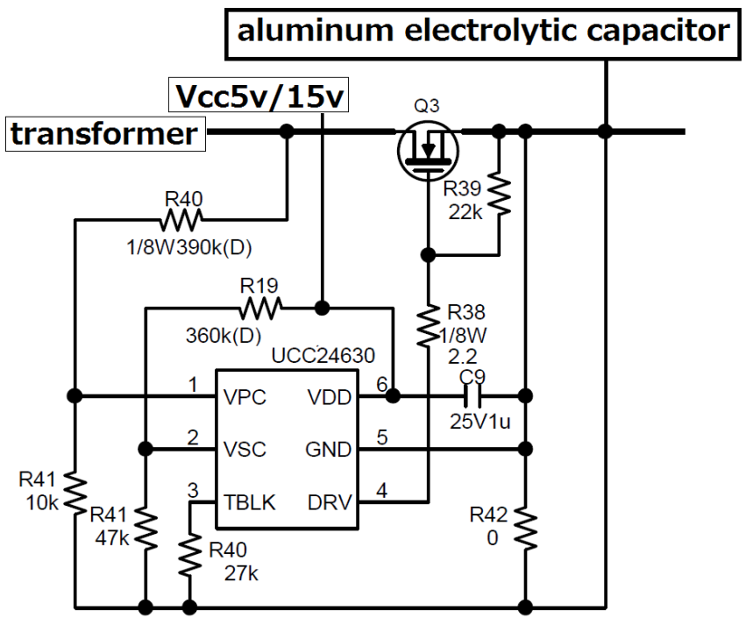
Vds
VPC
DRV

Slide 2
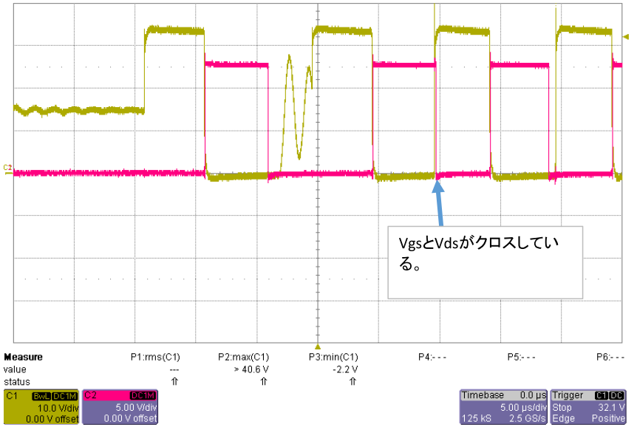
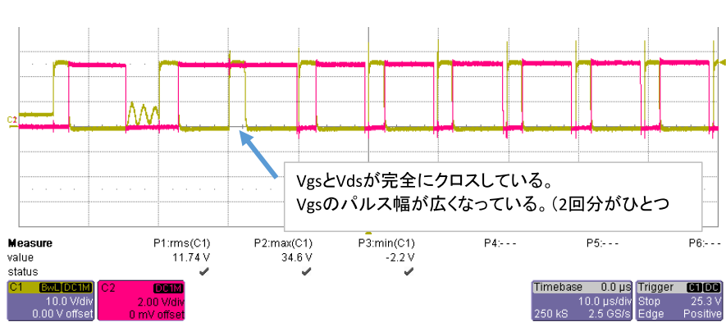
Vin : AC90V
Vout : DC15V
Iout : 0 -> Max
Ch1 : Vds
Ch2 : DRV
VPC and DRV are piled.
Vin : AC90V
Vout : DC5V
Iout : 0 -> Max
Ch1 : Vds
Ch2 : DRV
DRV does not become Low.

Slide 3
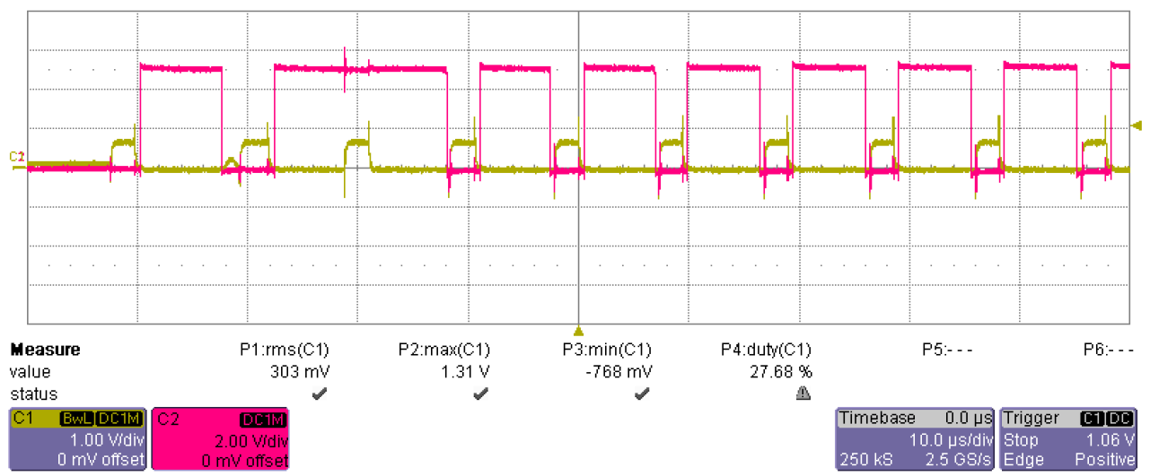
Vin : AC90V
Vout : DC5V
Iout : 0 -> Max
Ch1 : VPC
Ch2 : DRV
Vgs won't be Low.
Vin : AC90V
Vout : DC5V
Iout : 0 -> Max
Ch1 : Vds
Ch2 : DRV
DRV does not become Low.

