Slide 1
ANSYS Simulation Training
2/26/2025
Shane Hauser

Slide 2
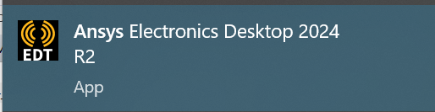
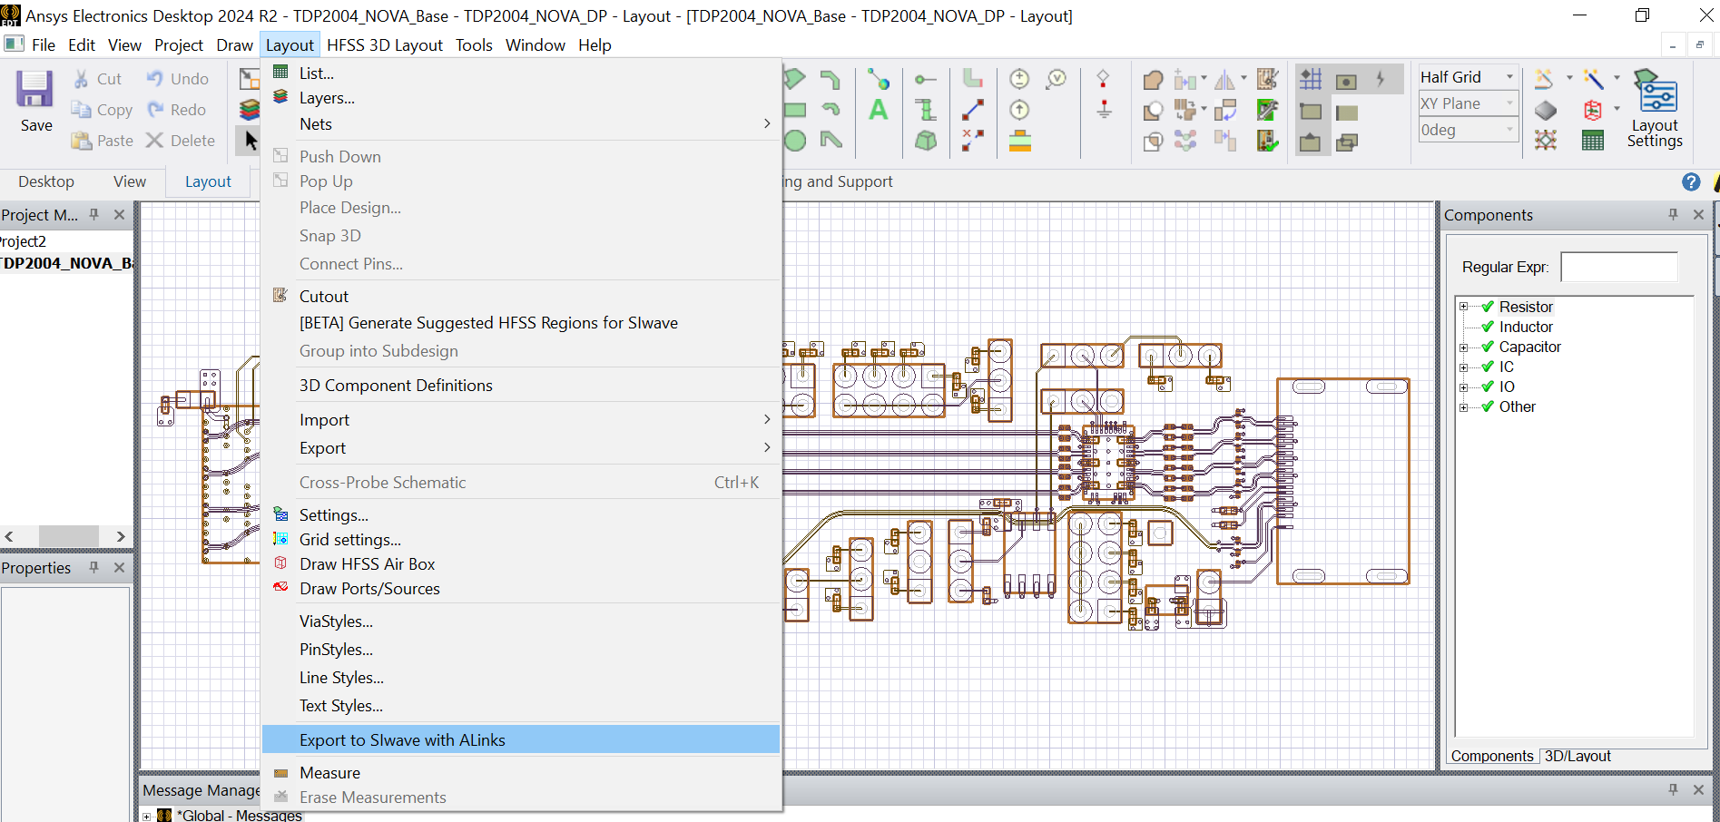
Ansys Desktop
Open Ansys desktop
File->Import-> Cadence/allegro...-> PCB Layout file
Check all nets are imported, click ok
Layout->export to SIwave with Alinks

Slide 3

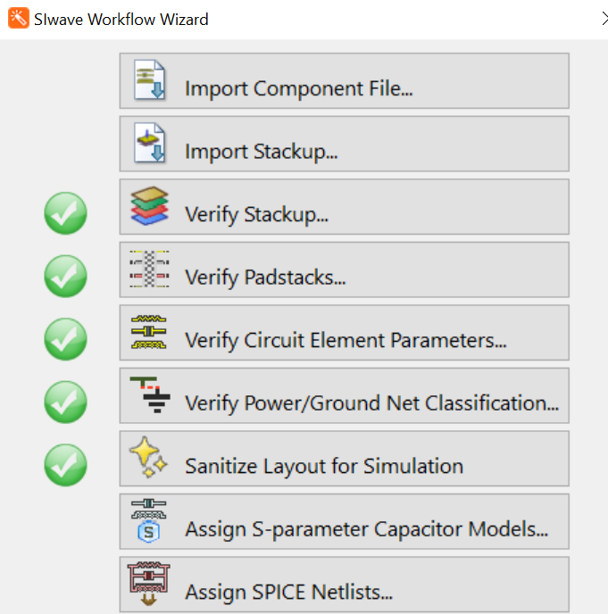
SIwave workflow wizard
SIwave should start by itself
Check all nets are imported, click import
Top left orange wand, SIwave workflow wizard
Skip first two options, click verify stackup, click ok
Click verify padstacks, click ok
Click verify circuit element parameters, click ok
Verify power/gnd net class, click auto verify, then ok
Sanitize layout for simulation
Save as SIwave project, Click check all nets, then sanitize, then ok

Slide 4
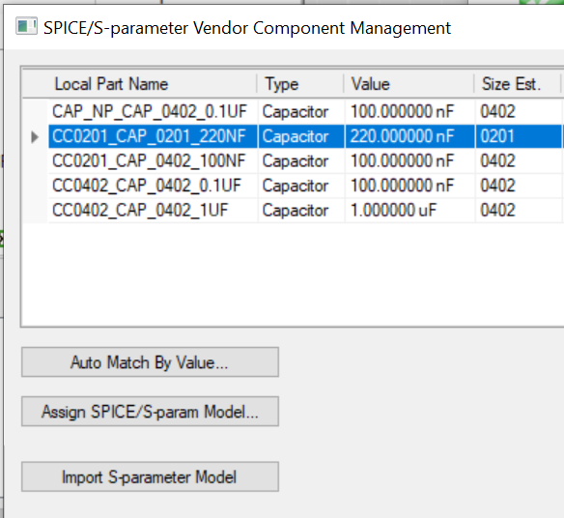
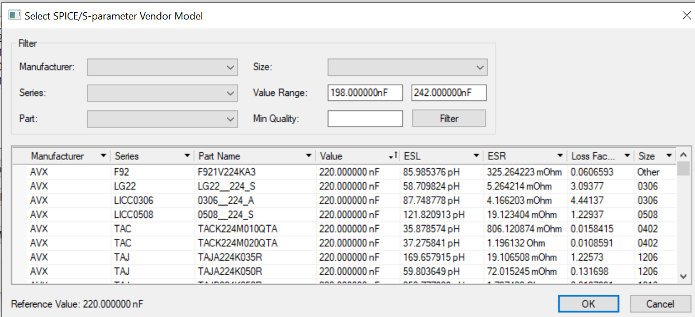
Siwave workflow wizard
Assign s-param capacitor models
Top list will have capacitors on board, need to match to a part
Only need to do for 0201 capacitors on high speed lines
Click capacitor and assign SPICE/S-param model
Find manufacturer part, (use filters), then click ok
Click ok, close workflow wizard

Slide 5
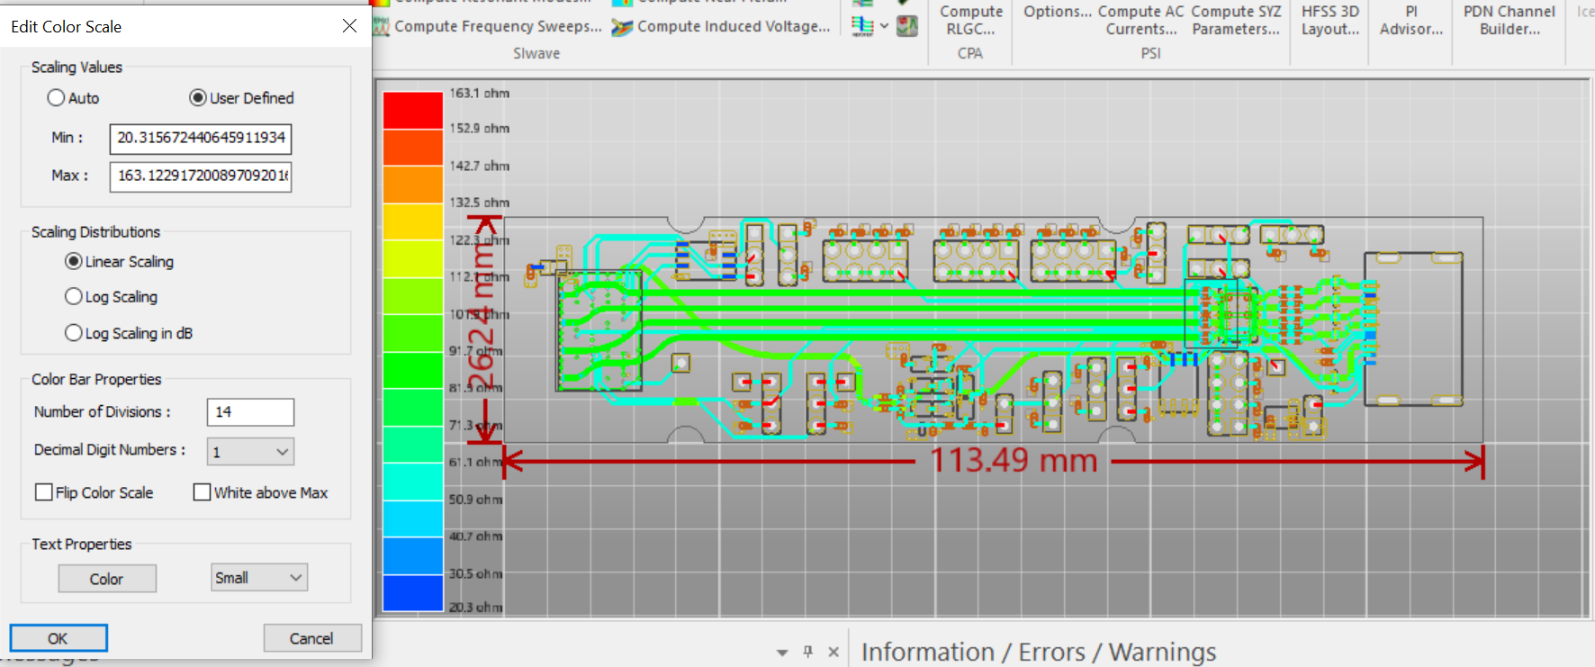
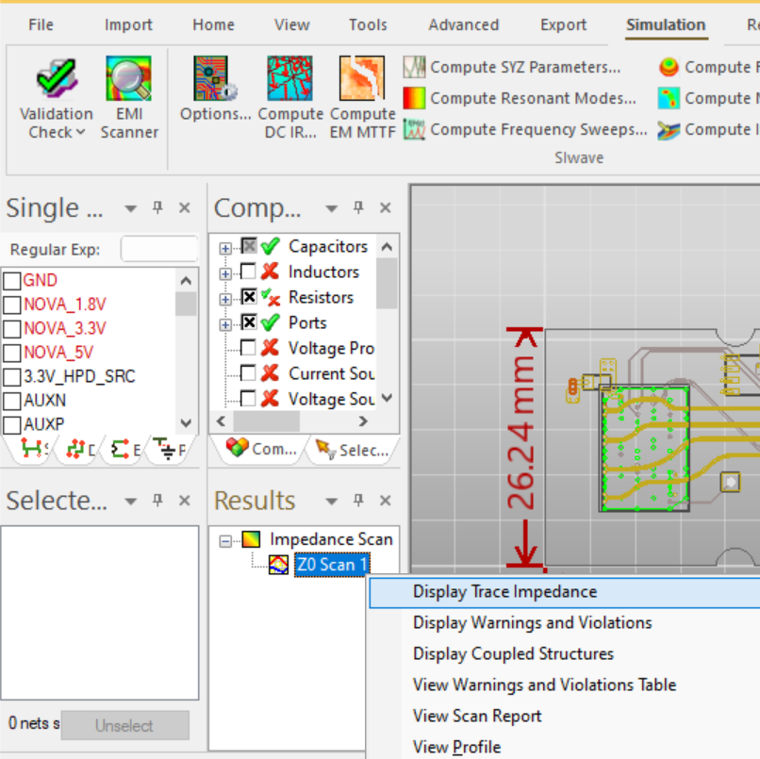
Differential Impedance scan
Go to simulation tab, click detect signal line impedance violations
Go to differential tab, select all nets, set speed to desired speed and simulate
Let simulation finish, Find z0 scan under results box, right click and hit display trace impedance
Hover over diff pairs to confirm impedance, can click bar chart on left to set range to look for if desired

Slide 6
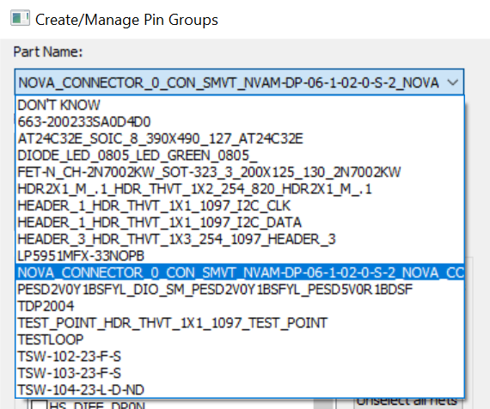
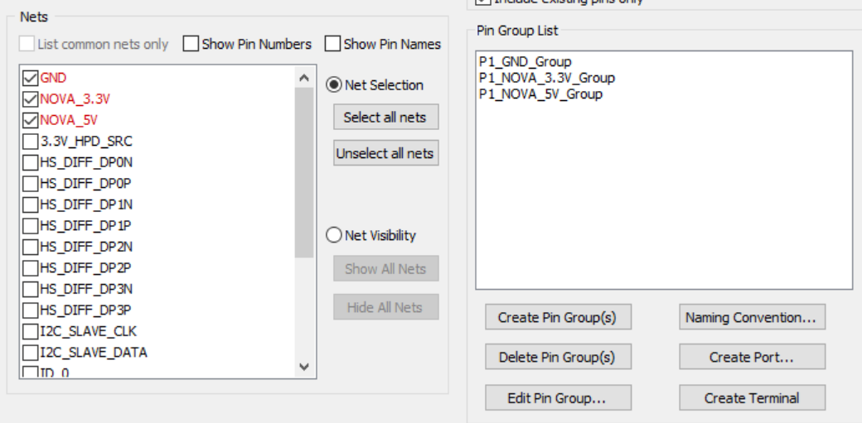
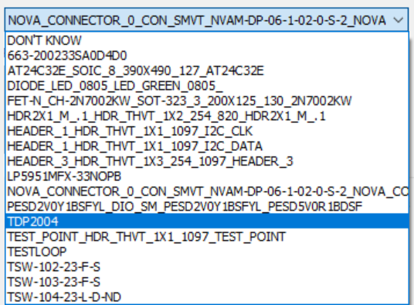
Create pin groups
Go to tools tab-> Design tools-> Create/manage pin groups
Select connector part, select power and GND nets, click create pin groups
Repeat for any devices/connectors in signal path

Slide 7
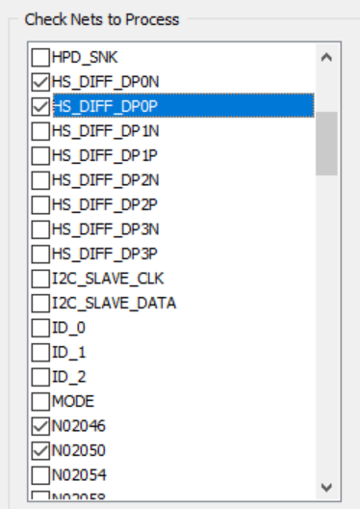
Create ports
Write down net names of high speed diff pairs
Will separate between pre-channel and post channel on TDP2004
Need to create two ports for each signal line (one at start one at end)
Design tools -> Generate ports on selected nets
Select p/n on first diff pair, select net names on other side of cap, hit generate
            Board layout representation:
C1
HS_DIFF_DP0P N02046
HS_DIFF_DP0N N02050
C2

Slide 8
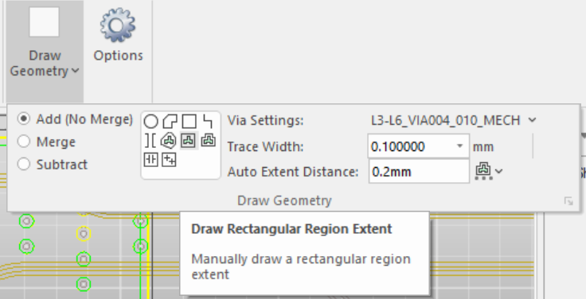
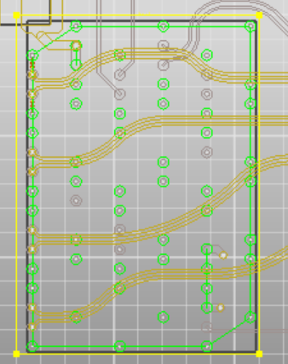
3D Modeling
Need to 3D model regions where signal overlaps vias, devices, and connectors
Home tab->Draw geometry->draw rectangular region extent
Draw squares over connectors
  or any part of signal that crosses vias

Slide 9
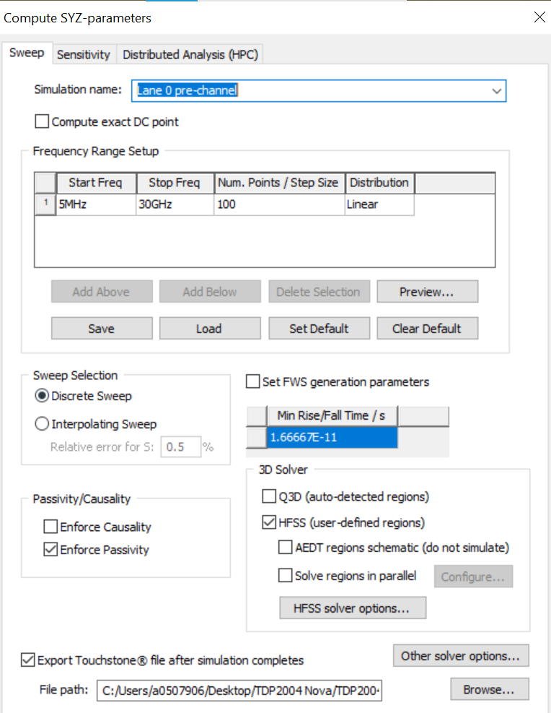
Simulate
Simulation tab-> compute syz parameters
Set start and stop frequencies for simulation, under 3D solver hit HFSS and export touchstone file after simulation
  Add name for sim as well
Hit launch, simulation will run (can take hours)

