Slide 1
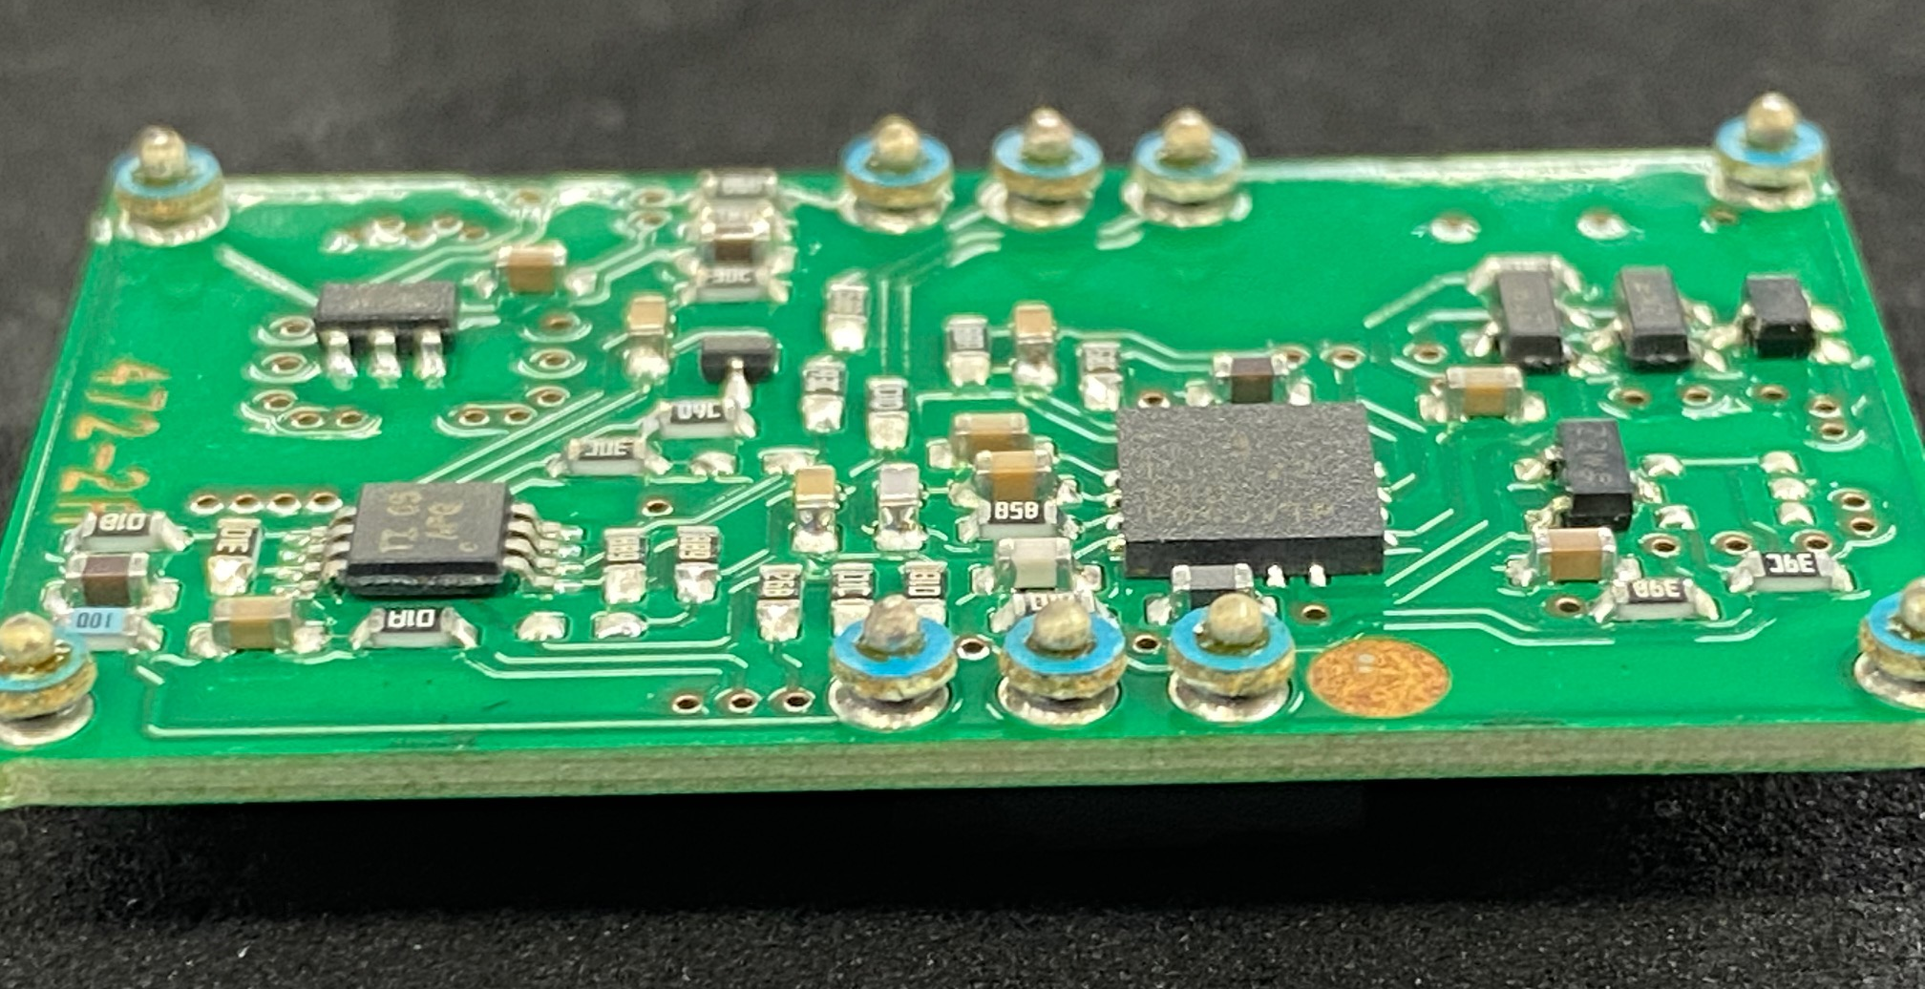
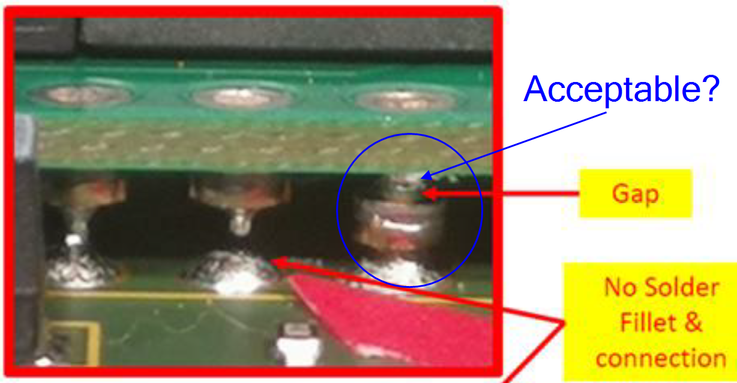
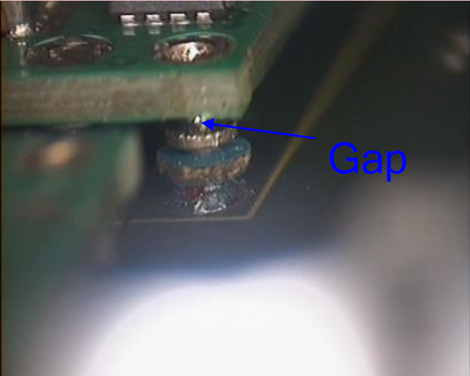
Hello Lidong,
What is the device (part number) on the bottom-right-image? It would be beneficial to know so we can take a look at the ePOD drawing which specifies material on bottom-right-corner of ePOD.
The bottom right image is from the part PTH12020WAZ. They seem to be of same type for PTH05050WAZ, PTH12020WAZ and PTH08T241WAZ. But not sure why there are variations for the one on the left? What are the reason there is such differences in terms of functionality & materials between the 2?
Need info from #1 above
The blue is like a washer to maintain a stand-off height at a consistent level.
See attached file. It is an App Note for High Temperature Soldering Requirements for Plug-In-Products (PIP). I would recommend the following.
The reason we ask is because some of the plates at these pins seem to be falling downward (but with connection) from the daughter board due to defective reflow process. So we would like to know more about these plates and whether that is acceptable. (See circled in blue in image below)
Thanks, Alejandro
0143.slta054a.pdf
+ Previous Questions:
1. How it is attached to the daughter PCB (the nickel plate blue color?) 2. What is the material of the plate? (cus we are not quite sure if that is nickel)
PTH05050WAZ
PTH12020WAZ
PTH05050WAZ
Gap
Acceptable?
PTH05050WAZ

Slide 2
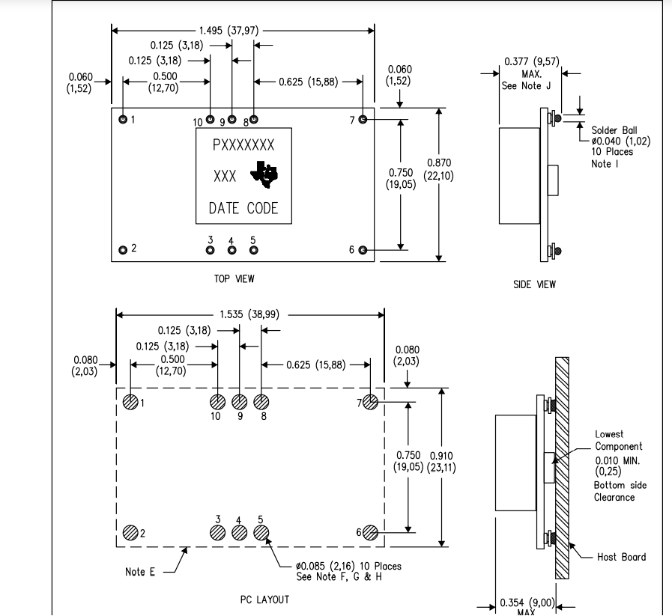
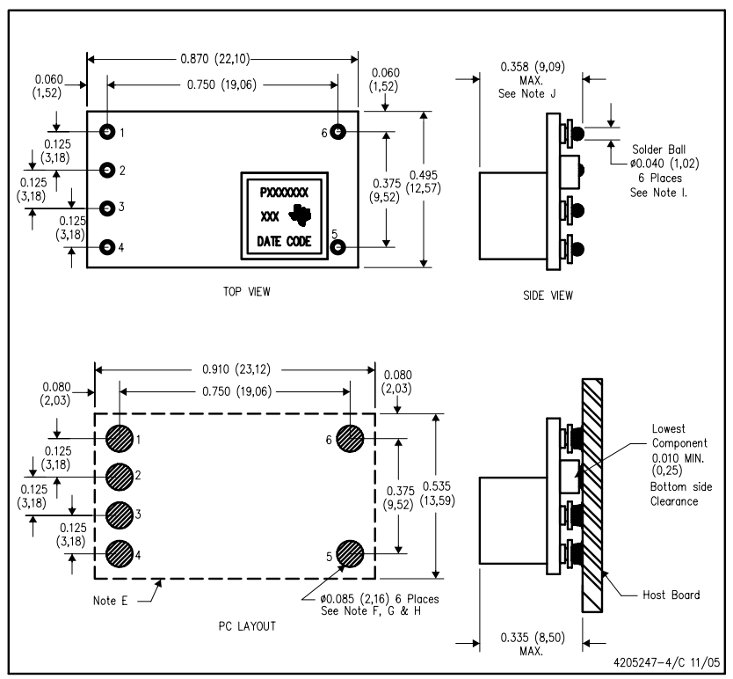
0950-5085(U809, U811) – PTH05050WAZ
0950-5084(U813) – PTH12020WAZ

