Slide 1
TPS548D22 BP Detection Threshold
Amnat Yakamna
March 31, 2016

Slide 2
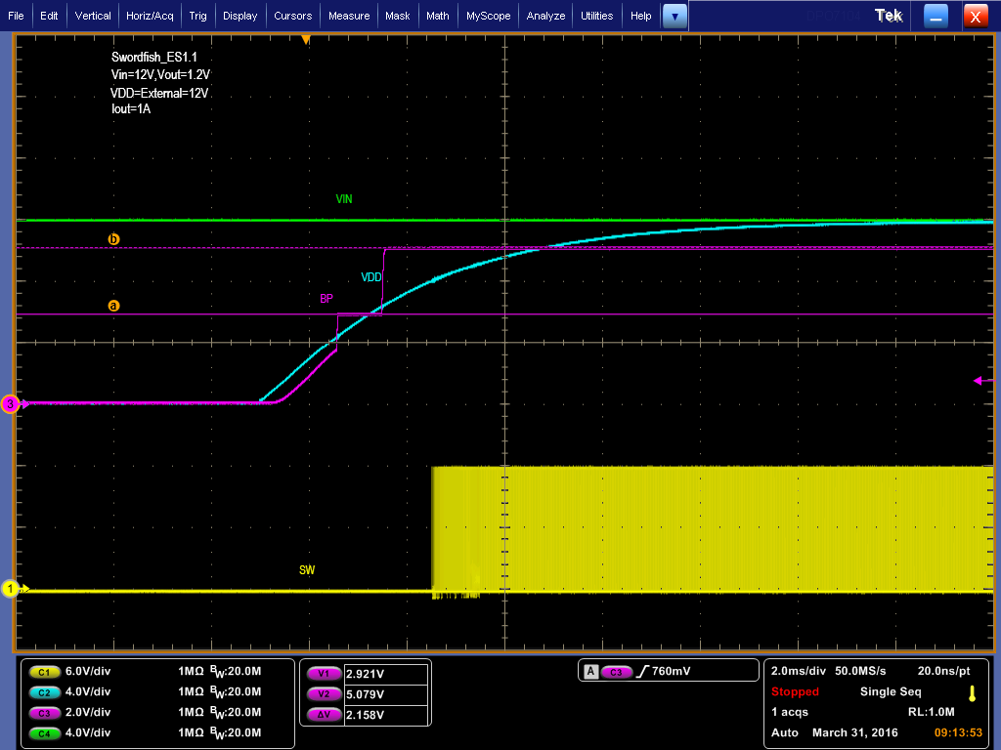
MODE, VSEL, FSEL Detection
VBP=~5.07V
MODE, VSEL, FSEL use this detection threshold voltage to determine the voltage ratio set by the pin strap resistors.
VBP detection threshold=~2.93V

Slide 3
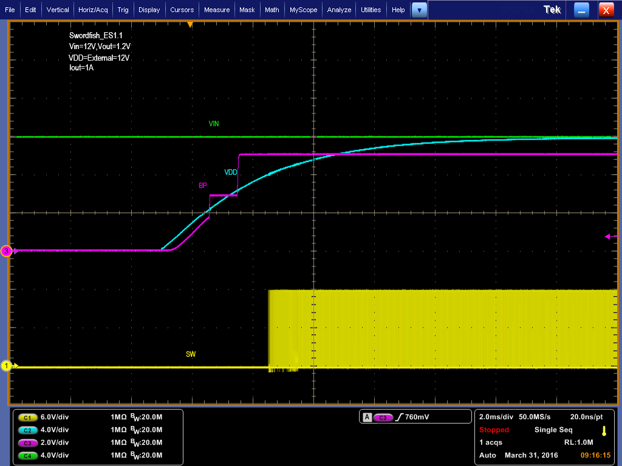
MODE, VSEL, FSEL Detection

