Slide 1
TEXAS BC 1.2 test FAIL
BQ24297

Slide 2
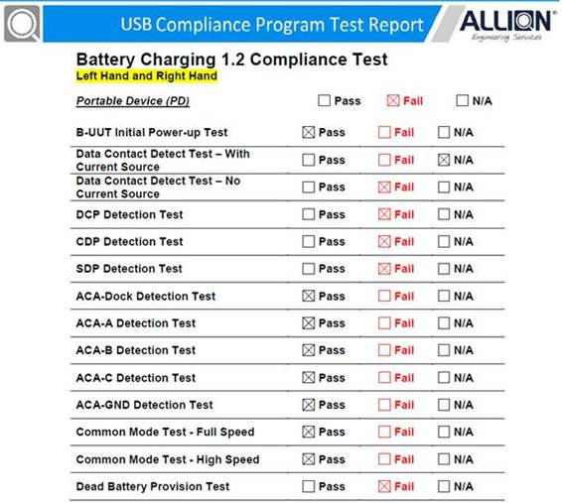

Slide 3
SCP/ Standard Downstream Port
DCP/ Dedicated Charging Port
CDP/ Charging Downstream Port
BC1.2 Compliance Plan – How to use MQP to test
http://www.usb.org/developers/docs/devclass_docs/USB_Battery_Charging_1.2.pdf
Test instrument MQP USB-PET
http://www.reeper.com.tw/compliance-test/otg2-0-compliance-tester.html

