Slide 1
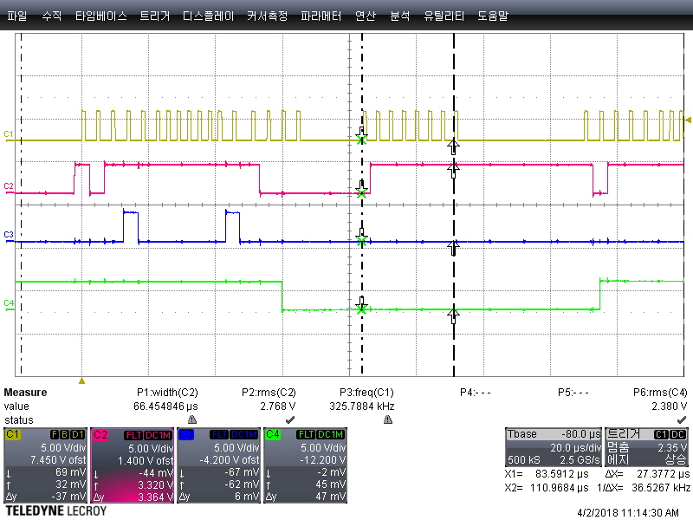
1. Changed code(by 2018.03.30)
Switching to
Special mode
Writing
configuration
code
Reading Error
Status code
CLK
_OE
LE
SDO
No SDO data

Slide 2
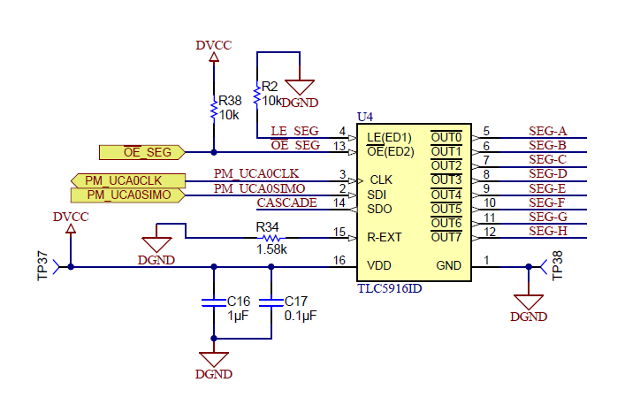
1. TLC5916 New Board CKT
1. Test Condition
1) CLK : General GPIO( Fclk= 3.5KHz), R-ext(open) : about 5mA
2) Test Result : Do not enter to Special mode
-. SEG-A is open, but SDO is all LED OK

Slide 3
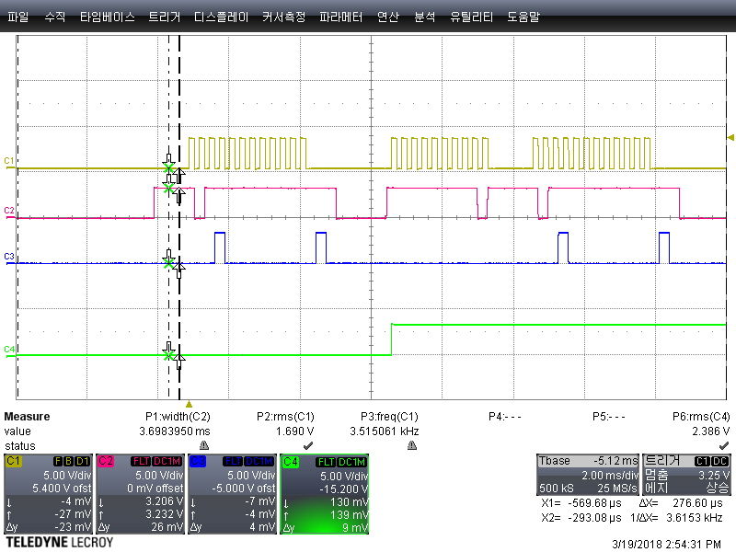
2. TLC5916 Timing
CLK
_OE
LE
LED 1 is open but SDO output is all LED ok
SDO

