Slide 1
TLC6C5748-Q1 program procedure

Slide 2
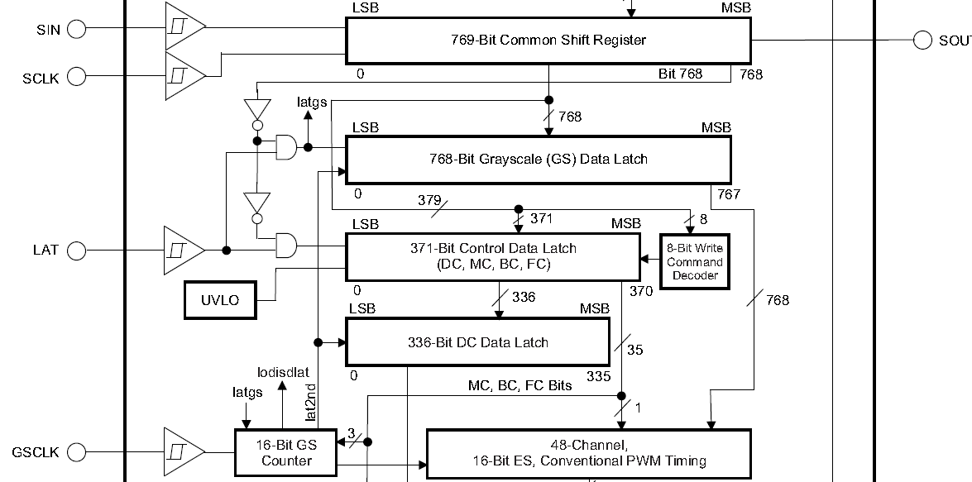
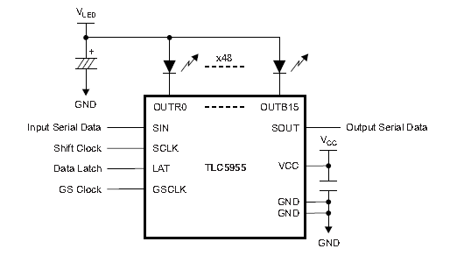
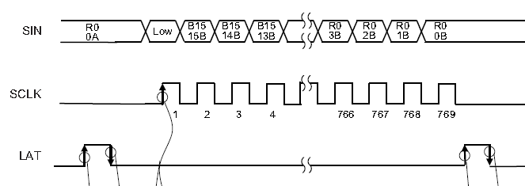
TLC6C5748-Q1 interface
Whole data for one frame
SIN: Serial data input for the 769-bit common shift register
SCLK: Serial data shift clock, SIN data is shifted to internal common register at the rising edge.
LAT: LAT is used to latch the data to control data or GS register to display.
GSCLK: Reference clock for the grayscale (GS) PWM control for all outputs.
Low for GS data, high for control data
Shift 769 bits data and input LAT pulse

Slide 3
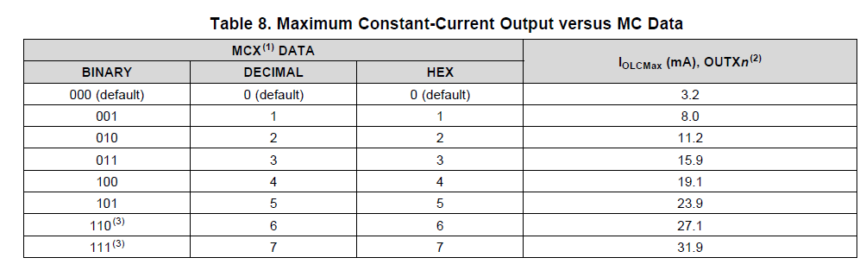
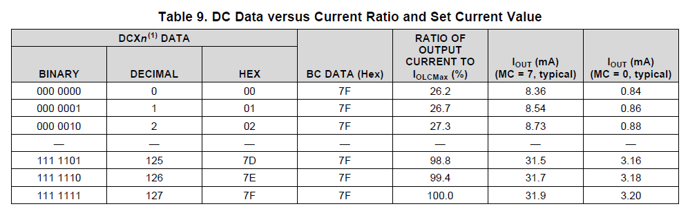
Max Current & Dot Correction
MC: Coarse current output tuning for all channels
DC: Fine current output tuning for individual channel (e.g, edge & corner)

Slide 4
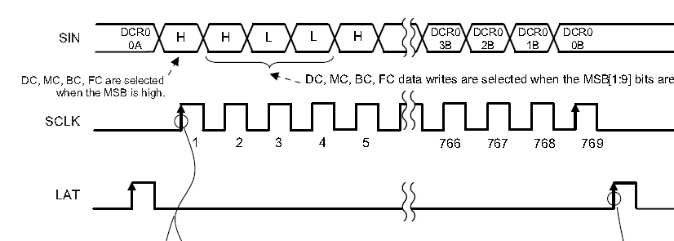
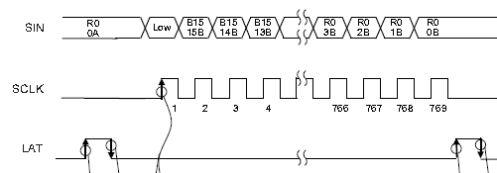
Data Write
Control Data
Grayscale (GS) Data
The control data latch is 371 bits long. The data latch contains dot correction (DC) data, maximum current (MC) data, global brightness control (BC) data, and function control (FC) data.
The GS data latch is 768 bits long, and sets the PWM timing for each constant-current output.

Slide 5
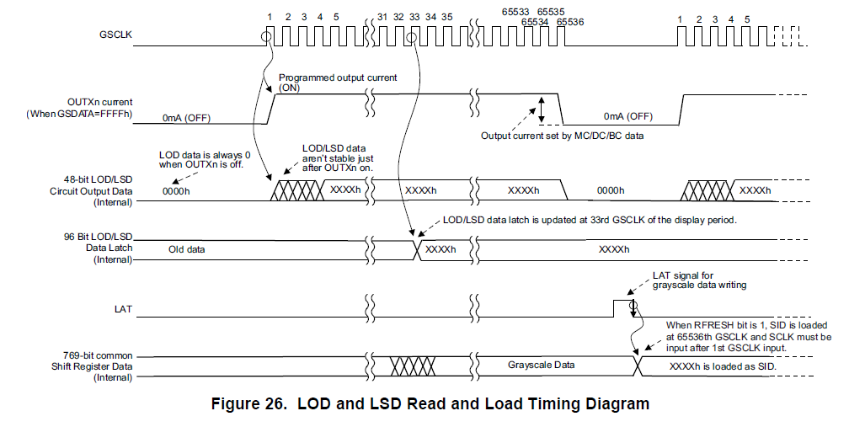
Data Read
SID Data
The SID data is 96 bits long. The data latch contains LOD data and LSD data.

Slide 6
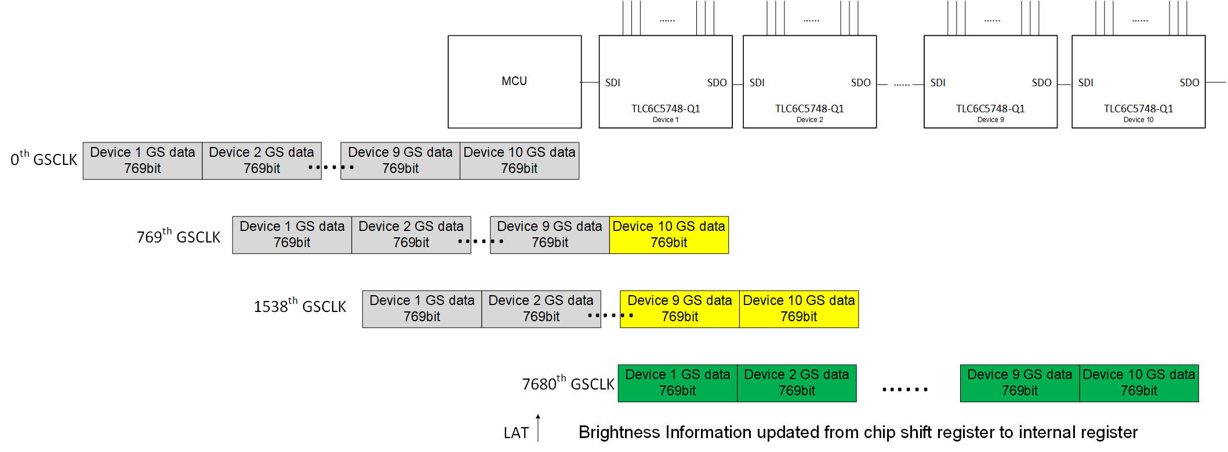
Daisy Chain Operation - Write

Slide 7
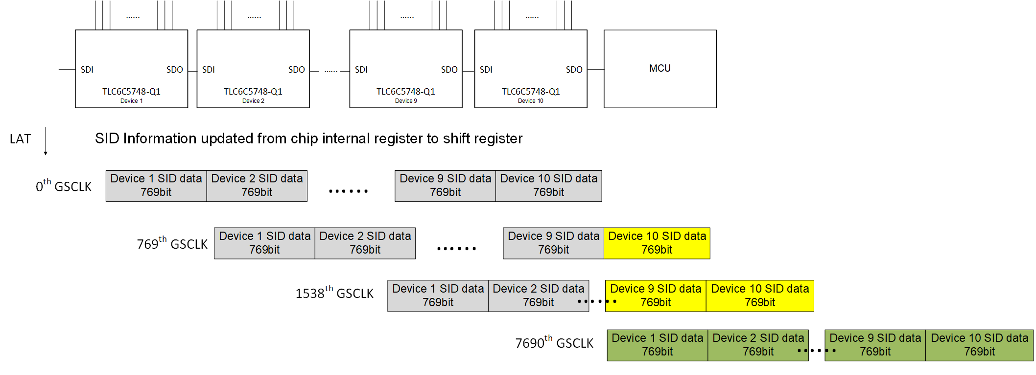
Daisy Chain Operation - Read

Slide 8
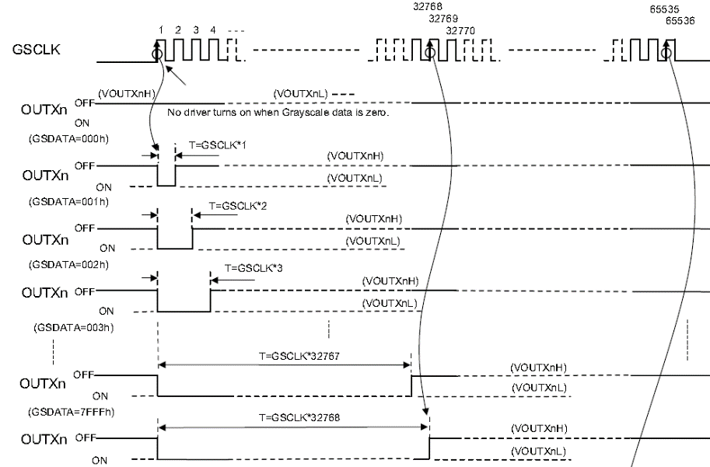
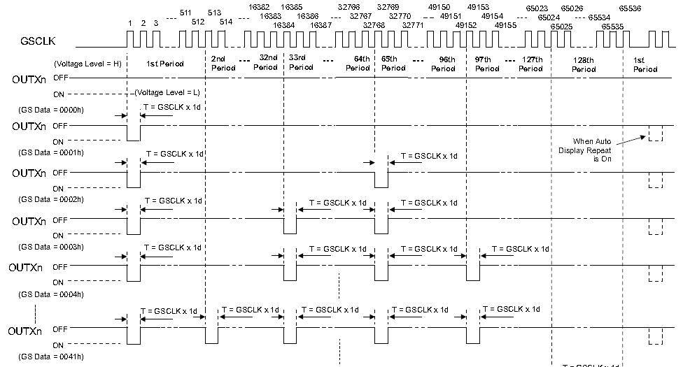
PWM dimming
Conventional PWM Control
Enhanced Spectrum (ES) PWM Control
In this PWM control, the total display period is divided into 128 display segments. Each display segment has a maximum of 512 GSCLKs.
If GS=100, for the first 100 rising edges of GSCLK, the channel turns on and then off until 65535 GSCLKs.

