Slide 1
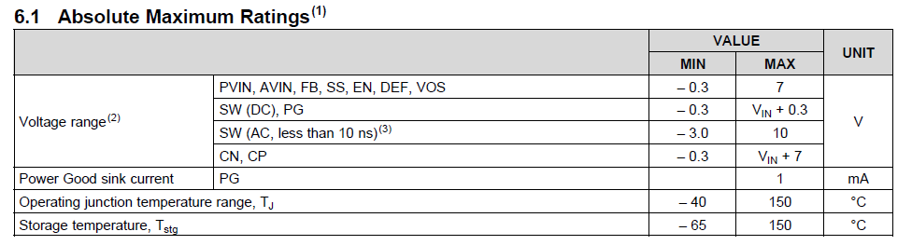
TLV62090EVM Test Result
■Overview
In the evaluation board of TLV 62090, the SW waveforms exceeding the absolute maximum rating are observed at the time of power
supply ON and OFF.
■Question
1, Why is it below the absolute maximum rating?
2, Is this behavior normal?
3, Could you please point out if there is a problem?
■Absolute Maximum Ratings
I’m talking about absolute maximum rating of SW voltage

Slide 2
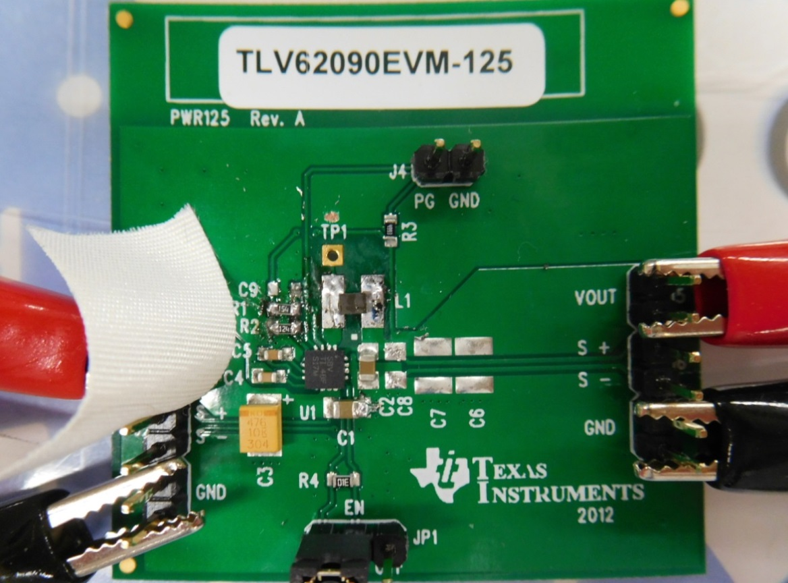
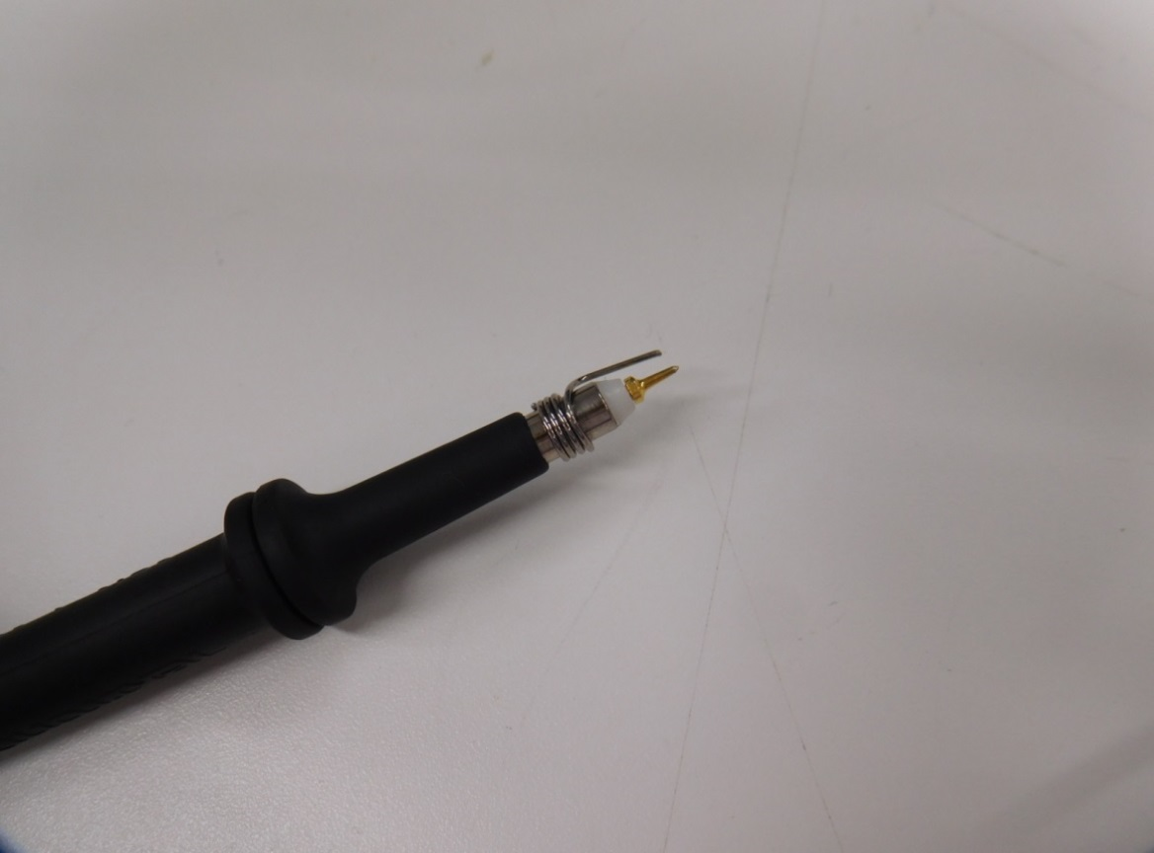
■Measurement Points
Measurement Point
Active Probe(P6205)
SW pin
CN pin
○ Output Voltage : 1.8V
○ They changed the constants of the evaluation board as follows.
R1 | 150kΩ
R2 | 120kΩ
L1 | MEKK2016T1R0M

Slide 3
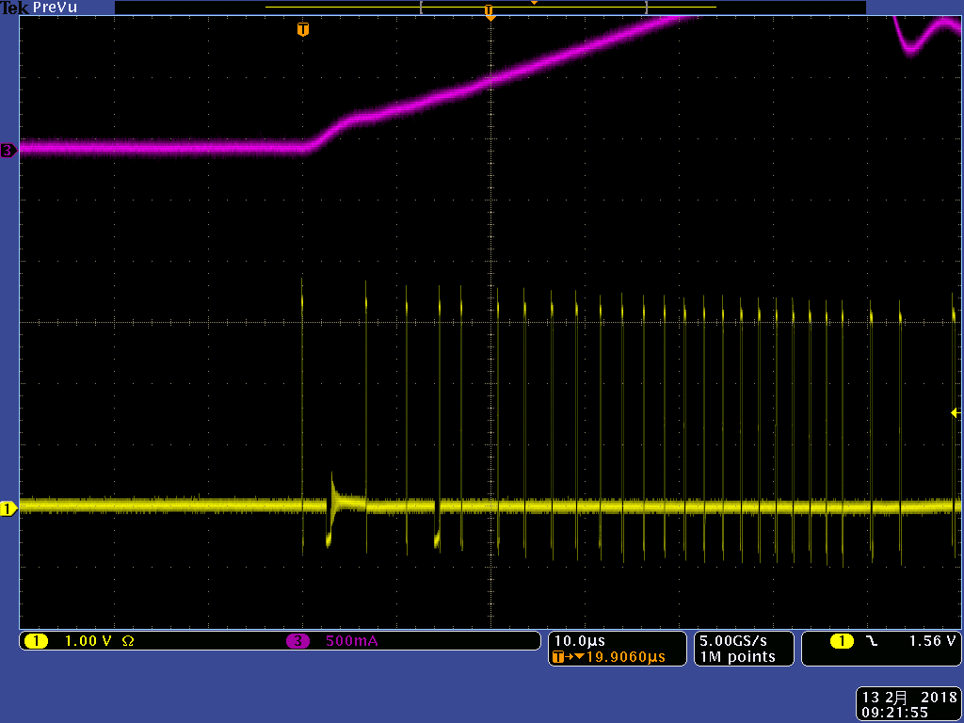
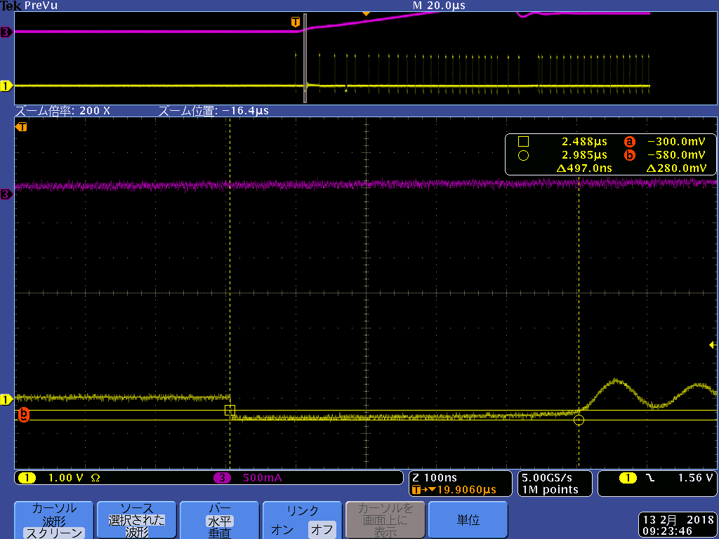
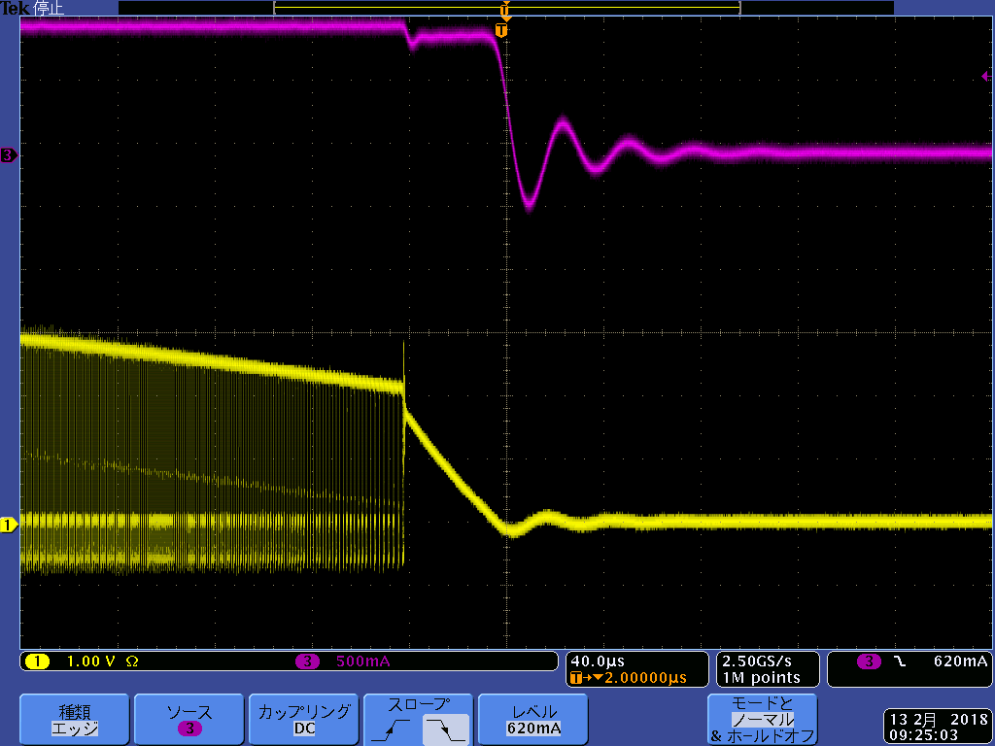
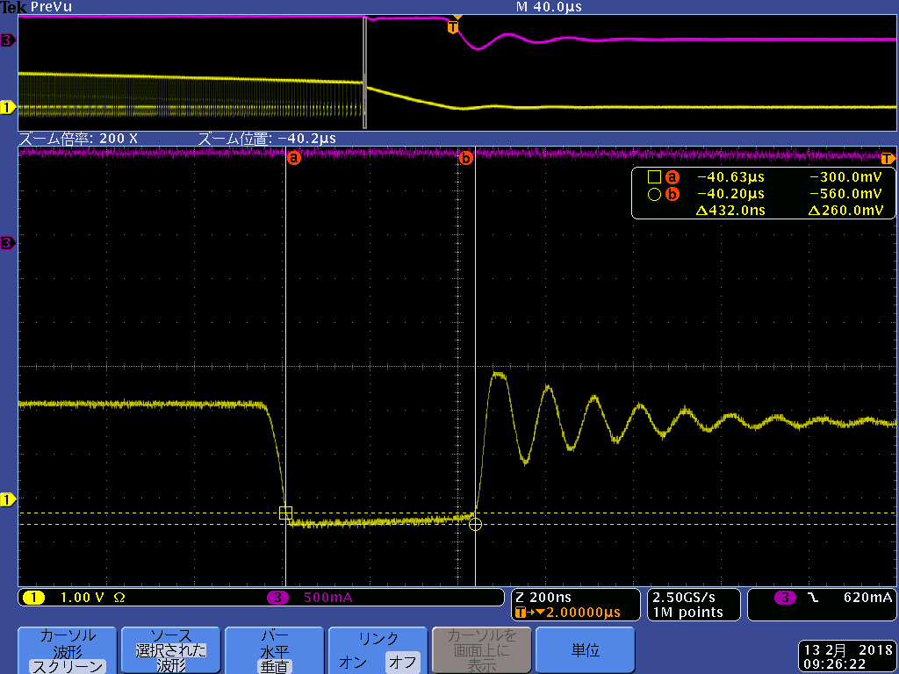
■Waveform
 | Overall waveform | Expanded waveform
Condition : Power ON Iout=1A CH.3：Iout CH.1：SW pin
Condition : Power OFF Iout=1A CH.3：Iout CH.1：SW pin
-580mV / 497ns
It below -0.3 V
-560mV / 432ns
It below -0.3 V

Slide 4
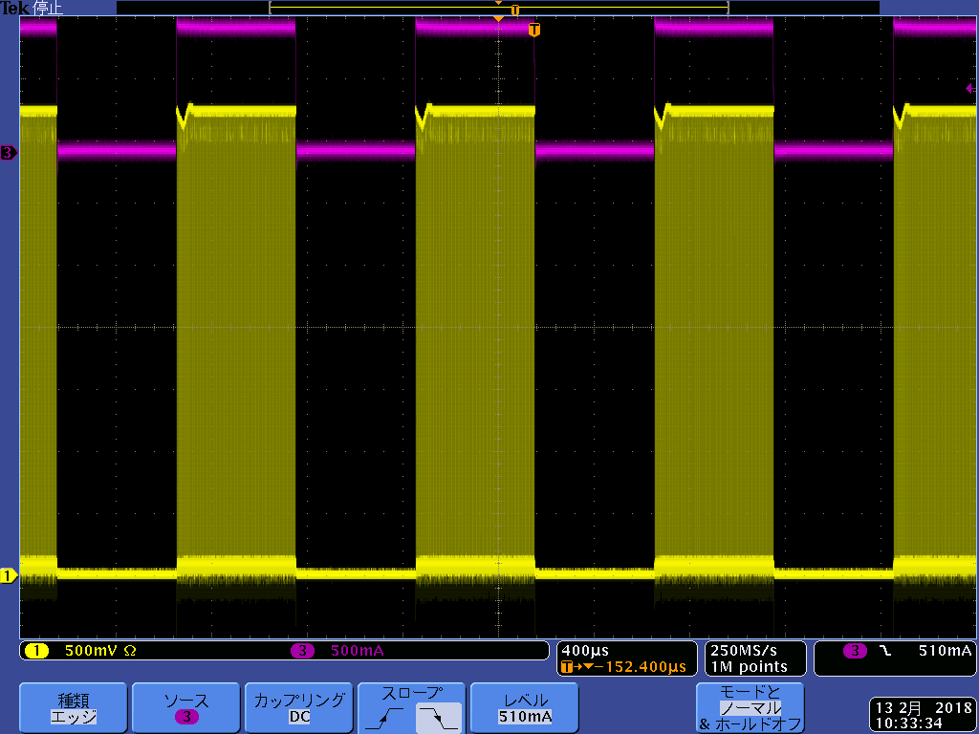
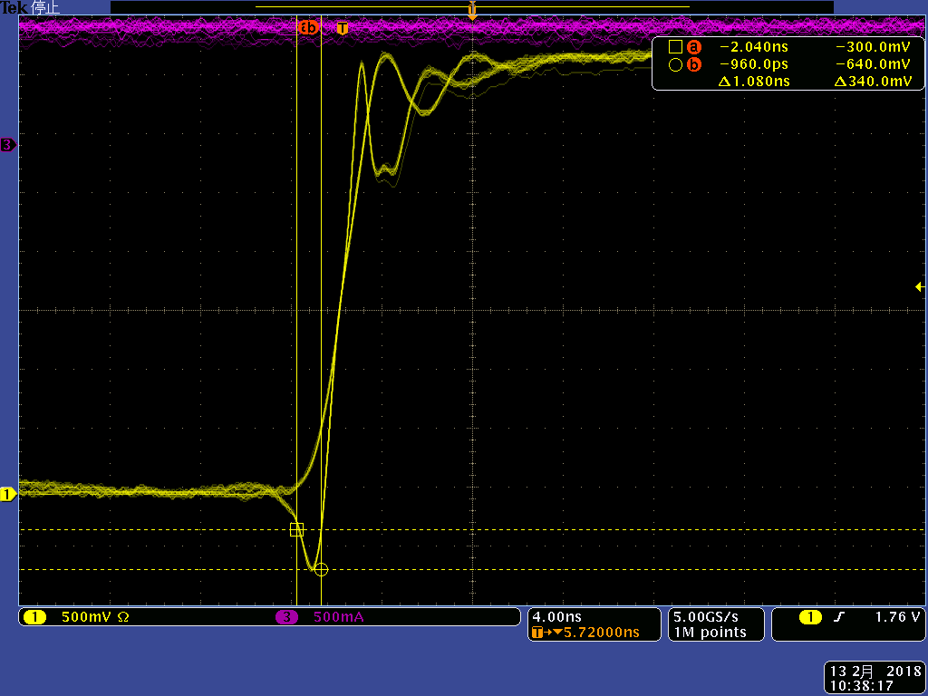
■Waveform
 | Overall waveform | Expanded waveform
Load response Iout=0A⇔1A CH.3：Iout CH.1：CN pin
-640mV / 1.08ns

