Slide 1
TLV733P Startup Sims
LP-MWL
Nick Butts

Slide 2
TLV733
Simulation Condition:
VIN = 2.5V
VIN ramp rate = 10mV/us (250µs total ramp time)
VOUT = 1.8V (fixed)
VEN = VIN
Cin=4.7uF
Cout=1uF
RLOAD = 18Ω (= 100mA @ 1.8Vout)
Measured startup is 1% VOUT (nom) to 99% VOUT (nom)

Slide 3
Statistical Results
Temperature | Mean µ (µs) | Standard Deviation σ (µs)
-40C | 457.8 | 62.49
25C | 364.3 | 46
85C | 308.5 | 34.18
125C | 285.3 | 29.31

Slide 4
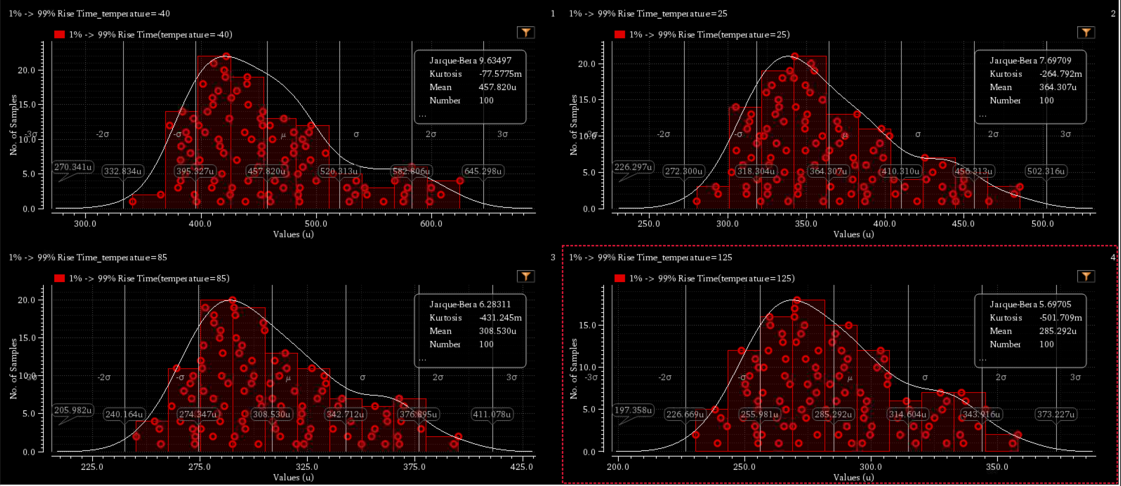
Monte Carlo Distribution

