Slide 1
TPS1H100-Q1 thermal behavior during over current

Slide 2
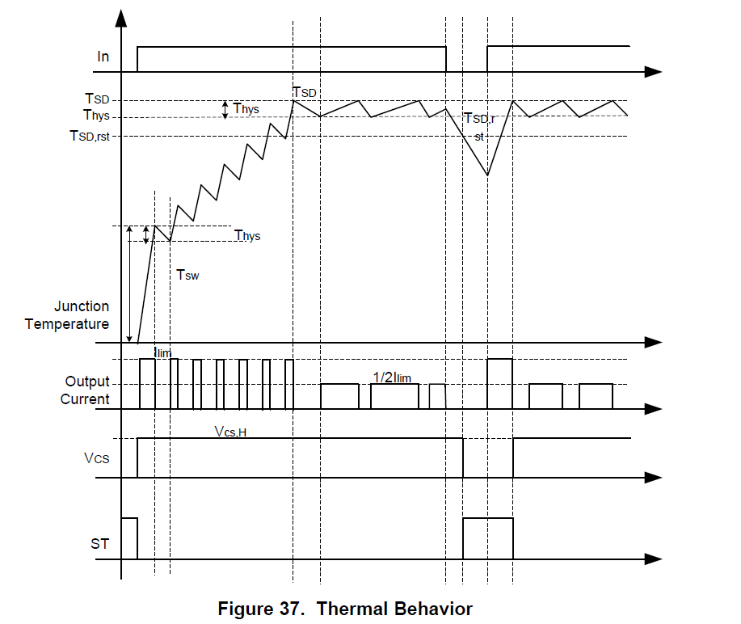
Datasheet description

Slide 3
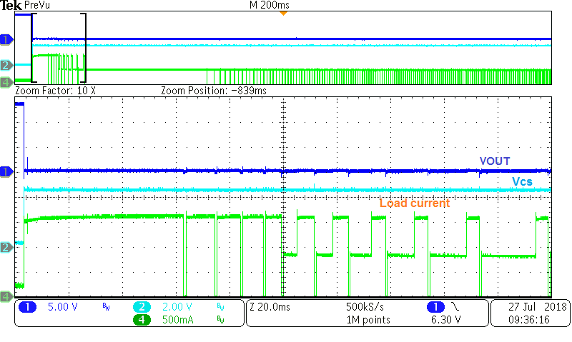
Bench test at VS = 13.5V and load current limit 1.5A
Tsw triggered
Tsw and Tsd triggered

Slide 4
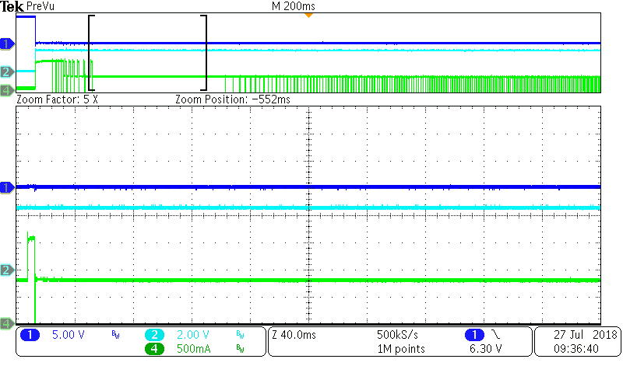
Bench test at VS = 13.5V and load current limit 1.5A
Tsd - Thys<TJ < Tsd

Slide 5
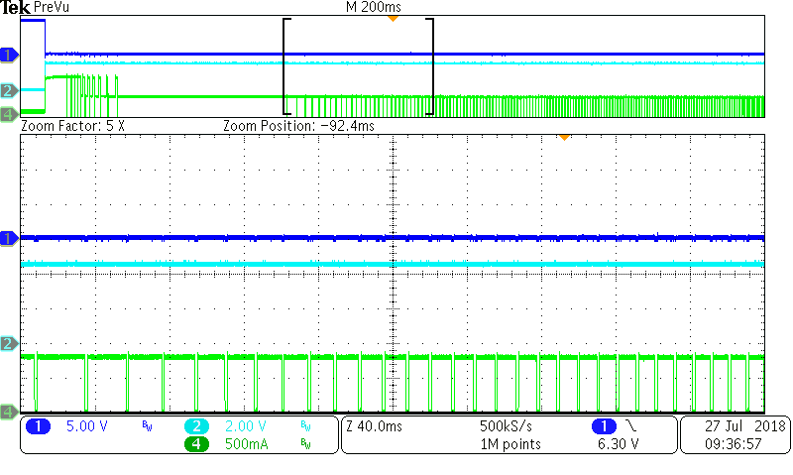
Bench test at VS = 13.5V and load current limit 1.5A
Tsd triggered

