Slide 1
TPS23523
Nini Zhong

Slide 2
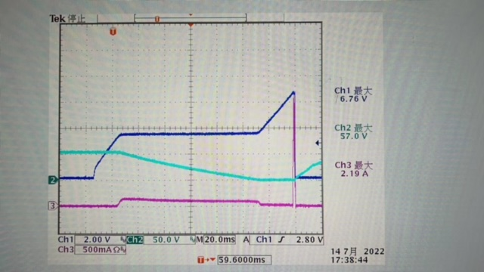
Hiccup protect waveform
CH1 Vgs
CH2 Vds
CH3 Ids

Slide 3
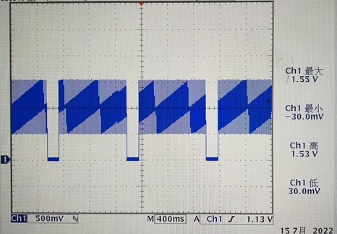
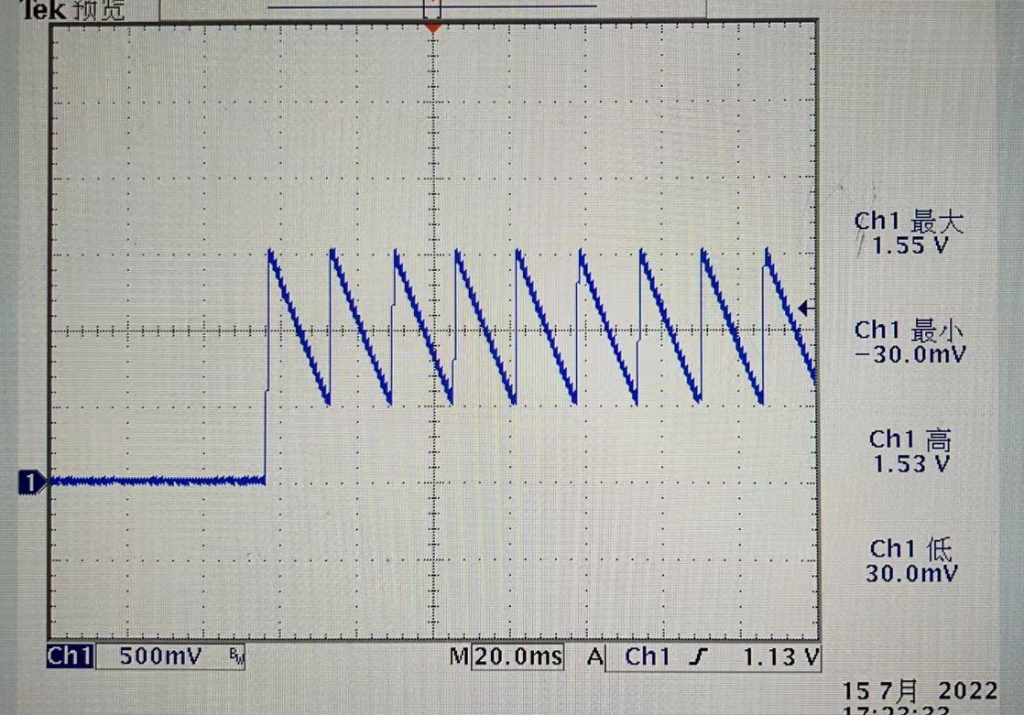
TMR waveform

Slide 4
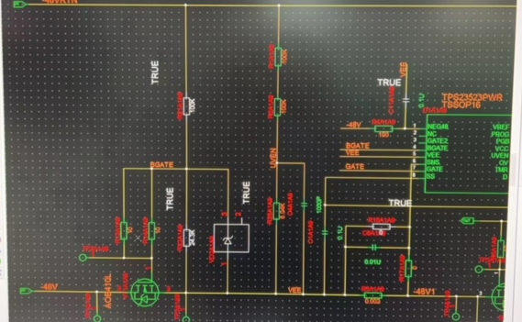
Schematic

Slide 5
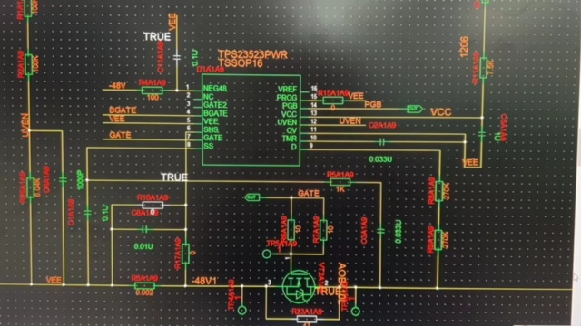
Schematic

