Slide 1
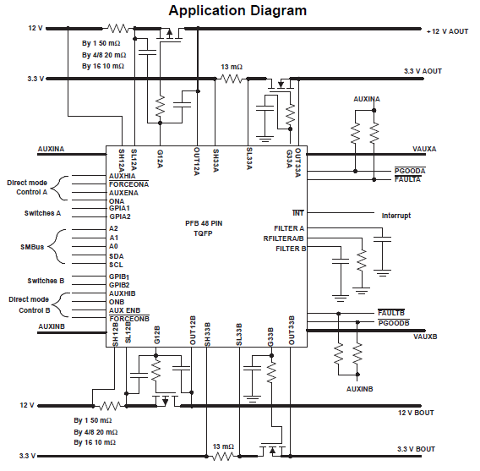
12V
3.3V#0
3.3V#1

