Slide 1
TPS2372 Support Needs

Slide 2
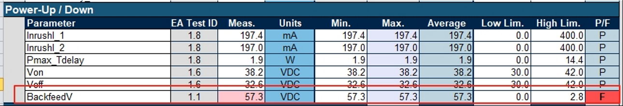
Sofias test_ BackfeedV falied
1. The BackfeedV parameter item failed when TPS2372 is carried out Sifos test，The attachment shows the schemactic, can you help analysis the potential reason for this issue?

Slide 3
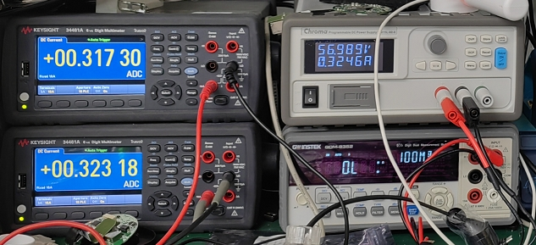
Power consumption
Based on the schematic，The power consumption of TPS28372-3 is large when the output is 15W. After removing the D703 TVS even，the power consumptions is about 5.8mA（323.18-317.3mA）still，the test point 323.18 is the input current，317.3mA is the current flows through L601, customer consider the difference of this two value is the consumption of TPS2372.
Can you help to analysis:
when the input is 57V, the load is 15W，Is it reasonable that the TPS2372-3 current consumption is 5.8mA?
If the schematic design is right?
Is there any way to reduce the consumption? The TPS2378 consumption is about 0.5A when customer use the same way to test.

