Slide 1
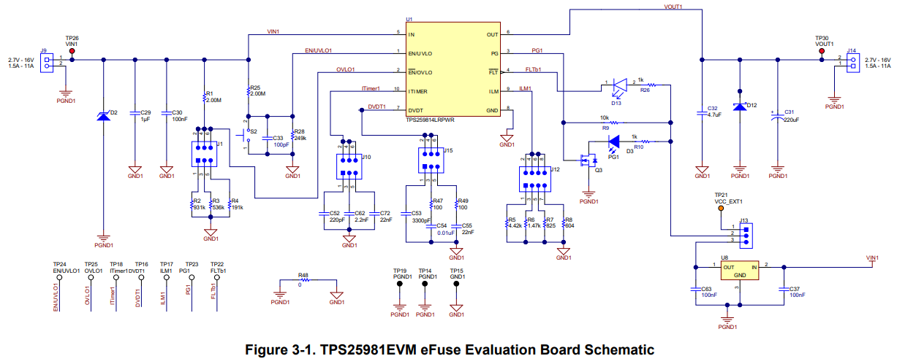

Customer changed some components on TPS25981EVM
J9：To power
J14：To load
R1：47kΩ
Short
VIN
Measurement
point
VOUT
Measurement point
OPEN
R4：10kΩ
C53：2200pF
R8：1.6kΩ
External SW

Slide 2
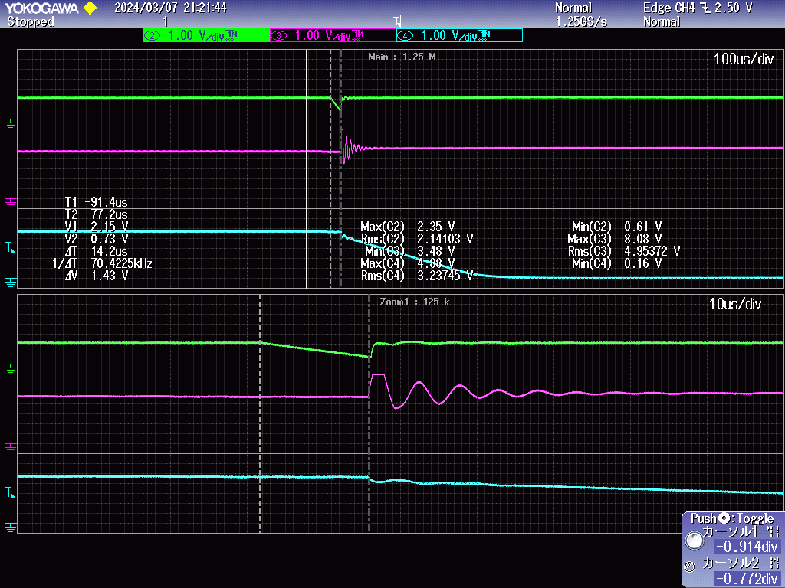
Vin: 5V, R_ILM:1.5kohm, ILIM:4.13A
ITIMER pin leave open
t_ITIMER: 14.2us
Question:
t_ITIMER is 14.2us when ITIMER pin open.
Is this result reasonable?

Slide 3
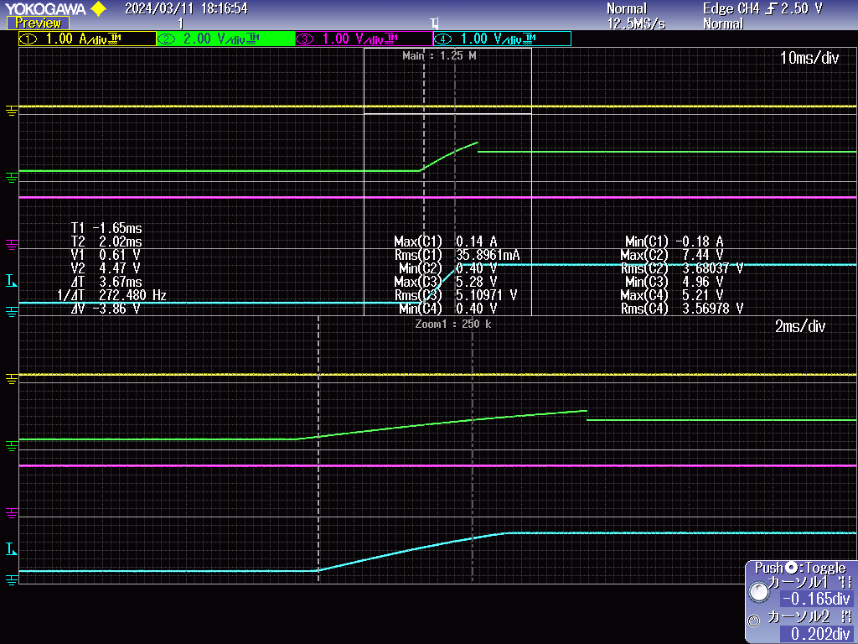

Vin: 5V, R_ILM:1.5kohm, ILIM:4.13A
Target slew rate: 1.5V/ms
From eq.4,
CdVdT(C53) :2200 pF
Result slew rate: 1.052 V/ms
Question:
Datasheet equation and results do not match.
Where are the factors?

Slide 4
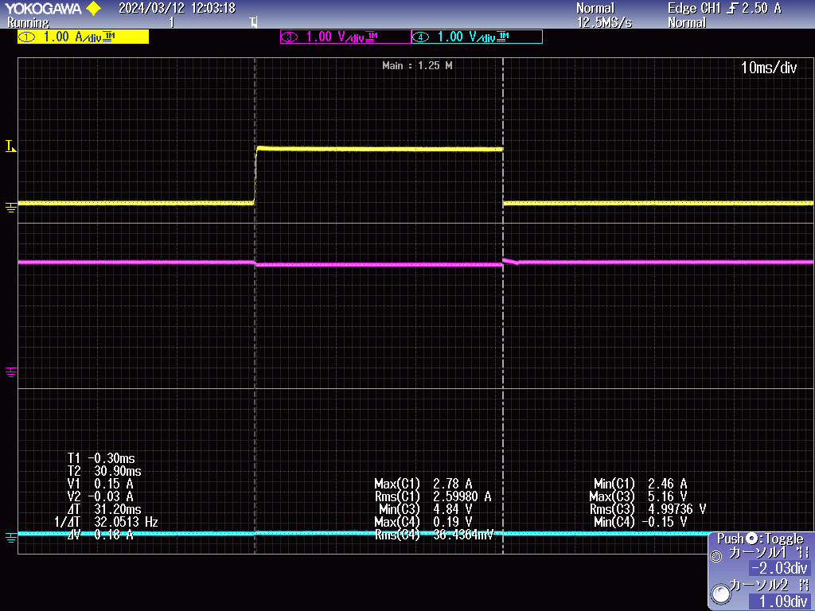
Vin: 5V, R_ILM:1.5kohm, ILIM:4.13A
Short VOUT with PGND
As a result,
Turn off current: 2.6A
Time to begin turn off: about 30ms
Question:
When short, the current which turn off start is smaller than ILIM.
And high current continue 30ms.
Is this result reasonable?

