Slide 1
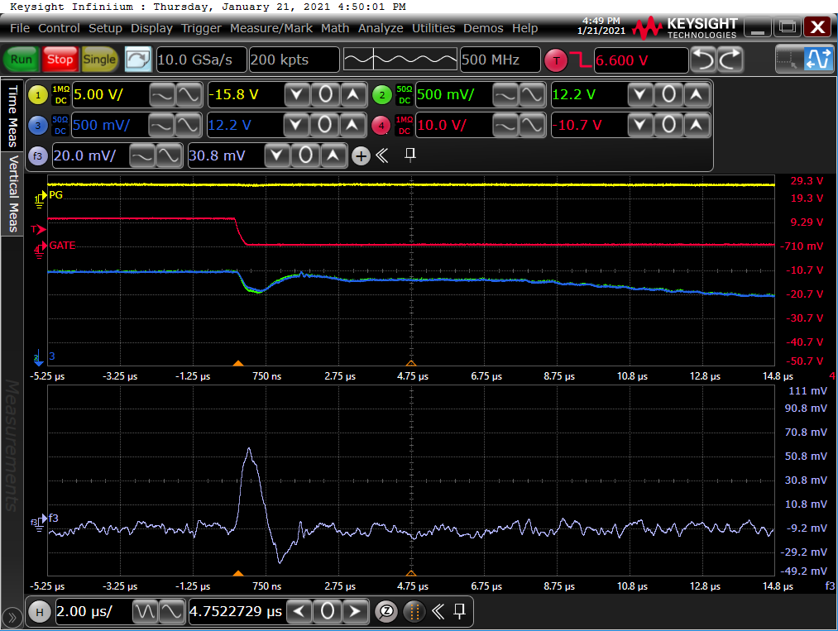
Case 1
Shout Down
ILIM=12.5A
ILIM x 2.1 = 30.4A
520ns
30.8A

Slide 2
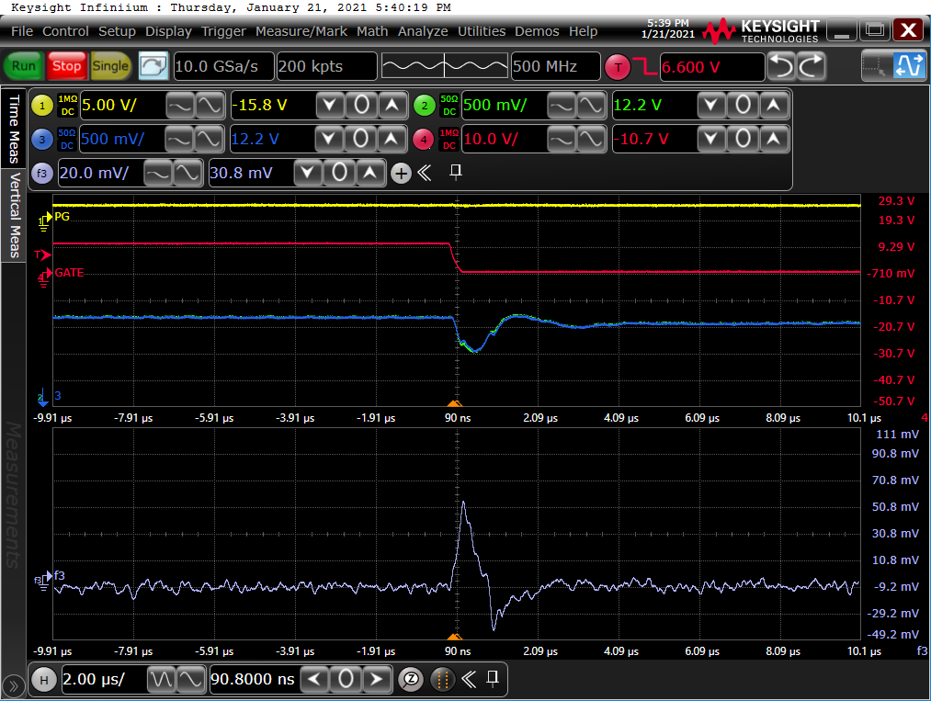
Case 2
Continuous work
ILIM=12.5A
ILIM x 2.1 = 30.4A
320ns
30.8A

