Slide 1
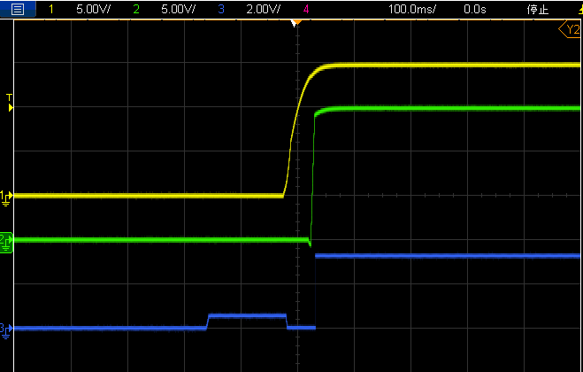
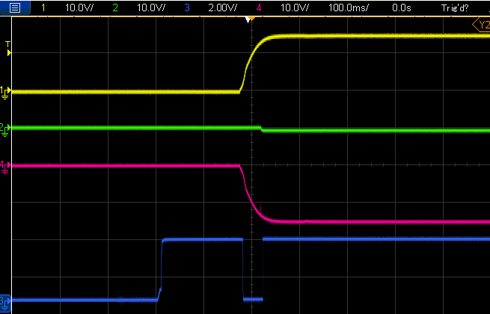
+15V
TPS26625
Load
-15V
LM5067-2
Normal Start up
+15Vin
TPS26625 OUT
-15Vin
TPS26625 Fault
Don’t Start Up but Fault is High

