Slide 1
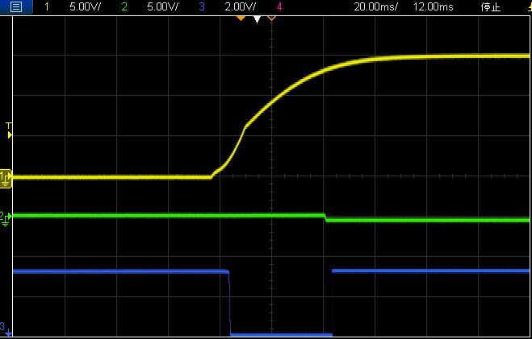
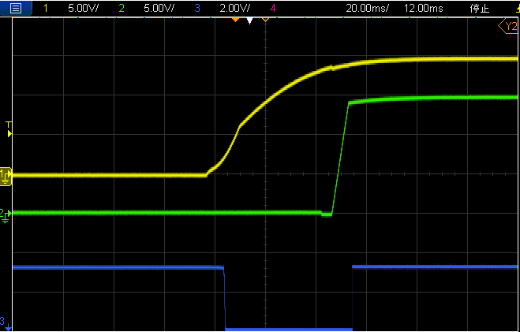
+15Vin
+15V
TPS26625
Load
-15V
TPS26625 OUT
LM5067-2
TPS26625 Fault
Don’t Start Up
+15V
TPS26625
Load
-15V
LM5067-2
Normal Start up

