Slide 1
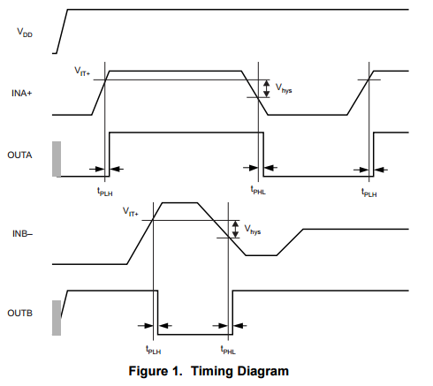
TPS3700-Q1 Timing Diagram
VIT- ?
Is VIT+ correct?
If yes, the VIT-(min) is not fixed.
The VIT-(min) is varied between 384mV~391.5mV.(“VIT+” – “Vhys”) For UV, the Timing diagram should refer the VIT- for worst case.

Slide 2
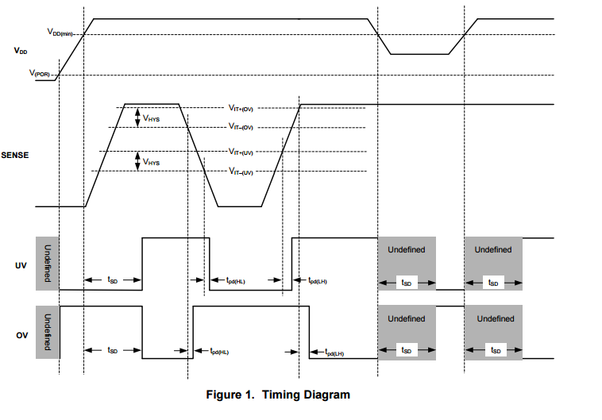
TPS3702-Q1 Timing Diagram

