Slide 1
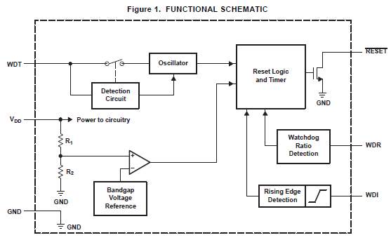
TPS3813I50QDBVRQ1
Vcc
Ru
Vdd
Q1
I accept resistance (Ru) between Vcc and Vdd and want to lower an MAX level of the reset threshold from 4.65V to 4.58V.
Because you want to find the value of the resistance level (Ru) by a calculation, let me confirm it how an electric current drifts to Vdd.
Therefore I need a min level of Idd.
Min : ??
Typ : 20uA
Max : 25uA
Q2
Please tell me Idd at Vdd=4.5V.
Please tell me Idd at Vdd=5.5V.

