Slide 1
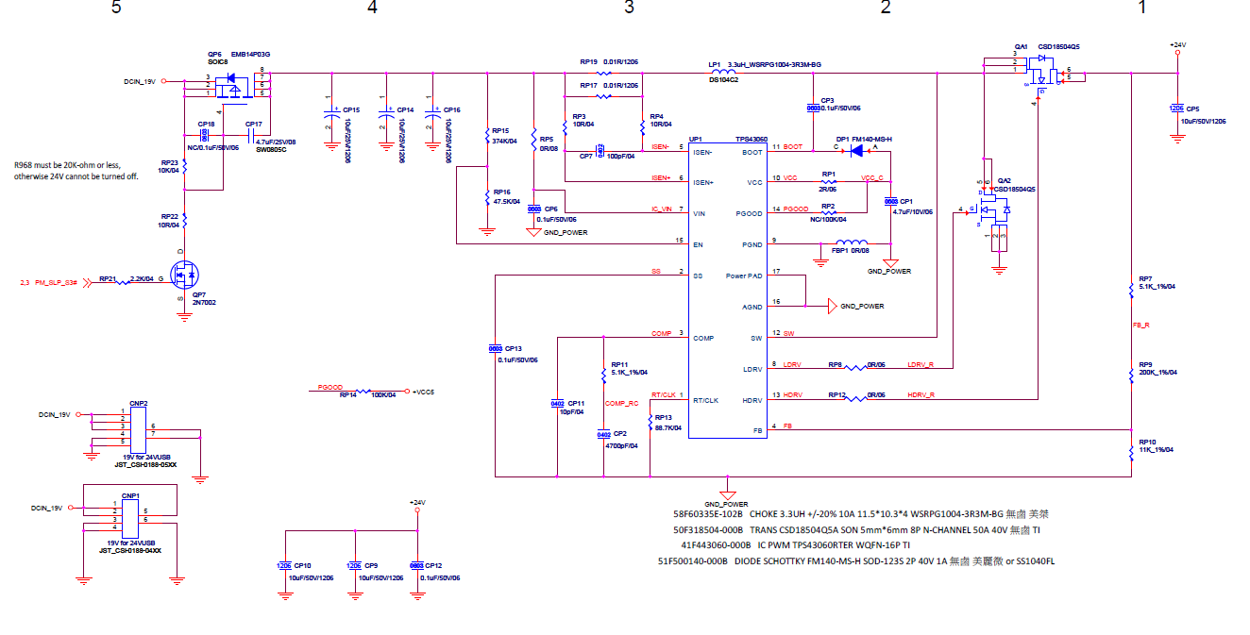
TPS43060
3.3uH
100uF
5.1K ohm
10pF
88.7K ohm
4700pF

Slide 2
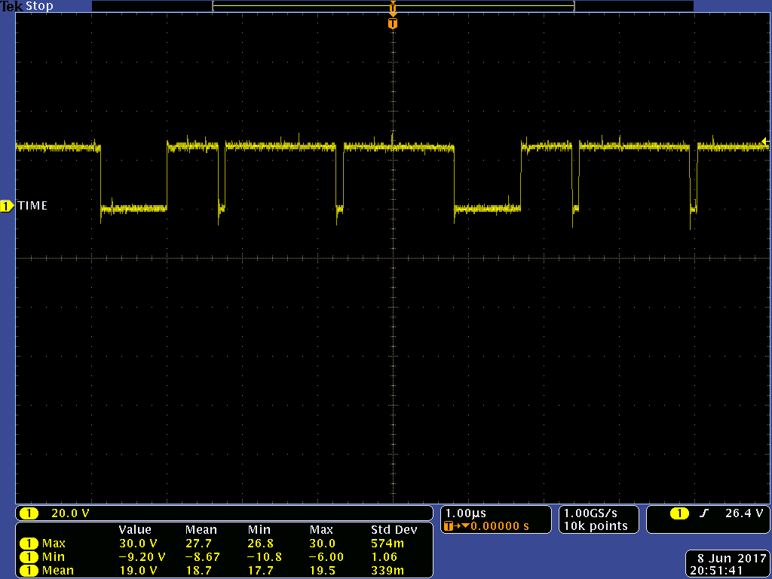
TPS43060

