Slide 1
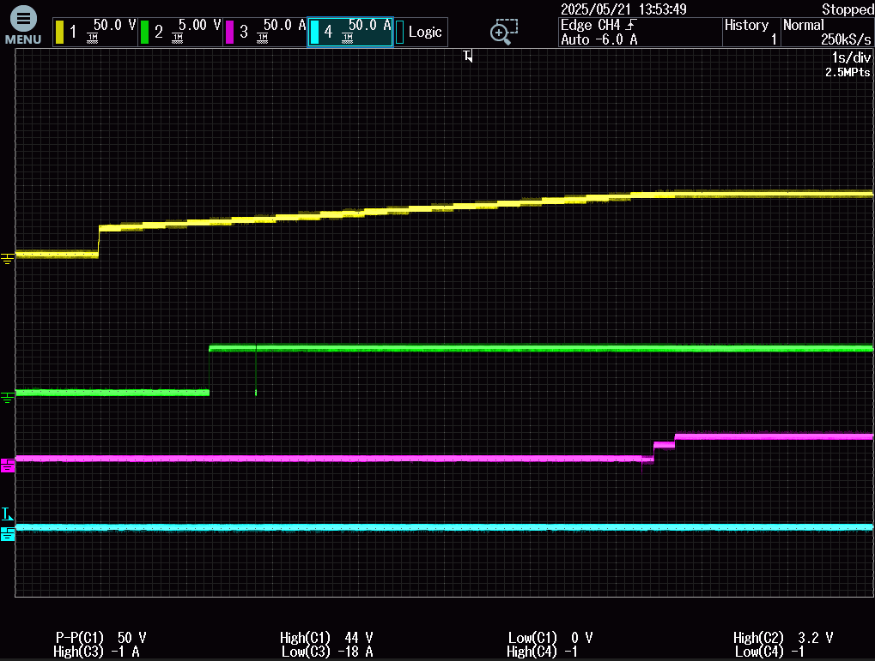
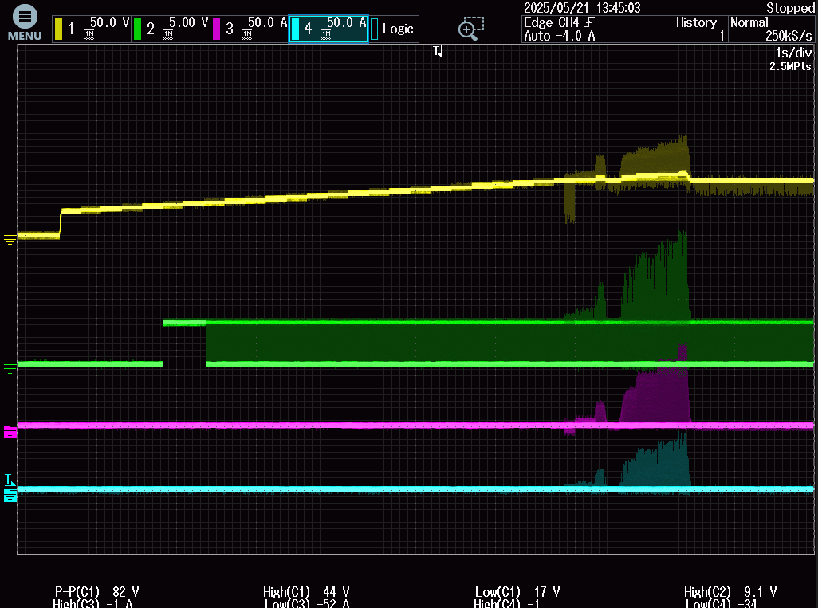
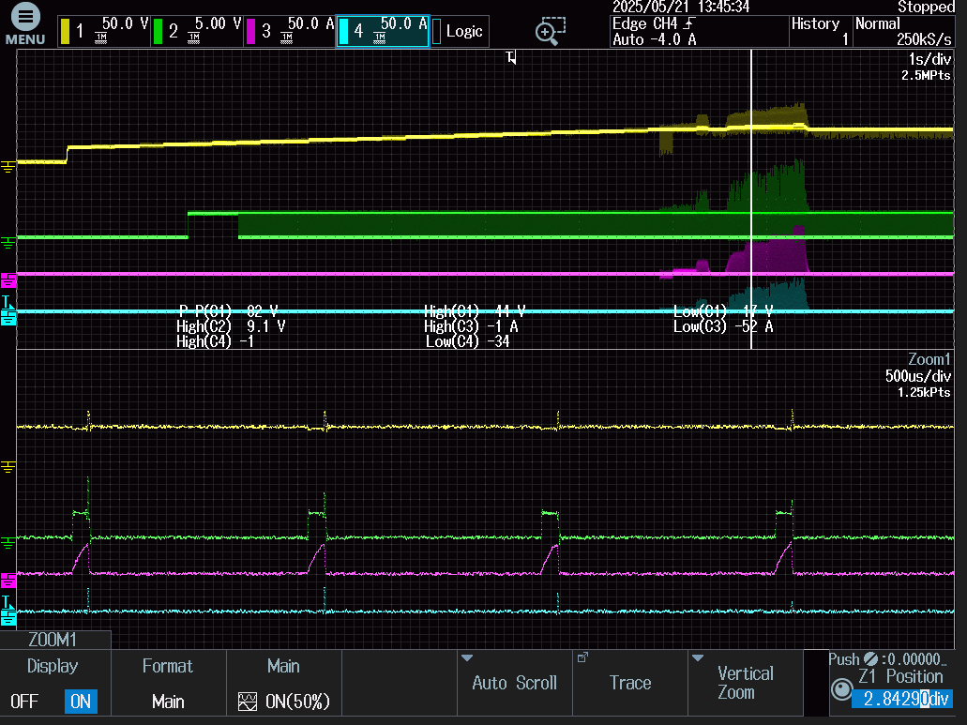
[Normal startup]
[NG, abnormal oscillation]
Vin:48V
FLT
Iin_current
Q> In abnormal case, FLT trigger during startup,
And it repeat continuously with 1.3ms period.
Below is zoom in waveforms.
After some seconds, whole device start to oscillation some IC burnt.
Ctmr=68nF, why FLT repeat 1.3ms period?
Would you please advise which should I check for more?
Q> Even normal startup, FLT triggered during startup. No fault condition found(looks not OC, not UV). Any possible reason?

