Slide 1
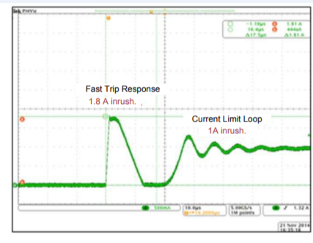
TPS4H000A-Q1
Less than 1us(typ)

