Slide 1

TPS51116 OCP Problem
The OCP is set at 9.159A as below equation and Excel worksheet.
When making OCP event with electronic load, IC is triggered till 16A.
VSM | Vtrip | Rtrip | Rds(on) | Vin | Vout | Fsw | L | Iripple | Iocp
 | 0.01 | 1000 | 0.0012 | 5 | 1.362 | 400000 | 0.0000015 | 1.651652 | 9.159159
Notes:
1

Slide 2
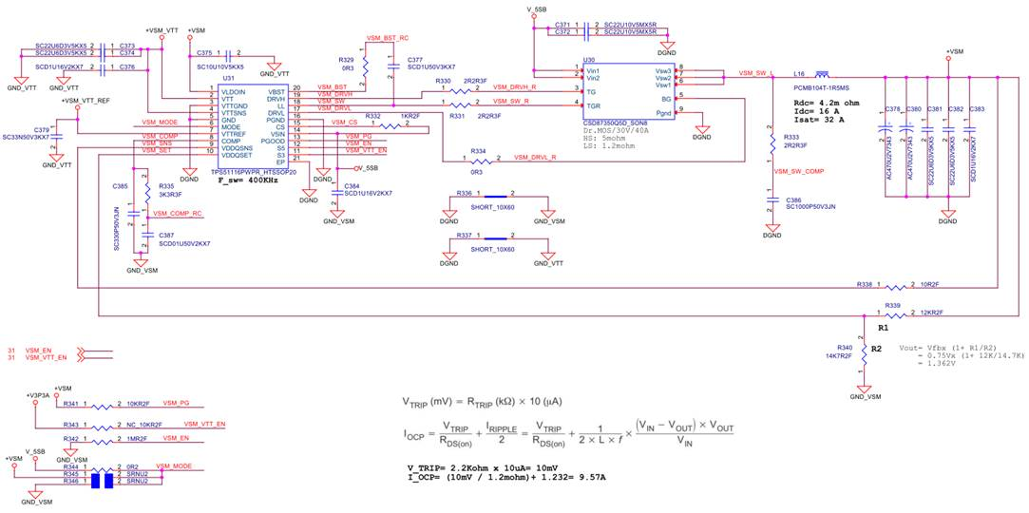
Schematic
Notes:
2

Slide 3
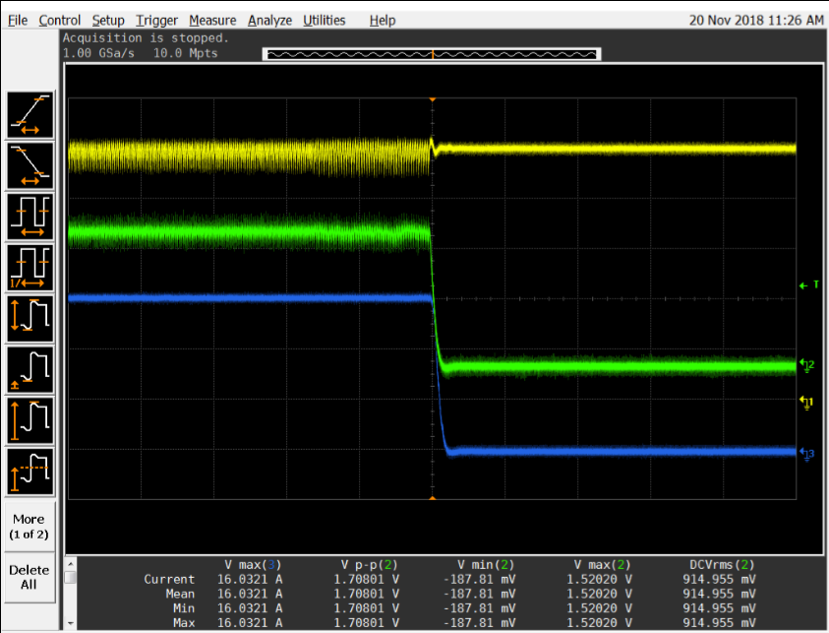
Measurement of the OCP point
The OCP trip point is 16A,
not at 9A?
+VSM (單位：V)
VIN nor |  | 5
Output Voltage | V_{NOR} | 1.35
 | V_{MAX} | 1.42
 | V_{Min} | 1.28
 | I max | 2.45
 | OCP | 9.57
 | OVP
Measure Results
Vin
Vout |  | 1.52V
I trip |  | 16A
 |  | Probe
CH1: | Vin | C372
CH2: | Vout | C382
CH3: | I load | C380
CH4:
Notes:
3

Slide 4
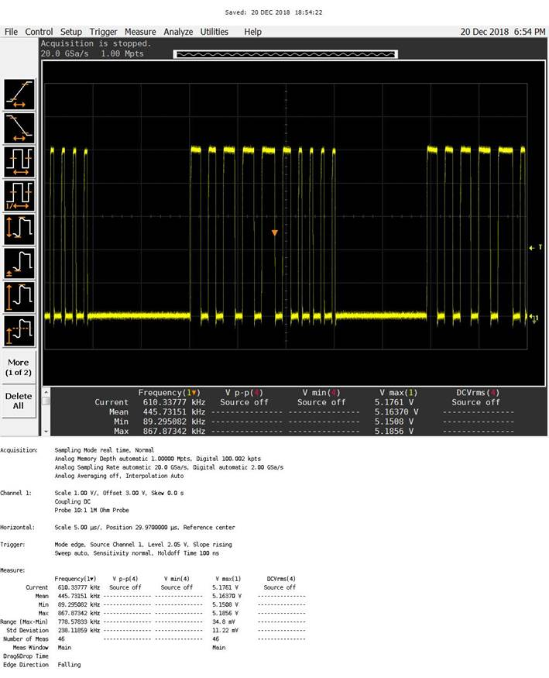
Waveform SW Node when load>2A
Is this waveform normal?
Notes:
4

Slide 5
Notes:
5

