Slide 1
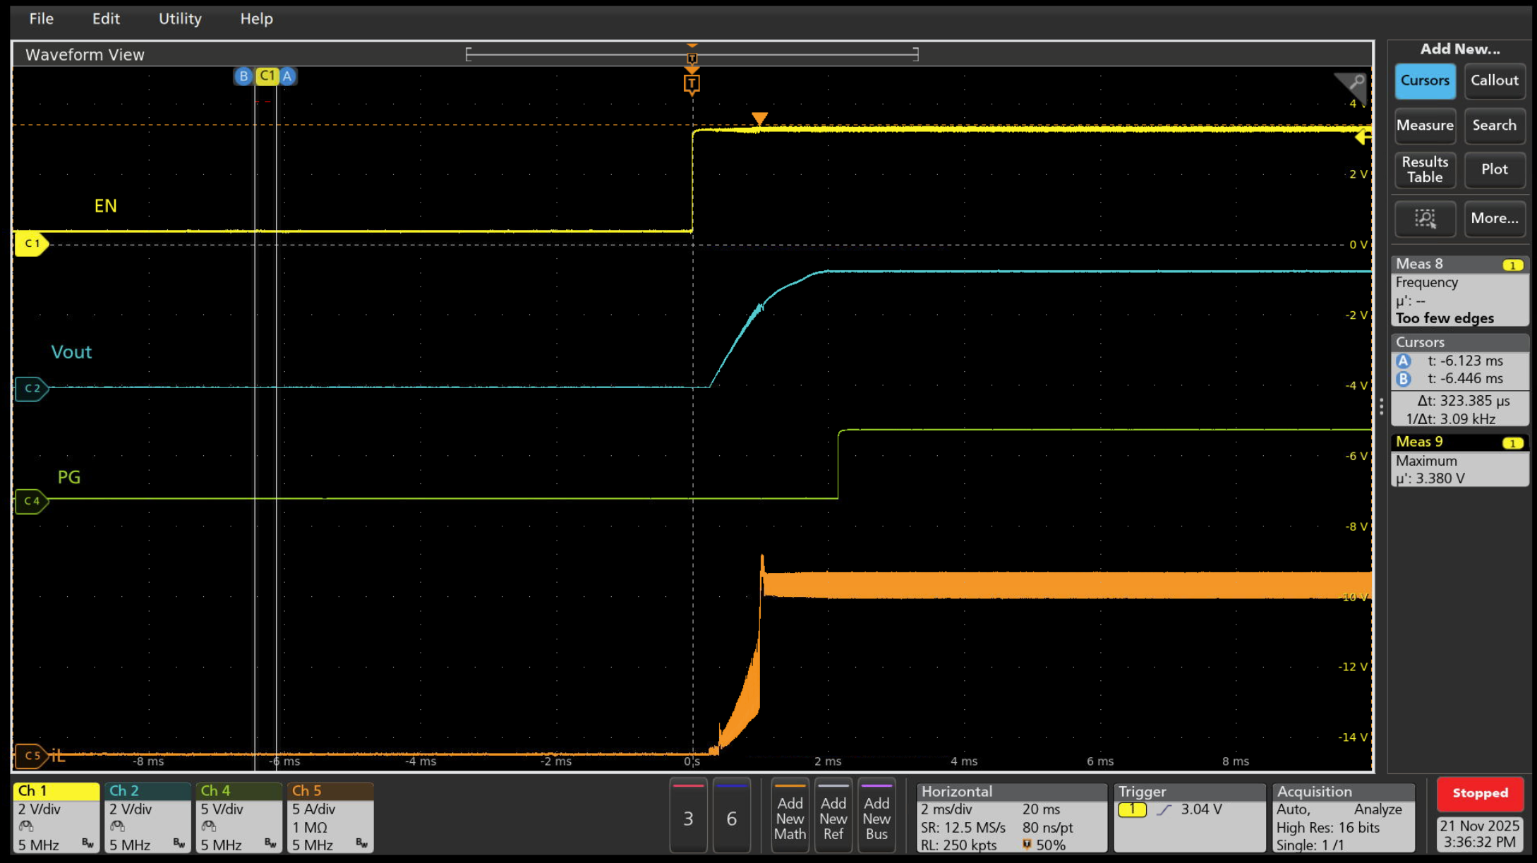
Startup through EN
Input = 12V, Vout = 3.3V, Iout = 12A

Slide 2
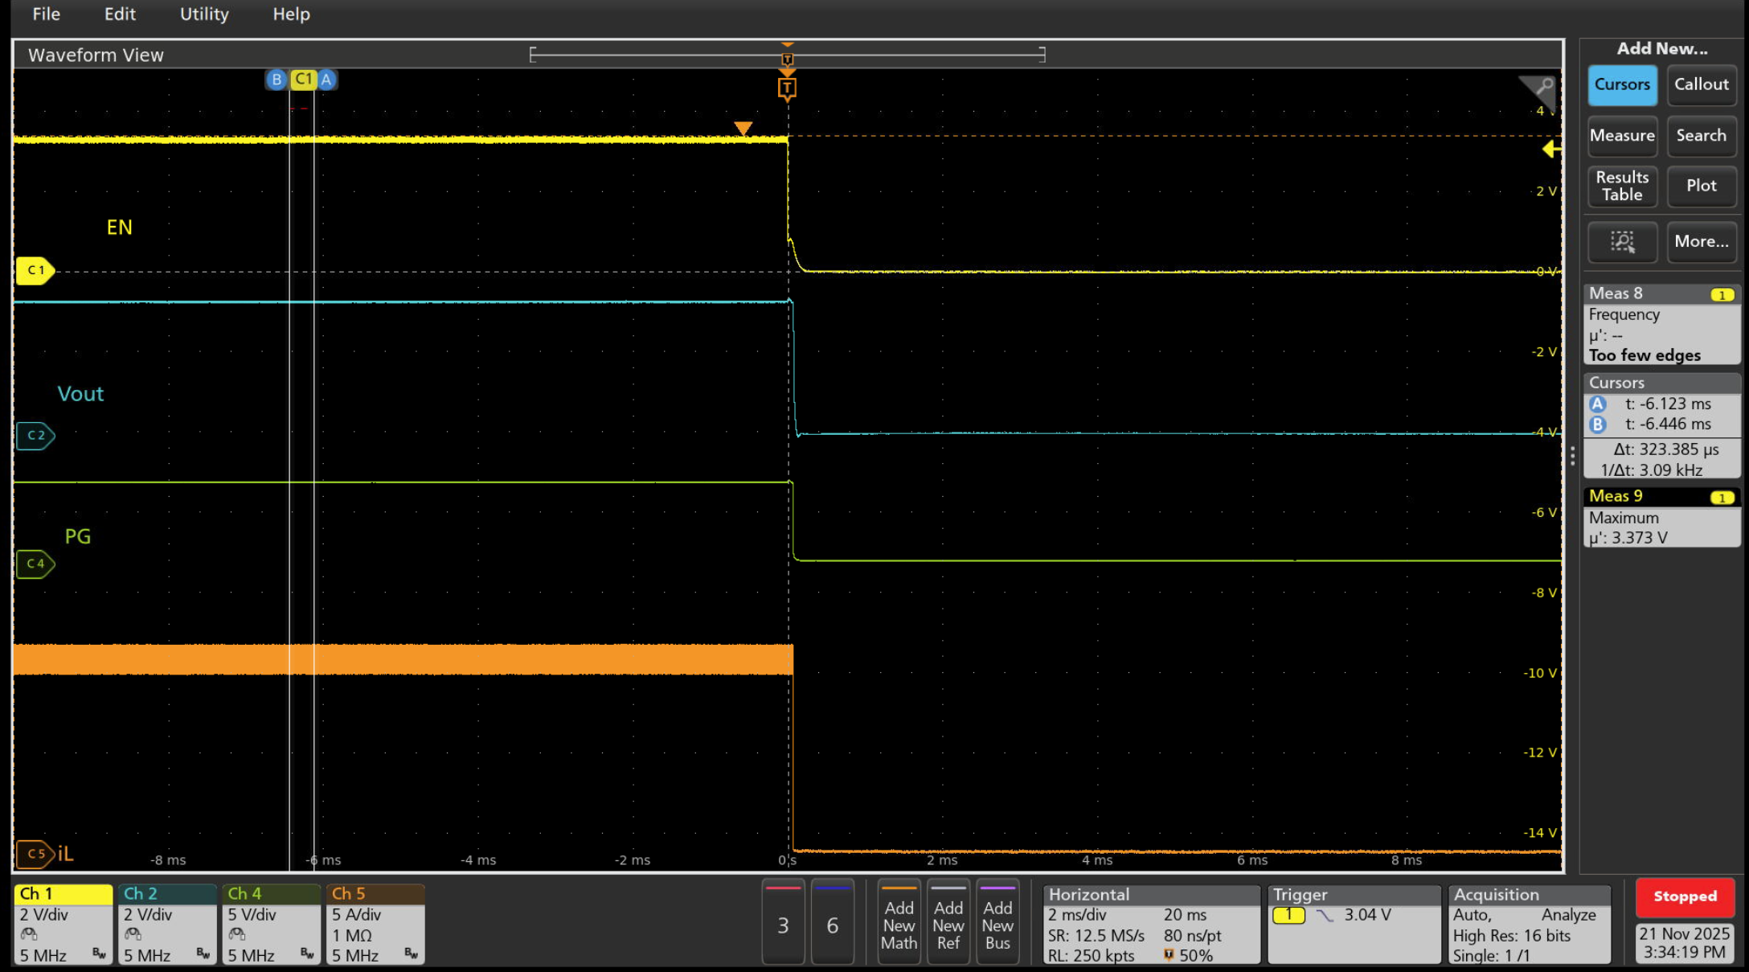
Shutdown through EN
Input = 12V, Vout = 3.3V, Iout = 12A

Slide 3
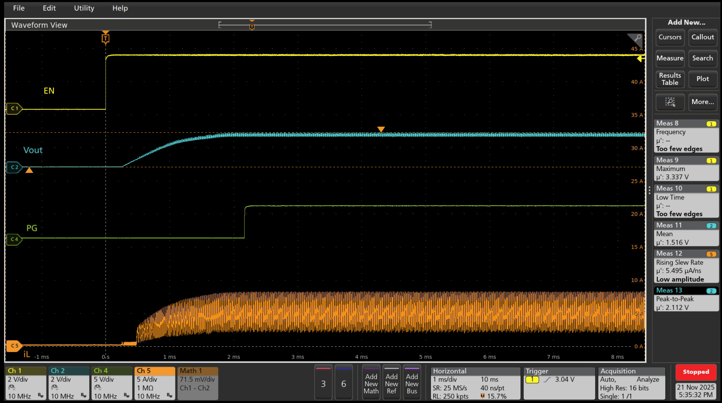
Startup through EN
Input = 12V, Vout = 1.8V, Iout = 12A

Slide 4
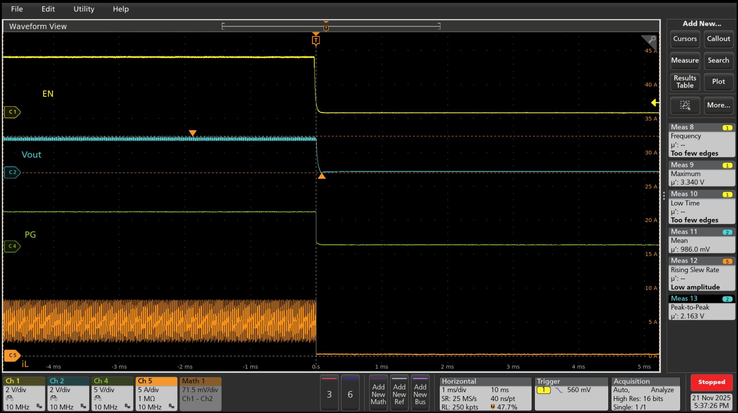
Shutdown through EN
Input = 12V, Vout = 1.8V, Iout = 12A

