Slide 1
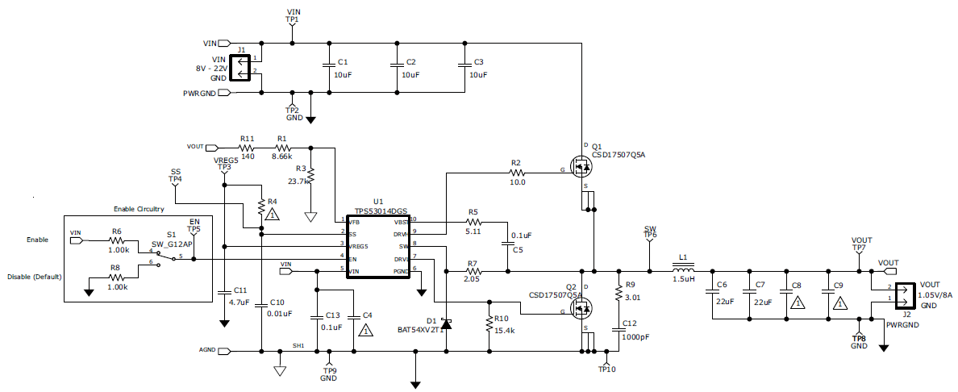
TPS53014 Original EVM
12Vin
1.05Vout, 1A

Slide 2
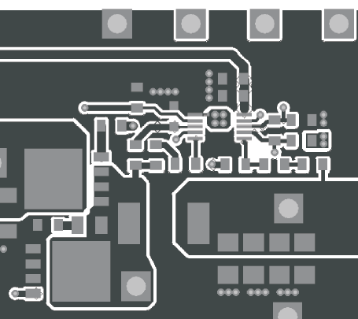
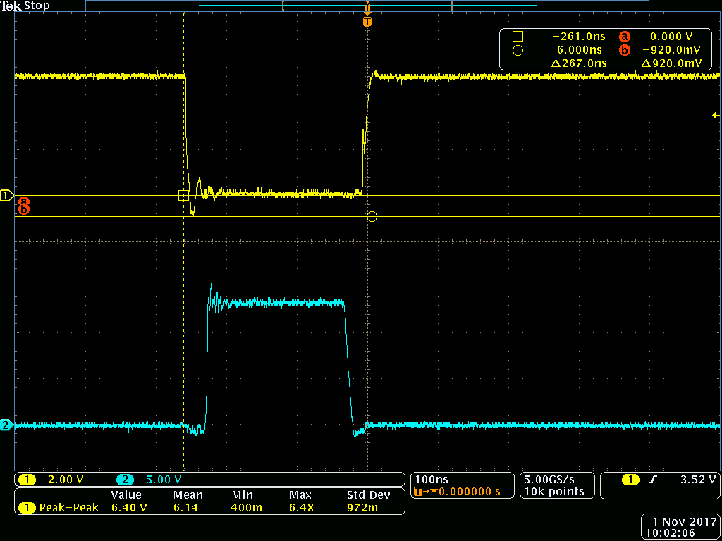
Under-shoot voltage at DRVL pin by Original EVM
Ch1: DRVL
Ch2: SW

Slide 3
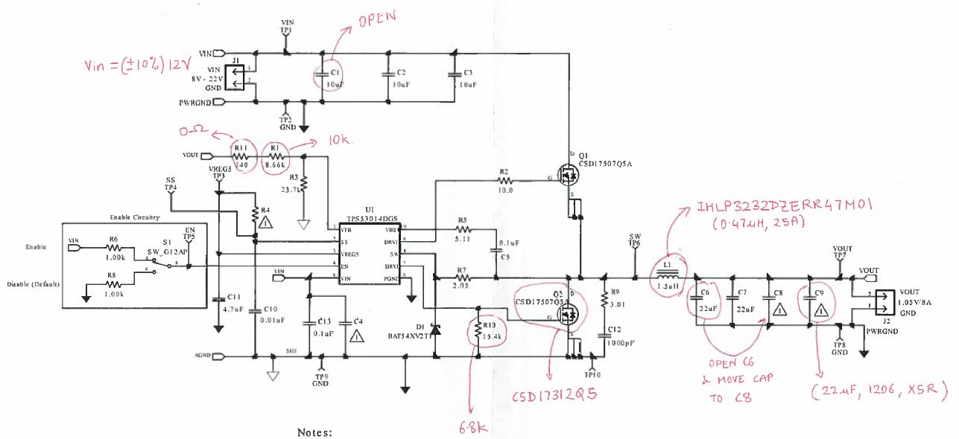
TPS53014 Custom EVM
12Vin
1.05Vout, 15A

Slide 4
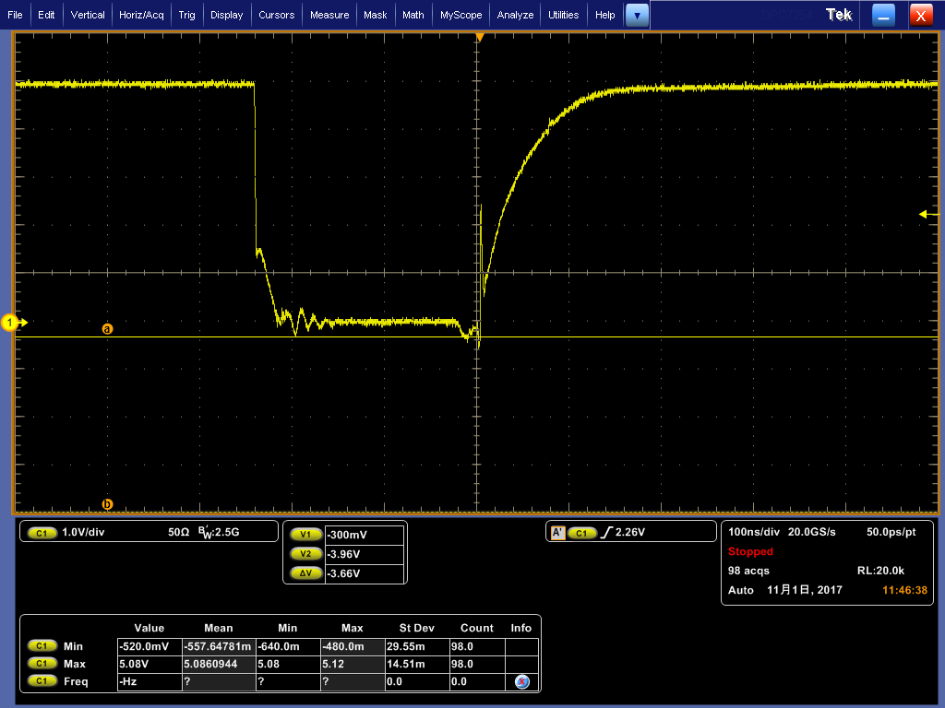
Under-shoot voltage at DRVL pin by Custom EVM
Ch1: DRVL

