Slide 1
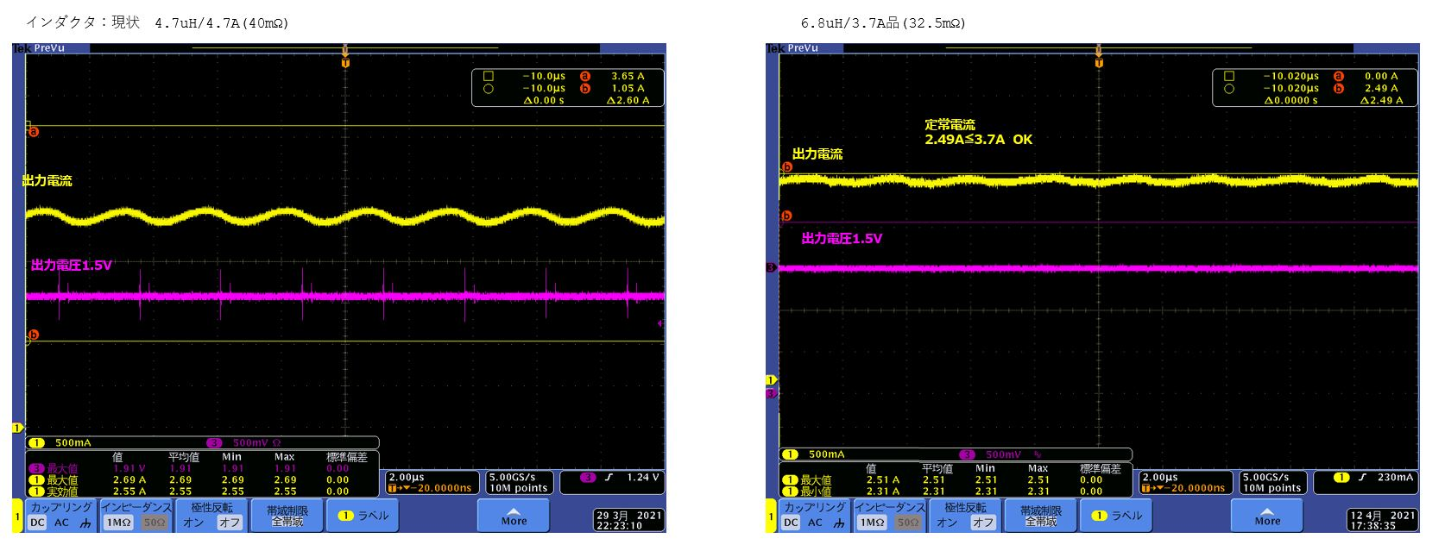
L: 4.7uH/4.7A(40mΩ)
L: 6.8uH/3.7A(32.5mΩ)
Iout average =2.49A
Iout
Iout
Vout : 1.5V
Vout : 1.5V

