Slide 1
TPS54120 Schematic/Layout Review
TI
11/14/2022

Slide 2
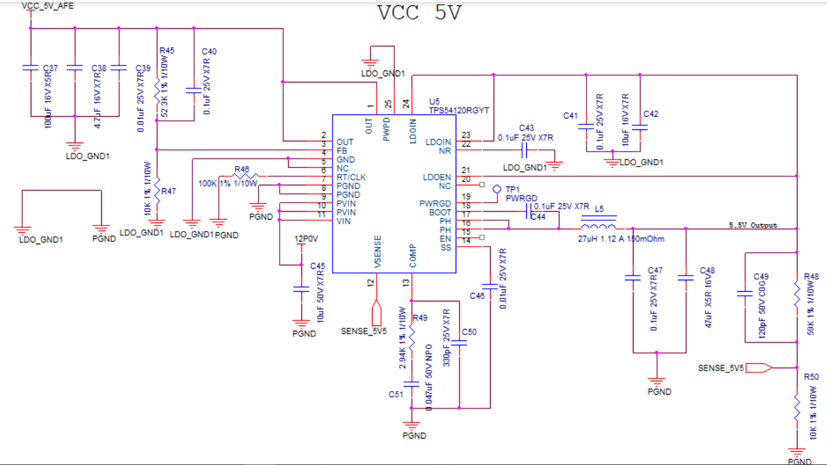
Schematic: Good

Slide 3
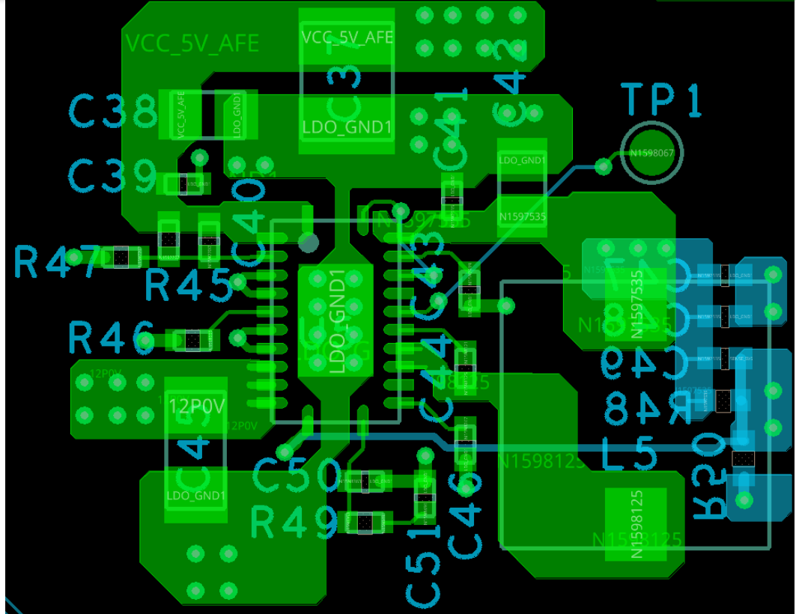
Layout: 1. Move feedback resistors R47/R45/C40 to the left side, place C38/C37/C39 close to pin, R45/C40 should be connected to Vin before the C37( for noise
filtering out), not directly on Vin pin(noisy without filtering)
2. Increase the width of GND copper from thermal pad to external to minimize the parasitic
3. Pin23/24 should be connected together solid (remove that via). Move C42 closer to the left
4. Move C43 GND outside inductor.
5. Move C46/C51/C50/R49 to the left side to keep away from switching node
6. Move R46 upper left. Rotate C45 180Deg and connect C45 GND directly on the PGND pin3. Delete that GND copper near SENSE /COMP pin
7. Make sure LDO_GND1 and PGND connect together properly.
C37
C38/C39

