Slide 1
TPS54122 Test
Index
EVM Setting
Resistor Setting
Test Setting
Test Result
2017-03-30
Sanghee Byun / Advanced Research Team

Slide 2
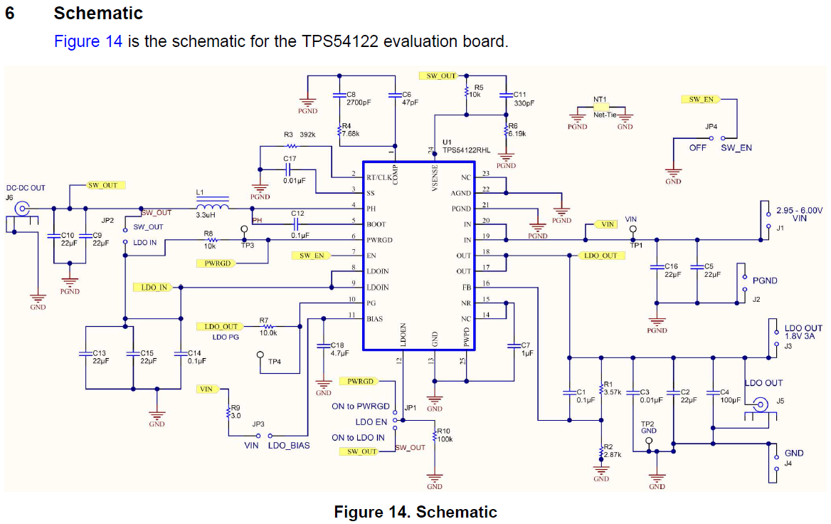
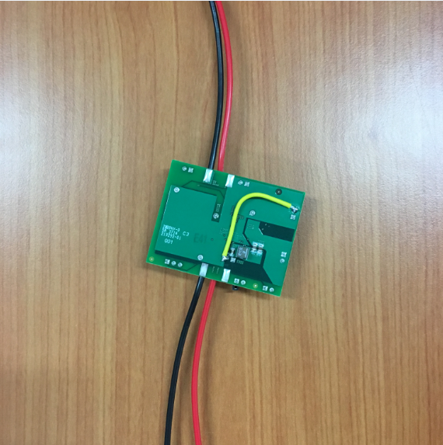
EVM Setting
1.
2.
1.
3.
1. VIN - LDO IN Direct Connecting (VIN = 5V, JP2 : OFF)
2. JP4 : OFF, OFF-SW_EN Non Connecting
3. JP3 : VIN-LDO_BIAS Connecting

Slide 3
Resistor Setting
1. SW OUT Resistor Set
2. LDO OUT Resistor Set
SW OUT : 1.2V
R4 | R5 | R6
12.7K | 10K | 22.1K
LDO OUT : 3.3V
R1 | R2
10K | 3.2K

Slide 4
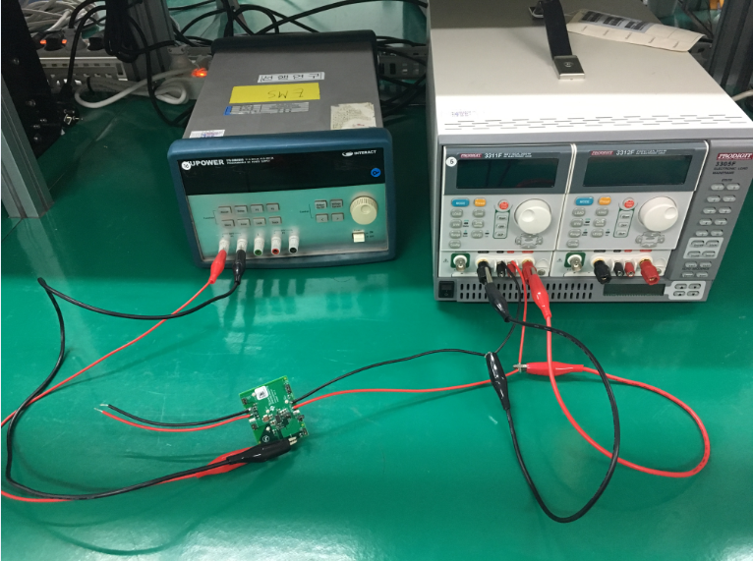
Test Setting
0.1~3A Load
VIN : 5V INPUT
SW OUT
LDO OUT

Slide 5
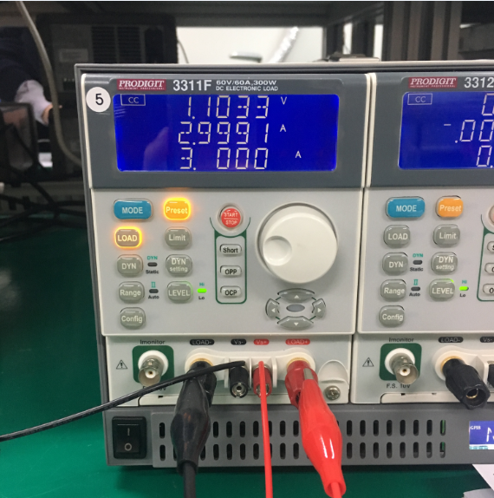
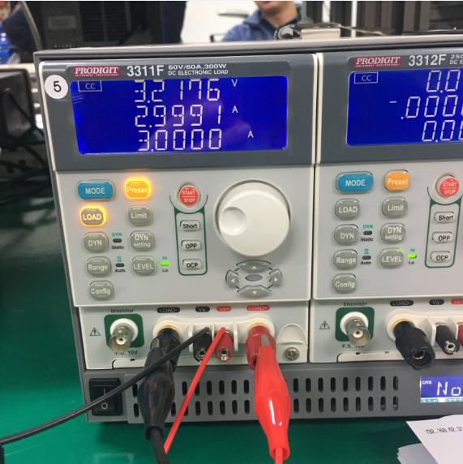
Test Result
Test No. | Load Current (A) | SW OUT (V) | LDO OUT (V)
1 | No load | 3.3167 | 1.1959
2 | 0.1 | 3.2873 | 1.1929
3 | 0.5 | 3.2783 | 1.1803
4 | 1 | 3.2674 | 1.1647
5 | 1.5 | 3.2566 | 1.1494
6 | 2 | 3.2441 | 1.1341
7 | 2.5 | 3.2323 | 1.1186
8 | 3 | 3.218 | 1.1033
Test – 8 : SW OUT
Test – 8 : LDO OUT

