Slide 1
TPS54340 VOUT DROPOUT ISSUE
01/12/2017

Slide 2
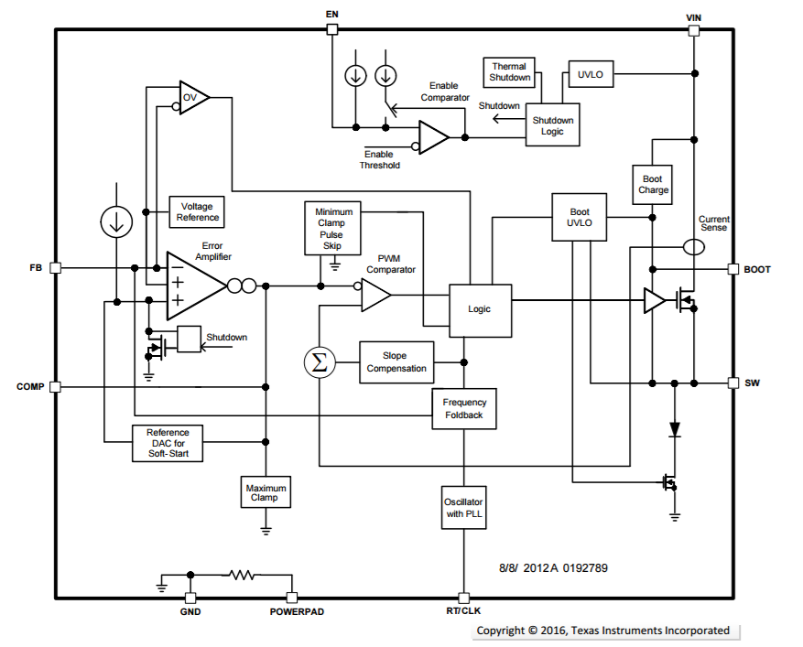
TPS54340 FUNCTIONAL DIAGRAM
INT_SS DAC circuitry + COMP pin maximum clamp

Slide 3
TPS54340 INTERNAL SS CIRCUITRY BLOCK DIAGRAM (REPRESENTATIVE – NOT ACTUAL CIRCUITRY)
Internal SS voltage is ramped up by stepping up an internal resistor divider network tap points that steps up to ~1.6V maximum voltage.
The step size for each resistor tap point is ~30mV.
A digital counter counts at fsw/32 frequency when internal SS voltage needs to be stepped up.
At the rising edge of “SS_DAC_UP_DOWN_CLK” the voltage on “INT_SS” is stepped up to the next resistor tap point.
“DOWN_COUNT” detects the external COMP_PIN voltage being clamped by TPS54340 IC.
When COMP_PIN voltage is clamped the DOWN_COUNT=1 which initiates “INT_SS” voltage being stepped down.
This is accomplished by stepping down on the resistor divider at the “SYSTEM_CLK” frequency fsw.
“SYSTEM_CLK” frequency is the same as the external frequency set by either RT pin resistor or CLK on RT pin.

Slide 4
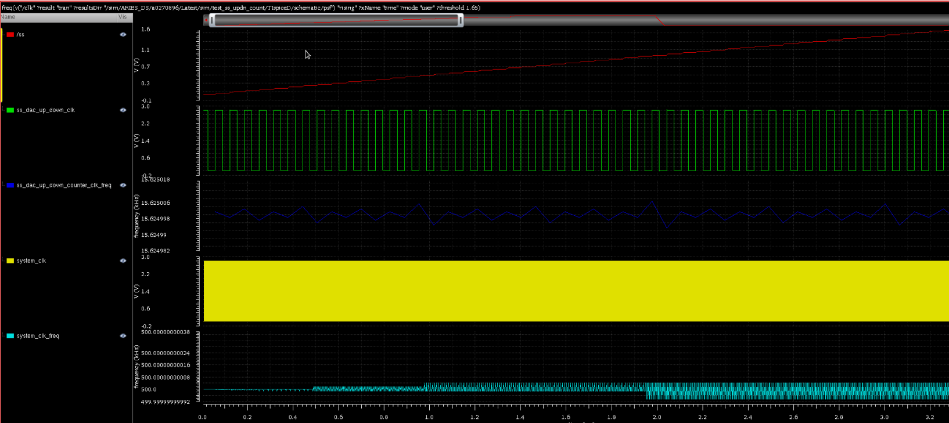
TPS54340 INTERNAL SS DAC UP COUNT SIM
Block level SS DAC simulation showing SS DAC counting UP.
Count UP is at fsw/32 frequency.
Fsw=500KHz in the above simulation.

Slide 5
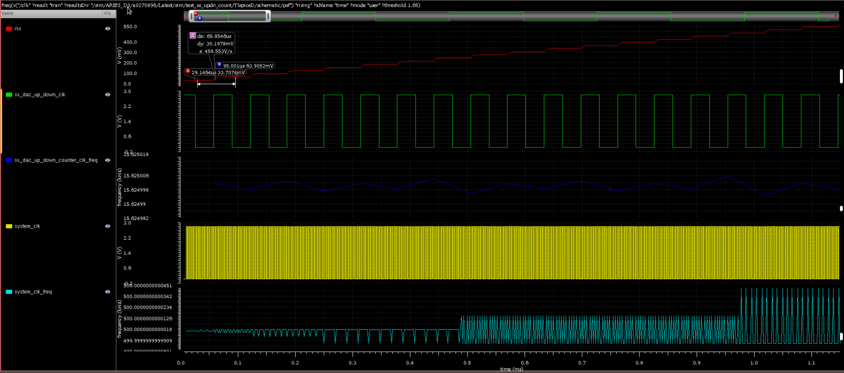
TPS54340 INTERNAL SS DAC UP COUNT SIM ZOOMED IN
System_CLK is running at 500 KHz frequency.
SS_DAC_UP_DOWN_CLK is running at 15.625 KHz frequency (500 KHz/32).
At the rising edge of SS_DAC_UP_DOWN_CLK the DAC voltage is stepped up by ~30mV.

Slide 6
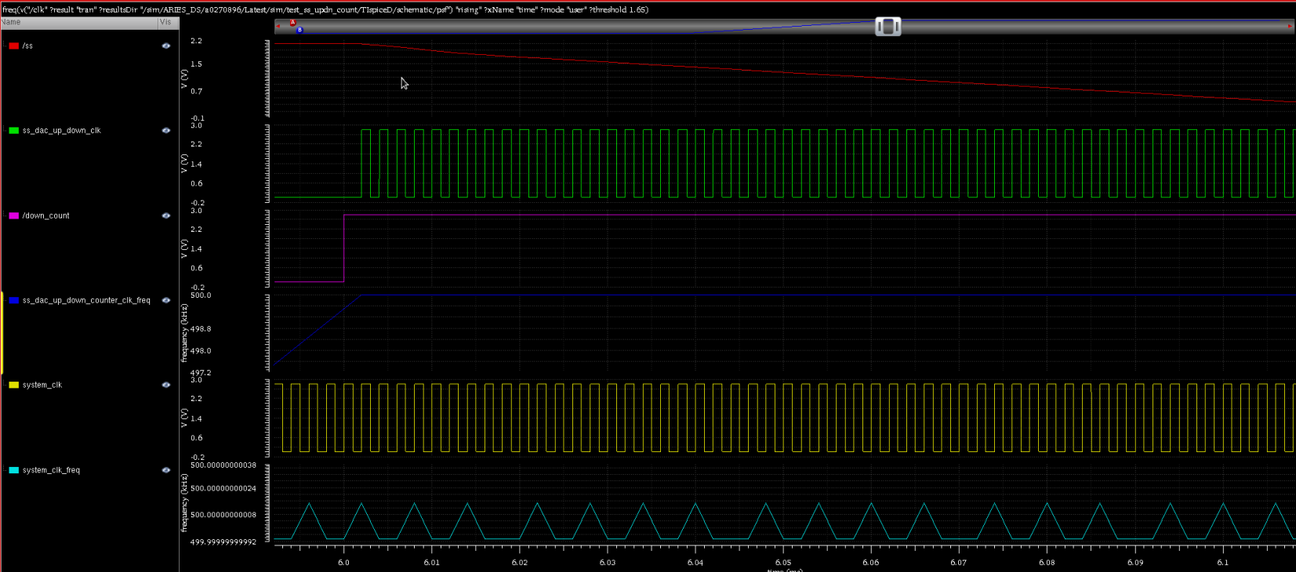
TPS54340 INTERNAL SS DAC DOWN COUNT SIM
Block level SS DAC simulation showing SS DAC counting DOWN.
Count DOWN is at fsw frequency.
Fsw=500KHz in the above simulation.

Slide 7
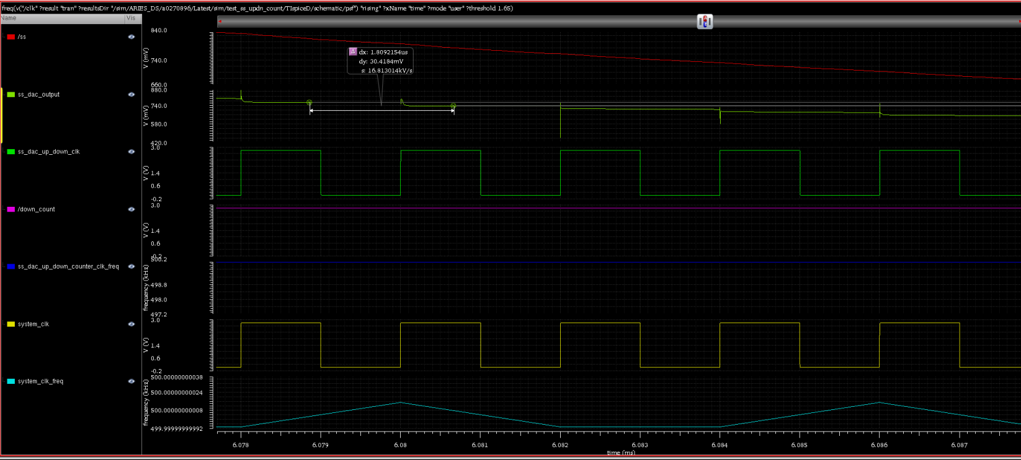
TPS54340 INTERNAL SS DAC DOWN COUNT SIM ZOOMED IN
System_CLK is running at 500 KHz frequency.
SS_DAC_UP_DOWN_CLK is running at 500 KHz frequency.
At the rising edge of SS_DAC_UP_DOWN_CLK the DAC voltage is stepped down by ~30mV.
“SS” voltage looks smooth because of the RC filter at the output of the SS_DAC circuitry.

Slide 8
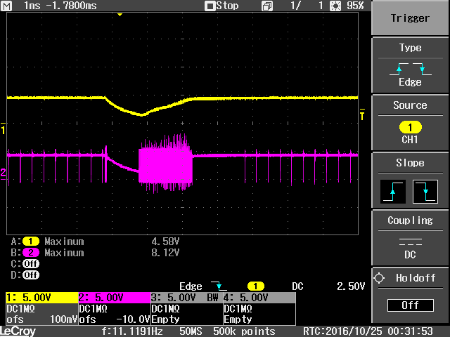
TPS54340 VOUT DROPOUT ISSUE
TPS54340 EVM design
VIN=5.1V
VOUT=5V
RLOAD=7Ω
CH1: VOUT
CH2: PH
VOUT drops by >1V when VIN gets to within a few 100mVs of VOUT.

Slide 9
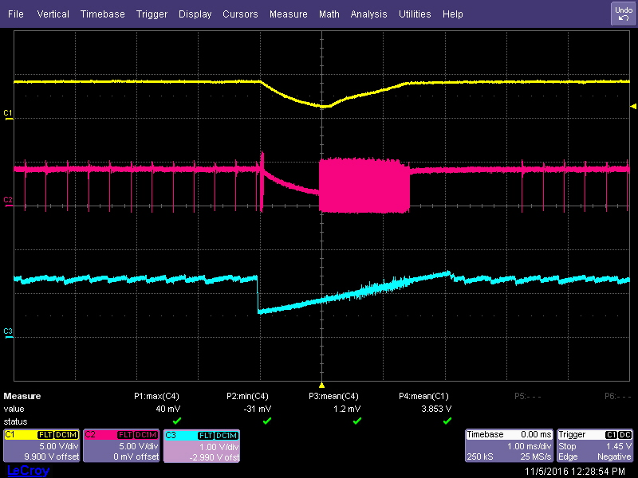
TPS54340 INTERNAL SS PROBING BY FA
TPS54340 EVM design
VIN=5.1V
VOUT=5V
RLOAD=7Ω
CH1: VOUT
CH2: PH
CH3: INT. SS
Internal SS (CH3) is pulled down incorrectly.
This causes FB voltage which was regulating close to ~0.8V (internal reference nominally) to be pulled down to within a few mVs of internal SS voltage.
Root cause of VOUT getting pulled down incorrectly is internal SS voltage being pulled down.

Slide 10
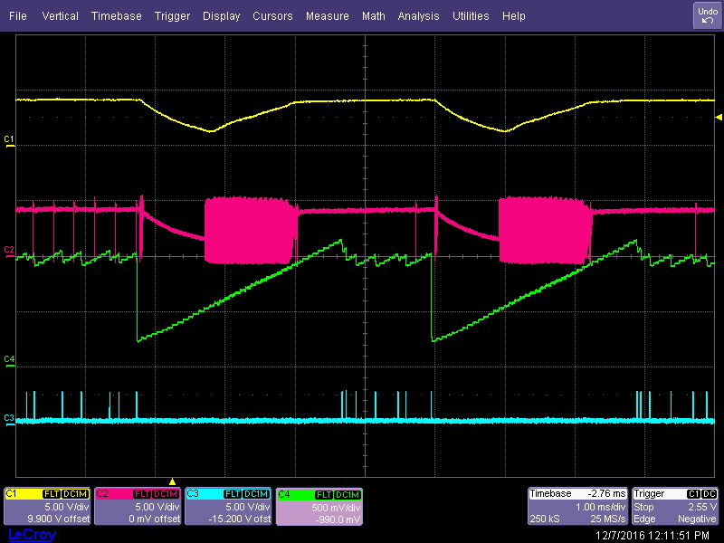
TPS54340 VOUT DROPOUT INTERNAL SS PROBE
VOUT in drop out <5V regulation voltage
TPS54340 EVM design
VIN=5.1V
VOUT=5V
RLOAD=7Ω
CH1: VOUT
CH2: PH
CH3: DOWN_COUNT
CH4: INT_SS

Slide 11
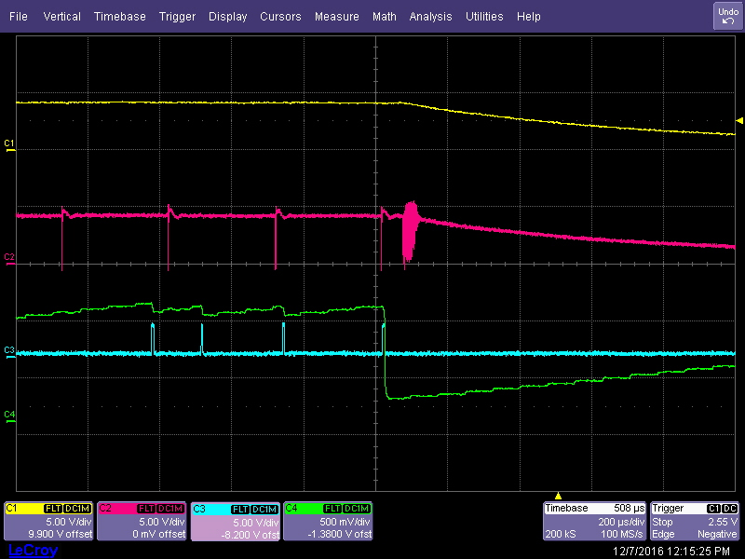
TPS54340 “INT_SS” “DOWN_COUNT” internal probing zoomed in
TPS54340 EVM design
VIN=5.1V
VOUT=5V
RLOAD=7Ω
CH1: VOUT
CH2: PH
CH3: DOWN_COUNT
CH4: INT_SS
6
5
“DOWN_COUNT” =1 when IC is clamping COMP pin voltage.
In the above scenario IC is clamping COMP pin voltage because VOUT is in drop out which means VFB<0.8V (internal reference voltage). This causes the error amplifier to pull COMP pin voltage high.
From the above waveform, when DOWN_COUNT=0 INT_SS voltage is stepped up by SS_DAC circuitry.
When DOWN_COUNT=1 INT_SS voltage is stepped down.
In the image above the first three instances of DOWN_COUNT going high results in correct operation. INT_SS voltage is stepped down in ~30mV steps at the down count clock frequency.
The fourth instance of DOWN_COUNT going high results in incorrect operation where INT_SS voltage steps down by ~800mV.

Slide 12
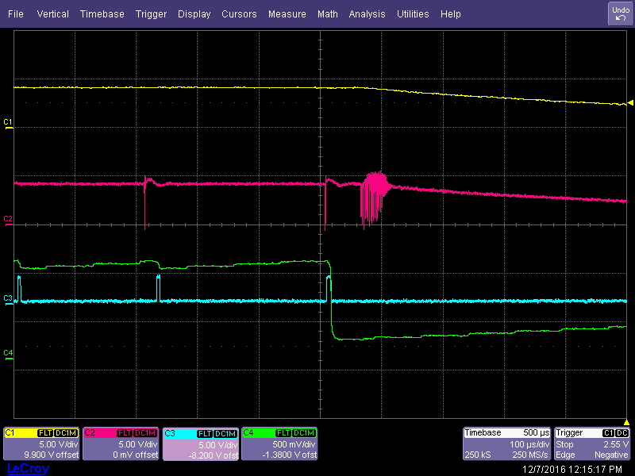
TPS54340 “INT_SS” “DOWN_COUNT” internal probing zoomed in
TPS54340 EVM design
VIN=5.1V
VOUT=5V
RLOAD=7Ω
CH1: VOUT
CH2: PH
CH3: DOWN_COUNT
CH4: INT_SS
1
2,3
In the image above the first two instances of DOWN_COUNT going high results in correct operation. INT_SS voltage is stepped down in ~30mV steps at the down count clock frequency.
The third instance of DOWN_COUNT going high results INT_SS being stepped down correctly.
However at the falling edge of DOWN_COUNT INT_SS voltage steps down by ~800mV. This is incorrect operation. This results in FB voltage to follow INT_SS which causes VOUT to fall.

Slide 13
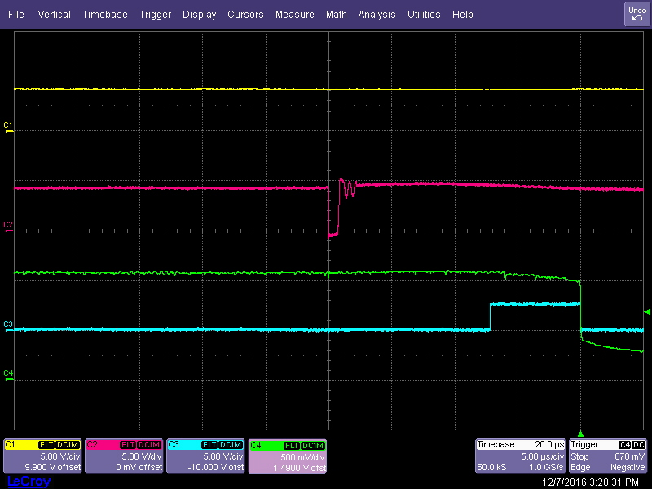
TPS54340 internal probing zoom in on last “DOWN_COUNT”
TPS54340 EVM design
VIN=5.1V
VOUT=5V
RLOAD=7Ω
CH1: VOUT
CH2: PH
CH3: DOWN_COUNT
CH4: INT_SS
1
2
In the image above at the rising edge of “DOWN_COUNT” “INT_SS” is stepped down.
At the falling edge of “DOWN_COUNT” “INT_SS” is pulled down by ~0.8V. Incorrect operation.

Slide 14
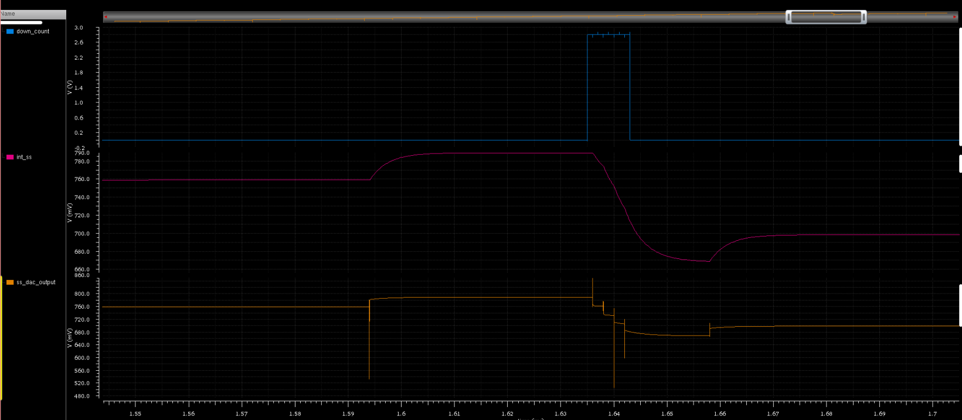
TPS54340 block level simulation with similar “DOWN_COUNT” pulse-width
Block level simulation with a ~7.5usec pulse-width signal on “DOWN_COUNT” does not show incorrect “INT_SS” operation.
When DOWN_COUNT=0 “INT_SS” up counts at fsw/32 frequency and then when DOWN_COUNT=1 “INT_SS” down counts at fsw frequency. For this simulation fsw=500 KHz.
At the falling edge of DOWN_COUNT in the simulation we do not see “INT_SS” step down by more than ~30mV.

Slide 15
TPS54340 VOUT FALSE DROP OUT ISSUE STATUS AND NEXT STEPS
STATUS
Internal SS voltage being pulled low incorrectly when the IC is in dropout. This results in VOUT being pulled low.
Multiple hi-lo transitions on “DOWN_COUNT” seems to be triggering incorrect operation on internal SS voltage.
“DOWN_COUNT” goes hi when IC is clamping external COMP pin voltage to a maximum value of ~1.8V.
TOP LEVEL simulation so far have not been able to reproduce customer issue or incorrect step down of internal SS voltage.
BLOCK LEVEL simulation of “SS_DAC” circuitry so far have not been able to reproduce incorrect internal SS operation.
NEXT STEPS
“SS_DAC” circuitry probing of internal nodes to find the signal(s) that could be causing incorrect operation of internal SS voltage.
Simulate BLOCK LEVEL “SS_DAC” circuit by exciting the circuit with the signal(s) from internal probing to verify hypothesis in simulation.
While internal probing of nodes is on-going running block level simulations with varying DOWN_COUNT negative edge w.r.t internal count bits to see if the incorrect “INT_SS” behavior can be simulated due to logic design.

Slide 16
TPS54340 UPDATE
Internal Probing of SS_DAC circuitry
“DOWN_COUNT” goes HI when external COMP pin voltage is clamped max by IC.
From previous probing of internal nodes we know that at the falling edge of “DOWN_COUNT” internal soft start votlage “INT_SS” gets reset to ~0mV.
FA has probed “SYSTEM_CLK” (slide #3) at the onset of the false “INT_SS” pull down.
18C pico probe with ~20fF of probe capacitance was used to probe “SYSTEM_CLK”.
Internal Probing sequence
Customer returned unit on TI EVM was used to verify this issue. Regulation VOUT~5.1V and Rload~1Ω.
VIN voltage was lowered from 5.4V to ~4.85V. At VIN~4.85V we observe false VOUT pull down.
From previous probing we know this is due to “INT_SS” getting falsely reset to ~0mV.
Probed “SYSTEM_CLK” to observe behavior of this signal during false “INT_SS” reset.
Probing “SYSTEM_CLK” with pico probe adds ~20fF of capacitance to this node.
Probing “SYSTEM_CLK” results in correct behavior where “INT_SS” does not get reset and VOUT does not drop. VOUT voltage continues to stay in drop out. Waveform of “SYSTEM_CLK” shown on next slide.
HYPOTHESIS:
Glitch on “SYSTEM_CLK” results in resetting internal soft start voltage to ~0mV.
When we probe this node we add capacitance to this node. This reduces the pulse-width of the glitch. This causes internal circuitry to not re-act to the glitch on “SYSTEM_CLK”.

Slide 17
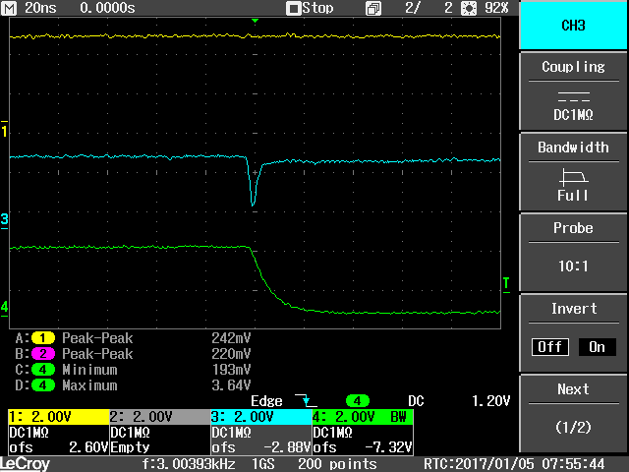
TPS54340 SYSTEM_CLK waveform
CH1: VOUT
CH3: SYSTEM_CLK
CH4:DOWN_COUNT

Slide 18
TPS54340 UPDATE
RECOMMENDATION
Internal SS_DAC circuitry incorrectly resets “INT_SS” voltage to ~0mV when “DOWN_COUNT”.
At the falling edge of “DOWN_COUNT” a glitch on “SYSTEM_CLK” results in “INT_SS” getting reset to ~0mV.
To stay away from this region of operation the following 2 conditions is recommended.
a) PH duty cycle <95%. This should include losses in the system due to HS rdson and output inductance resistance.
b) The “INT_SS” voltage signal can also incorrectly reset to 0 mV when operating at current limit. The external COMP pin voltage is clamped max by the IC when operating at current limit. If SS resetting when operating in current limit is an issue, the peak current should be kept below the 4.5 A minimum shown in the Electrical Characteristics table.
.

