Slide 1
TPS543C20 TPS543C20A TPS543B20 Schematic & Layout Checklist
Texas Instruments
BSR-MV HC
May 2021

Slide 2
Agenda
TPS543B20/C20/C20A Schematic Checklist
TPS543B20/C20/C20A Layout Checklist
Generic Best Practices for Schematics

Slide 3
TPS543C20 TPS543C20A TPS543B20 Schematic Checklist
BSR-MV HC
May 2021

Slide 4
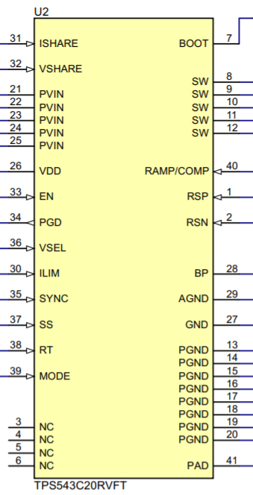
Schematic Overview
Click the box to go to the
corresponding pin

Slide 5
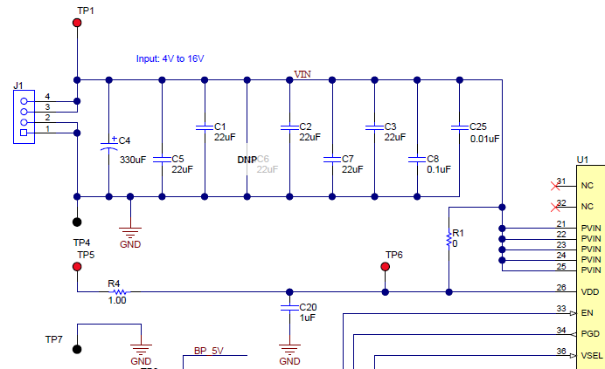
Schematic Notes: PVIN
Back to Schematic
 | Rail #1 | Rail #2 | Rail #3
A minimum of 2.2-µF input capacitance is required. Use 0402 capacitors with a rating of at least 25V. These capacitors are used to minimize high-frequency ringing and give minimum ripple voltage desired for the application. Use WEBENCH or calculator to calculate the input capacitance.
Include a 10nF-100nF 0402 input capacitor This capacitor minimizes high frequency voltage overshoots and undershoots from switching.

Slide 6
Schematic Notes: VDD
Back to Schematic
 | Rail #1 | Rail #2 | Rail #3
Use a 0Ω resistor to connect VCC to PVIN. This is the controller power supply input. This resistor is not needed if driving VDD with an external supply.
A high quality, ceramic, X5R/X7R decoupling capacitor of at least 1µF is required to reduce noise on the controller supply.

Slide 7
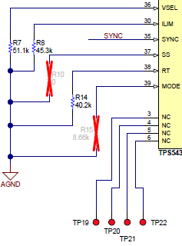
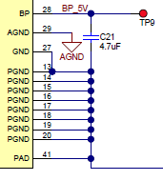
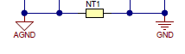
Schematic Notes: AGND
Back to Schematic
 | Rail #1 | Rail #2 | Rail #3
Use AGND for VSEL, ILIM, SS, RT, & MODE.. Use separate symbols for AGND and PGND.

Slide 8
Schematic Notes: GND/PGND/PAD
Back to Schematic
 | Rail #1 | Rail #2 | Rail #3
Ensure that GND, PGND, & PAD pins are connected together. DO NOT connect AGND directly to these pins.
Use PGND for PVIN, VDD, and output capacitors. Use separate symbols for AGND and PGND.

Slide 9
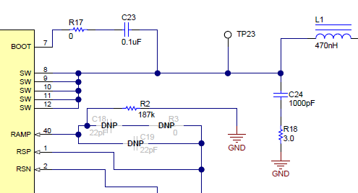
Schematic Notes: BOOT
Back to Schematic
 | Rail #1 | Rail #2 | Rail #3
Include a 0-2Ω resistor in series with the BOOT capacitor with an 0402 package size. Optional but highly recommended in case of SW overshoot issues.
Connect at least 100-nF capacitor from the BOOT pin to the SW pin, at least 25-V rated, X5R, and 0603 size. 10-V rating, X5R or better dielectric, and 0402 size or larger ensure stable capacitance across all operating conditions
9

Slide 10
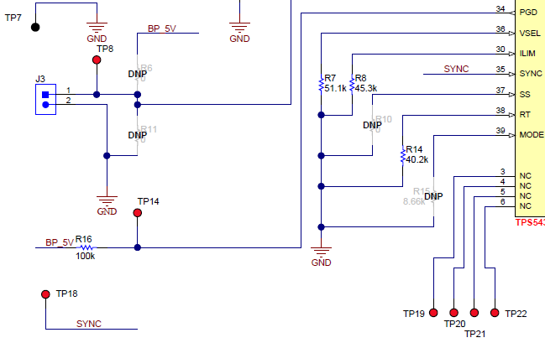
Schematic Notes: PGD
Back to Schematic
 | Rail #1 | Rail #2 | Rail #3
Have a 100k resistor connected between the pin to BP

Slide 11
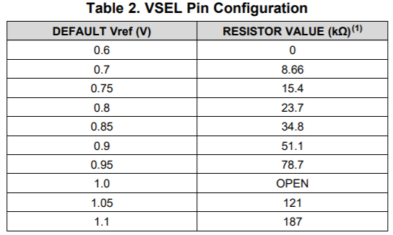
Schematic Notes: VSEL
Back to Schematic
 | Rail #1 | Rail #2 | Rail #3
VSEL is used to program the initial boot voltage value between 0.6V and 1.1V, based on the value of the resistor connected between VSEL and AGND. The table lists the different voltage options, and the corresponding resistor values.

Slide 12
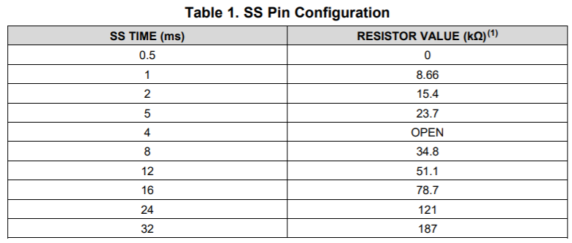
Schematic Notes: SS
Back to Schematic
 | Rail #1 | Rail #2 | Rail #3
If using the default soft-start time, add a placeholder for a resistor between SS pin to ground. If the inrush current is high and you want to add a soft-start time, shorting it to ground will not allow for necessary design changes later on.
Otherwise, use the table to determine the resistor value required for the chosen soft start time.

Slide 13
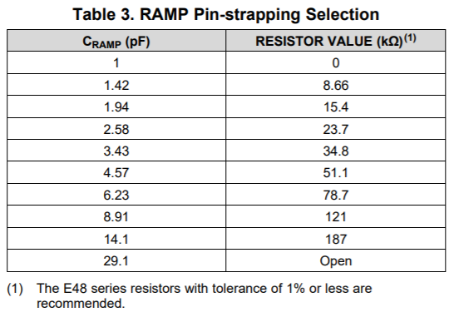
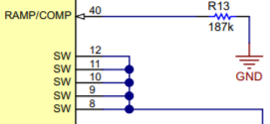
Schematic Notes: RAMP
Back to Schematic
 | Rail #1 | Rail #2 | Rail #3
The RAMP resistor sets the internal ramp capacitor, which in turn sets the internal ramp amplitude for the control loop. A higher ramp resistor will select a higher ramp capacitance and increase the bandwidth of the converter.
Determine which ramp capacitor to use by using the Excel Design Calculator Tool or WEBENCH. Consult WEBENCH for evaluating the impact of RAMP selection on phase margin and loop stability. The table to the right shows which resistor to select for a given ramp capacitor.
Notes:
The link to the tool is NOT functional, as the tool is currently not published. This will be fixed in a future revision of the presentation.

Slide 14
Schematic Notes: EN
Back to Schematic
 | Rail #1 | Rail #2 | Rail #3
The recommended max voltage on the EN pin is 5.5V. It cannot be connected to PVIN directly (unless PVIN max is below 5.5V) R6 and R11 are placeholders in the event that a resistor divider is used to set the EN voltage.

Slide 15
Schematic Notes: ILIM
Back to Schematic
 | Rail #1 | Rail #2 | Rail #3
The current limit is set by a resistor connected between ILIM and GND. Refer to this Excel calculator to determine the proper value for this resistor.

Slide 16
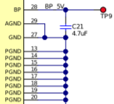
Schematic Notes: BP
Back to Schematic
 | Rail #1 | Rail #2 | Rail #3
This pin requires a minimum 2.2µF, 16V, X5R capacitor connected to GND. Do not use 10V rated capacitors. The DC bias loss of capacitance on a 10V cap operating at 5.1V output is severe and could compromise the stability of the LDO.

Slide 17
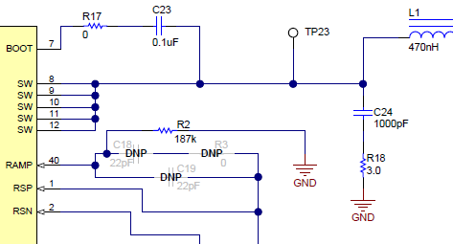
Schematic Notes: SW
Back to Schematic
 | Rail #1 | Rail #2 | Rail #3
Connect this pin to the output inductor.
RC Snubber from SW to PGND for Vin >= 12V (not usually needed for Vin = 5V) Capacitor: 1nF with 0603 package and minimum 25V rating Resistor: 1Ω with 0805 package If the SW pin ringing is too high, a snubber helps minimize high frequency voltage overshoots and undershoots from switching

Slide 18
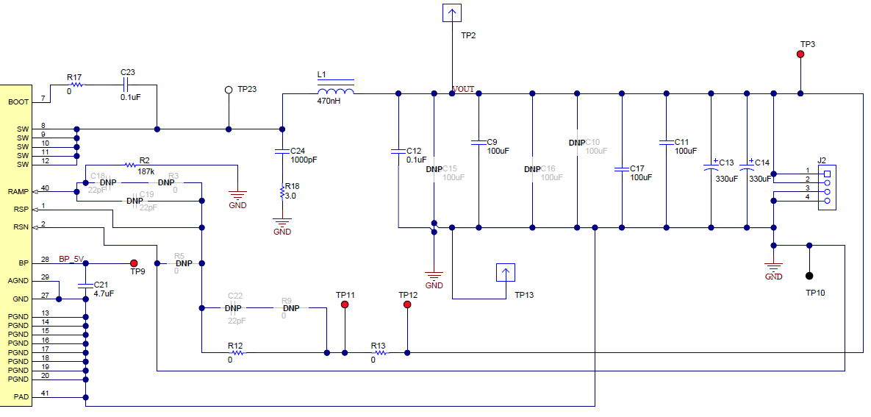
Schematic Notes: COUT
Back to Schematic
 | Rail #1 | Rail #2 | Rail #3
When trying to achieve lowest noise (not shown here), consider adding 1 x 100µF, 1 x 47µF, 1 x 10µF, and/or 1x1µF ceramic capacitor as part of the output capacitor bank – to ensure that there are not gaps due to capacitor self resonances. Output filters made of 1µF, 10µF and 100µF capacitors without capacitors between those values often have inter-capacitor resonances that result in noise peaks between the two capacitors internal self-resonance frequencies.

Slide 19
Schematic Notes: RSP/RSN (1/4)
Next Slide
 | Rail #1 | Rail #2 | Rail #3
If feedback resistors are used (not shown here), ensure that the feedback divider network gives the appropriate Vout based on the Vref chosen.
If feedback resistors are used, ensure that RFB_LS is between 0.499k and 20k. Less than 0.499K results in more current in FB path (less efficiency at light load) Greater than 20k can result in a design more susceptible to noise The feedback resistor values should be much less than 100k.

Slide 20
Schematic Notes: RSP/RSN (2/4)
Next Slide
 | Rail #1 | Rail #2 | Rail #3
Ensure that you have a cap (e.g. 1nF) or 0-ohm resistor footprint between the RSP and RSN pins. This is a placeholder for a capacitor and can be populated and value adjusted if you see noise issues.
If the application has ferrite beads, ensure that the output is taken after the ferrite bead. This will adjust the converter for the DC drop across the ferrite bead. The LC resonance of ferrite bead-cap must be far from the LC resonance of inductor-Cout. If they resonate at the same frequency then a substantial amount of noise can be passed through to the output.

Slide 21
Schematic Notes: RSP/RSN (3/4)
Next Slide
 | Rail #1 | Rail #2 | Rail #3
If not using a 0-ohm resistor in series with the RSP trace, connect a Cfilter of around 1nF between the RSP- RSN pins close to the IC (not shown here). The Cfilt should be lower than the value mentioned in the equation below. Cfilt = 1 / (2*PI*R*Fsw) R = Series resistance on RSP line + Series resistance on RSN line Fsw = switching frequency

Slide 22
Schematic Notes: RSP/RSN (4/4)
Back to Schematic
 | Rail #1 | Rail #2 | Rail #3
If using a filter capacitor, use a 10 to 100 ohm resistor in series with the trace connecting from the Vout at the remote end to the RSP pin of the IC.
If not using a filter capacitor (as is shown here), use a 0 ohm resistor if you don’t want to use the filter cap between the RSP & RSN nets. This resistor helps to break the net – so that during routing the RSP pin is connected to the remote end of the load rather than the Vout at the output of the buck converter. This resistor, in combination with the capacitor across the RSP-RSN nets, can serve as a filter to filter out the high frequency noise on the RSP & RSN lines.

Slide 23
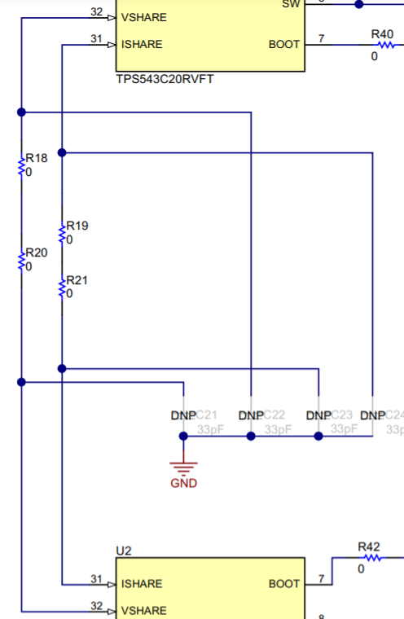
Schematic Notes: ISHARE/VSHARE
Back to Schematic
 | Rail #1 | Rail #2 | Rail #3
If using single-phase operation, float these pins.
If using dual-phase operation, connect VSHARE/ISHARE of one IC with VSHARE/ISHARE of the other IC using 0-ohm resistors.

Slide 24
Schematic Notes: SYNC (1/2)
Next Slide
 | Rail #1 | Rail #2 | Rail #3
This pin is used for synchronizing the clock between the primary IC and the secondary IC, and can also be used to synchronize to an external clock. For single-phase designs without using an external clock, float this pin.

Slide 25
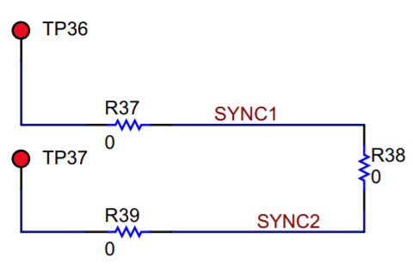
Schematic Notes: SYNC (2/2)
Back to Schematic
 | Rail #1 | Rail #2 | Rail #3
For dual-phase designs, connect the SYNC pin of the primary IC to the SYNC pin of the secondary IC. The MODE and RT pins set SYNC in vs SYNC out. If using an external clock, connect it to both SYNC pins.

Slide 26
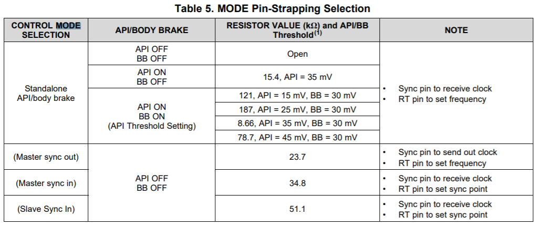
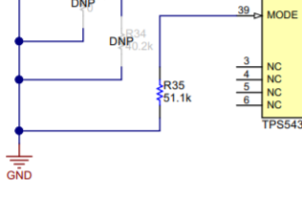
Schematic Notes: MODE
Back to Schematic
 | Rail #1 | Rail #2 | Rail #3
Connecting a resistor between the MODE pin and GND sets the operation mode and the API/Body Brake feature. See the table for determining the proper resistor value.
If using Standalone API/Body Brake with API and BB off, use an unpopulated resistor footprint in place of an open circuit

Slide 27
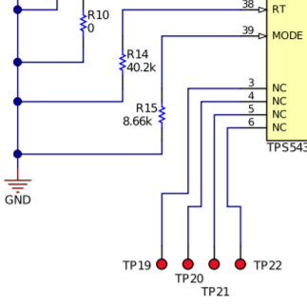
Schematic Notes: RT (1/2)
Next Slide
 | Rail #1 | Rail #2 | Rail #3
This pin sets the switching frequency if not using an external clock. Connect a resistor to ground to set the switching frequency, based on the table.
If using an external clock, set the RT resistor value such that the frequency is within 20% of the external clock frequency.

Slide 28
Schematic Notes: RT (2/2)
Back to Schematic
 | Rail #1 | Rail #2 | Rail #3
For dual-phase designs with an internal clock, the RT pin on the secondary device is used to select one of various sync point options, as is shown in the table.
For dual-phase designs with an external clock, the RT pin on each IC sets its own sync point for the clock phase shift.

Slide 29
Frequency Check
 | Rail #1 | Rail #2 | Rail #3
Check fsw based on min on/off time and check that fsw is set correctly
Ensure that the proper RT resistor is selected for your application

Slide 30
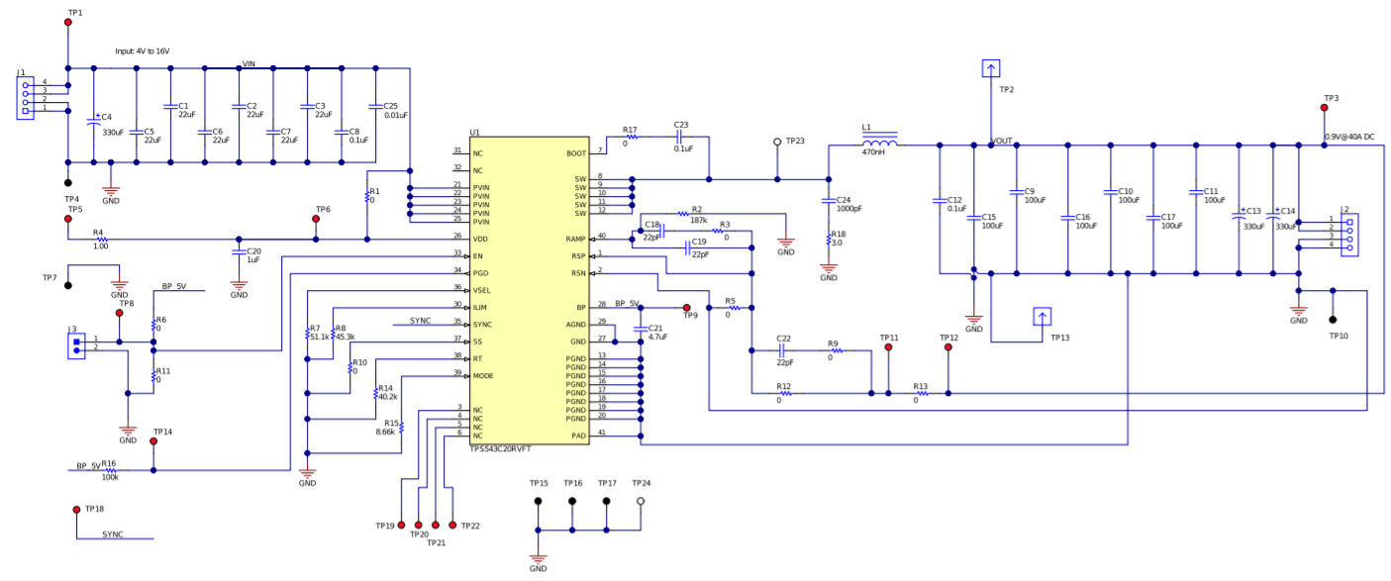
Output Capacitor Check
 | Rail #1 | Rail #2 | Rail #3
Check output cap meets stability, ripple and transient requirements.
Check ESR of non ceramic caps. Check DC voltage derating of ceramic caps (50% to 70% typical)
Ensure that the LC double pole is below 1/30th of switching frequency

Slide 31
Boot Capacitor & Snubber Check
 | Rail #1 | Rail #2 | Rail #3
Check BOOT series RC
Check SW node RC snubber values

Slide 32
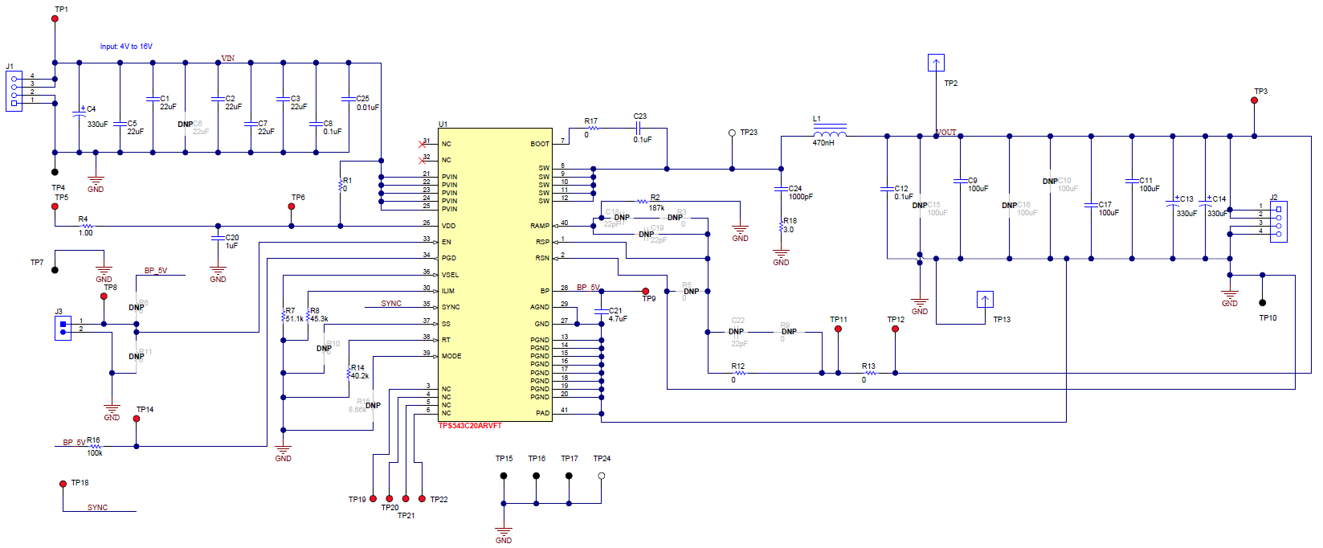
Inductor Check
 | Rail #1 | Rail #2 | Rail #3
If input LC is used, check to make sure the Q is properly dampened (Not shown here)

Slide 33
TPS543B20 TPS543C20 TPS543C20A Layout Checklist
BSR-MV
May 2021

Slide 34
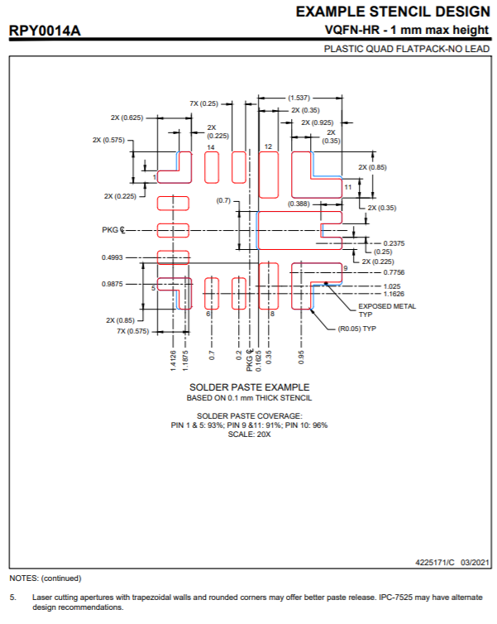
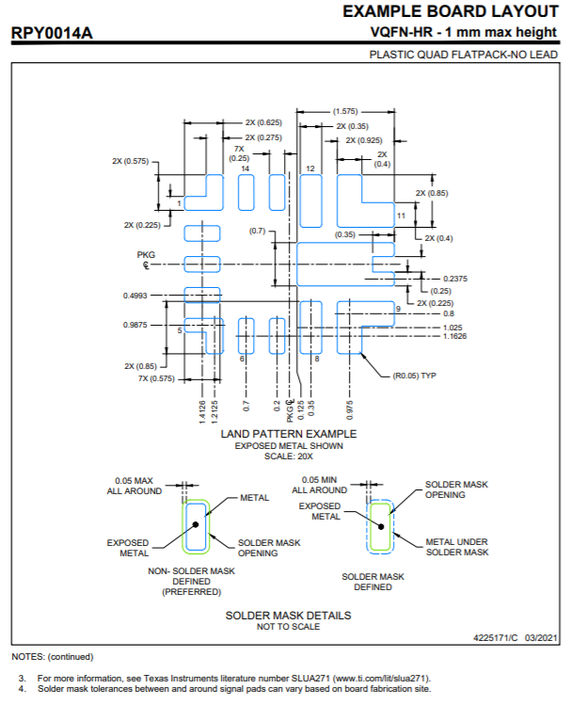
TPS543B20 TPS543C20 TPS543C20A Footprint
Please ensure that the device footprint on the board matches the TI Recommended footprint in the datasheet.
The matching includes the pad size, the solder mask & the stencil (solder paste)
Please note that Non Solder Mask Defined pad is preferred.
Please note the corner pins in this package and they are important for package reliability

Slide 35
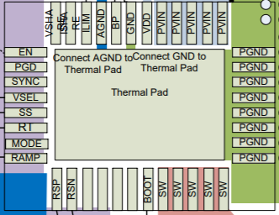
Layout Overview
Click the box to go to the
corresponding pin

Slide 36
Layout Notes: PVIN (1/2)
Back to Layout
 | Rail #1 | Rail #2 | Rail #3
Connect a 100nF capacitor between PVIN and GND. The bottom plate of the capacitor should be connected to GND directly. The GND should be connected using a short trace between the pin and the Thermal pad only.
The high frequency decoupling capacitor (1 nF to 0.1 µF) should be placed next to the PVIN pin and PGND pin as close as the spacing rule allows. This helps suppress the switch node ringing.
Ensure that the PVIN bypass capacitors should be on the same side of the PCB as the VOUT capacitors and inductor, see VOUT slide.

Slide 37
Layout Notes: PVIN (2/2)
Back to Layout
 | Rail #1 | Rail #2 | Rail #3
Place the VIN decoupling capacitors (µF capacitor bank) as close to the PVIN and PGND as possible to minimize the input AC current loop
Do not use PVIN plane connection for VDD. VDD needs to be tapped off from PVIN with separate trace connection.

Slide 38
Layout Notes: VDD
Back to Layout
 | Rail #1 | Rail #2 | Rail #3
Do not use PVIN plane connection for VDD. VDD needs to be tapped off from PVIN with separate trace connection.
Place VDD and BP decoupling capacitors as close to the device pins as possible
Ensure to provide GND vias for each decoupling capacitor and make the loop as small as possible. If this loop area is large, it can sometimes manifest as ground bounce leading to load regulation issues.

Slide 39
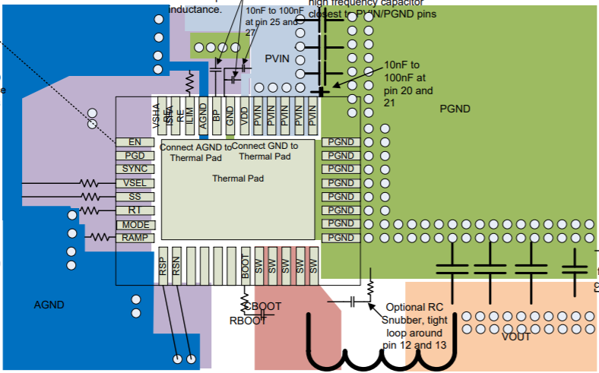
Layout Notes: GND/PGND/AGND/PAD
Back to Layout
 | Rail #1 | Rail #2 | Rail #3
Use a large solid plane for PGND. The PGND pins MUST also be connected to the thermal pad. Connect GND pin to the thermal pad. Use as many vias for the thermal pad as possible.
Use an internal solid plane for AGND to reduce the BP bypass parasitics. Only connect AGND to GND at the thermal pad. This prevents noise from coupling into AGND and causing malfunctions.

Slide 40
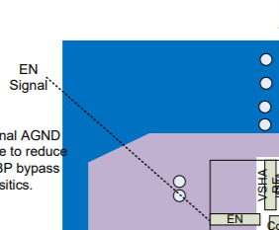
Layout Notes: EN
Back to Layout
 | Rail #1 | Rail #2 | Rail #3
Route the traces for EN away from any high voltage switching nodes, such as SW and BOOT, to avoid noise coupling.

Slide 41
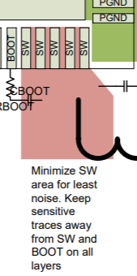
Layout Notes: BOOT
Back to Layout
 | Rail #1 | Rail #2 | Rail #3
Minimize SW area for least noise. Keep sensitive traces away from SW and BOOT on all layers.

Slide 42
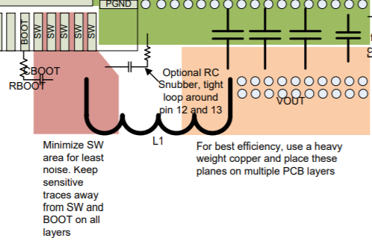
Layout Notes: SW
Back to Layout
 | Rail #1 | Rail #2 | Rail #3
Add blank space between the SW and the VOUT planes. This can add greater noise immunity against the SW radiating noise across the inductor.
Ensure that the SW trace is as short and as wide as possible. Use separate vias or traces to connect SW to the RC snubber and bootstrap capacitor. Do not use the same connection for these components.

Slide 43
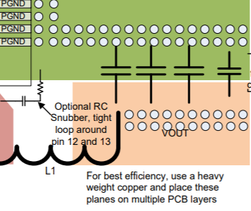
Layout Notes: VOUT
Back to Layout
 | Rail #1 | Rail #2 | Rail #3
Ensure that there is at least one inner PGND layer, in order to shield and isolate the small signal traces from noisy power lines. Each capacitor must have PGND vias.
Ensure that the VOUT capacitors and inductor should be on the same side of the PCB as the PVIN bypass capacitors, see PVIN slide.

Slide 44
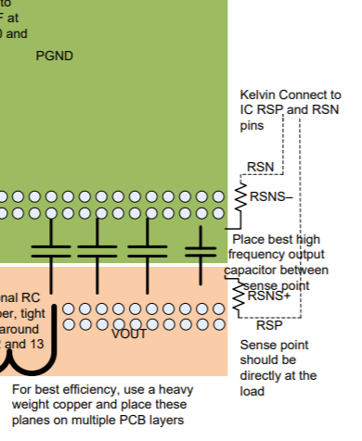
Layout Notes: RSP/RSN (1/3)
Next Slide
 | Rail #1 | Rail #2 | Rail #3
Ensure that the RSN pin is directly tied to the load GND rather than the IC GND. If not properly routed, the regulation differential voltage is across the supply voltage at the load to the IC GND, rather than the differential voltage across the load. This can result in DC set-point errors, AC regulation (noise/stability) issues, and voltage coupling.

Slide 45
Layout Notes: RSP/RSN (2/3)
Next Slide
 | Rail #1 | Rail #2 | Rail #3
Do NOT place the remote sense resistors near the inductor. The sense point should be directly at the load. Use the best high-frequency output capacitor across the sense resistors.
Ensure that the remote sense traces are routed as a differential pair, with matched length. These traces act as inputs to a differential amplifier with high impedance. Mismatches can result in remote sense voltage errors.

Slide 46
Layout Notes: RSP/RSN (3/3)
Back to Layout
 | Rail #1 | Rail #2 | Rail #3
Do NOT route the remote sense lines close to or underneath the SW node without shielding them with GND planes. Doing otherwise can result in AC coupling from the SW into the RSP node, affecting regulation. These lines can be routed around the inductor.

Slide 47
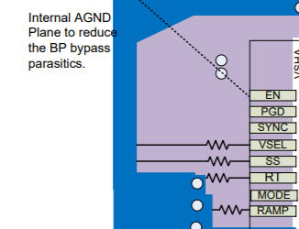
Layout Notes: PGD
Back to Layout
 | Rail #1 | Rail #2 | Rail #3
Route the traces for PGD away from any high voltage switching nodes, such as SW and BOOT, to avoid noise coupling.
Place the resistor for PGD (not shown here) as close to the device pin as possible.

Slide 48
Layout Notes: VSEL
Back to Layout
 | Rail #1 | Rail #2 | Rail #3
Route the traces for VSEL away from any high voltage switching nodes, such as SW and BOOT, to avoid noise coupling.
Place the resistor for VSEL as close to the device pin as possible.

Slide 49
Layout Notes: SS
Back to Layout
 | Rail #1 | Rail #2 | Rail #3
Route the traces for SS away from any high voltage switching nodes, such as SW and BOOT, to avoid noise coupling.
Place the resistor for SS as close to the device pin as possible.

Slide 50
Layout Notes: RAMP
Back to Layout
 | Rail #1 | Rail #2 | Rail #3
Route the traces for RAMP away from any high voltage switching nodes, such as SW and BOOT, to avoid noise coupling.
Place the resistor for RAMP as close to the device pin as possible.

Slide 51
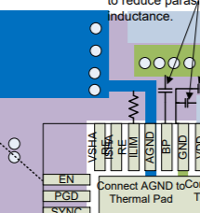
Layout Notes: ILIM
Back to Layout
 | Rail #1 | Rail #2 | Rail #3
Route the traces for ILIM away from any high voltage switching nodes, such as SW and BOOT, to avoid noise coupling.
Place the resistor for ILIM as close to the device pin as possible.

Slide 52
Layout Notes: BP
Back to Layout
 | Rail #1 | Rail #2 | Rail #3
Place the decoupling capacitor for the BP pin as close to the pin as possible.
Ensure to provide GND vias for the decoupling capacitor and make the loop as small as possible. If this loop area is large, it can manifest as ground bouncing, leading to load regulation issues.

Slide 53
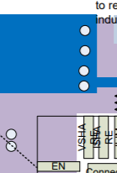
Layout Notes: SYNC
Back to Layout
 | Rail #1 | Rail #2 | Rail #3
This pin can be left floating if not in use.
If using dual-phase operation or using an external clock, ensure that this trace is routed away from sensitive analog signals such as VSHARE, ISHARE, RT, and FB.

Slide 54
Layout Notes: MODE
Back to Layout
 | Rail #1 | Rail #2 | Rail #3
Route the traces for MODE away from any high voltage switching nodes, such as SW and BOOT, to avoid noise coupling.
Place the resistor for MODE, if used, as close to the device pin as possible (not shown here).

Slide 55
Layout Notes: RT
Back to Layout
 | Rail #1 | Rail #2 | Rail #3
Route the traces for RT away from any high voltage switching nodes, such as SW and BOOT, to avoid noise coupling.
Place the resistor for RT as close to the device pin as possible.

Slide 56
Layout Notes: ISHARE/VSHARE
Back to Layout
 | Rail #1 | Rail #2 | Rail #3
If using single-phase operation, float these pins.
If using dual-phase operation, be sure to route these traces away from noisy traces such as SW and SYNC. If routed too closely, the signal can couple into VSHARE/ISHARE.

Slide 57
Generic Best Practices for Quick Schematic Review
BSR-MV
May 2021

Slide 58
Generic Best Practices for Quick Schematic Review (1/2)
TPS543C20A SPECIFICATION
INPUT VOLTAGE: 12V
OUTPUT VOLTAGE: 0.9V
OUTPUT LOAD CURRENT: 40A
OUTPUT VOLTAGE RIPPLE: ±10mVpp
OUTPUT VOLTAGE UNDER/OVERSHOOT AFTER LOAD STEP: 50mV
OUTPUT OVERCURRENT: 46A
SOFT-START TIME: 0.5ms
SWITCHING FREQUENCY: 0.5MHz
OPERATING MODE: Fixed Frequency
OPERATING TEMPERATURE: 25ºC
Add text for expected currents and voltages near input and output terminals
If pins are connected to off sheet supply, note the voltage level.
Check standardized Info Note
12V
0.9V, 40A
12V
GRM31CR60J107ME39L
No 4-way ties
Add text for significant off-page
components (eg. output capacitors)
Different ground symbols for
quiet and power ground when applicable
Ground symbols should point down

Slide 59
Generic Best Practices for Quick Schematic Review (2/2)
TPS543C20A SPECIFICATION
INPUT VOLTAGE: 12V
OUTPUT VOLTAGE: 0.9V
OUTPUT LOAD CURRENT: 40A
OUTPUT VOLTAGE RIPPLE: ±10mVpp
OUTPUT VOLTAGE UNDER/OVERSHOOT AFTER LOAD STEP: 50mV
OUTPUT OVERCURRENT: 46A
SOFT-START TIME: 0.5ms
SWITCHING FREQUENCY: 0.5MHz
OPERATING MODE: Fixed Frequency
OPERATING TEMPERATURE: 25ºC
Check input cap meets bypass
and ripple requirements
Note part number or value, rdc and
Irms, isat rating of inductor
12V
2.5V, 15A
12V
GRM31CR60J107ME39L
Check FB network is correct (including feedforward cap, external ripple injection and any external margining circuits)
Note part number or value, esr and voltage rating, dielectric for capacitors

Slide 60
Important notice and disclaimer
TI PROVIDES TECHNICAL AND RELIABILITY DATA (INCLUDING DATASHEETS), DESIGN RESOURCES (INCLUDING REFERENCE DESIGNS), APPLICATION OR OTHER DESIGN ADVICE, WEB TOOLS, SAFETY INFORMATION, AND OTHER RESOURCES “AS IS” AND WITH ALL FAULTS, AND DISCLAIMS ALL WARRANTIES, EXPRESS AND IMPLIED, INCLUDING WITHOUT LIMITATION ANY IMPLIED WARRANTIES OF MERCHANTABILITY, FITNESS FOR A PARTICULAR PURPOSE OR NON-INFRINGEMENT OF THIRD PARTY INTELLECTUAL PROPERTY RIGHTS.
These resources are intended for skilled developers designing with TI products. You are solely responsible for (1) selecting the appropriate TI products for your application, (2) designing, validating and testing your application, and (3) ensuring your application meets applicable standards, and any other safety, security, or other requirements.
These resources are subject to change without notice. TI grants you permission to use these resources only for development of an application that uses the TI products described in the resource. Other reproduction and display of these resources is prohibited. No license is granted to any other TI intellectual property right or to any third party intellectual property right. TI disclaims responsibility for, and you will fully indemnify TI and its representatives against, any claims, damages, costs, losses, and liabilities arising out of your use of these resources.
TI’s products are provided subject to TI’s Terms of Sale or other applicable terms available either on ti.com or provided in conjunction with such TI products. TI’s provision of these resources does not expand or otherwise alter TI’s applicable warranties or warranty disclaimers for TI products.

