Slide 1
TPS544C26 Configuration Programming User Guide Rev.1.1
Nancy
3/13/2024

Slide 2
How to unlock the device?

Slide 3
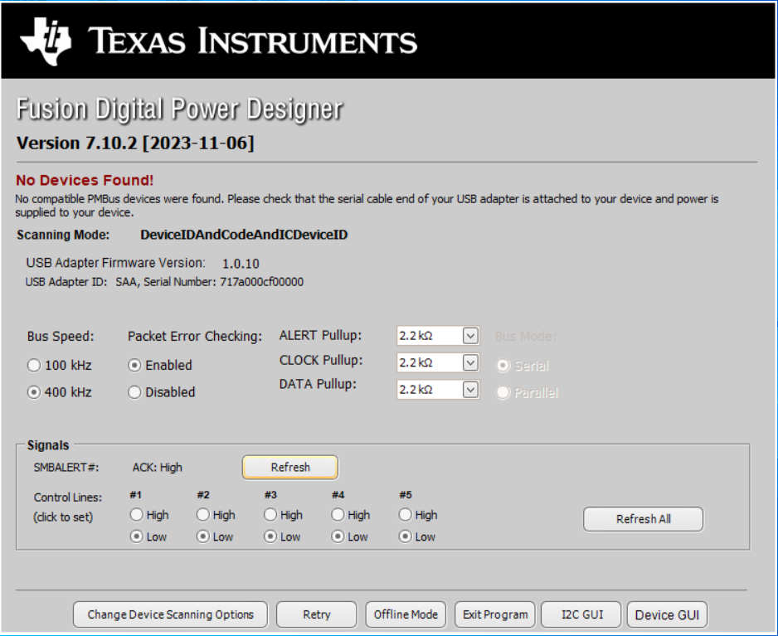
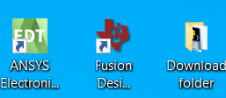

Slide 4
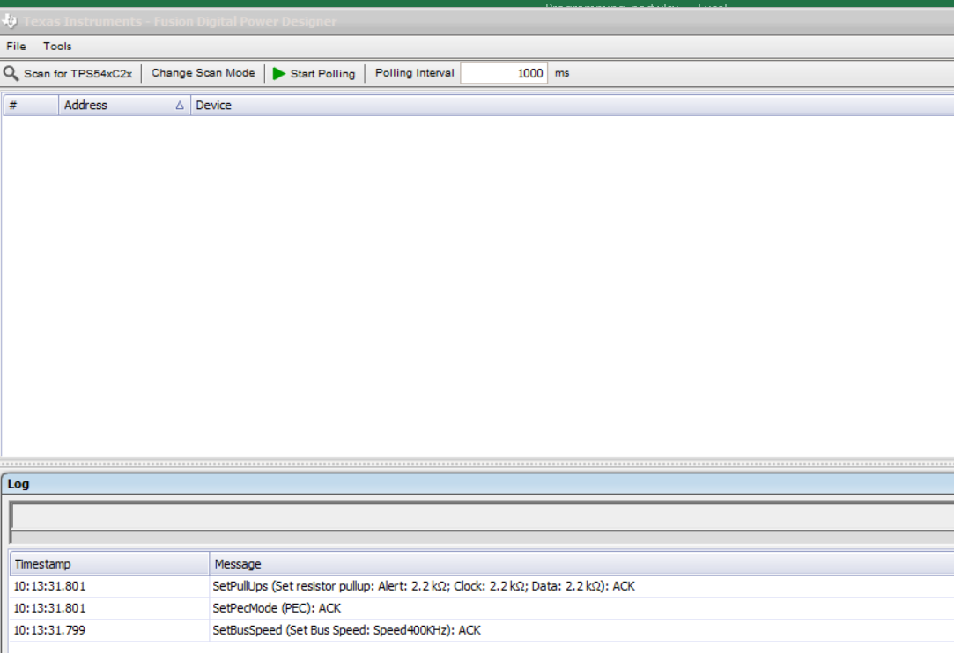

Slide 5
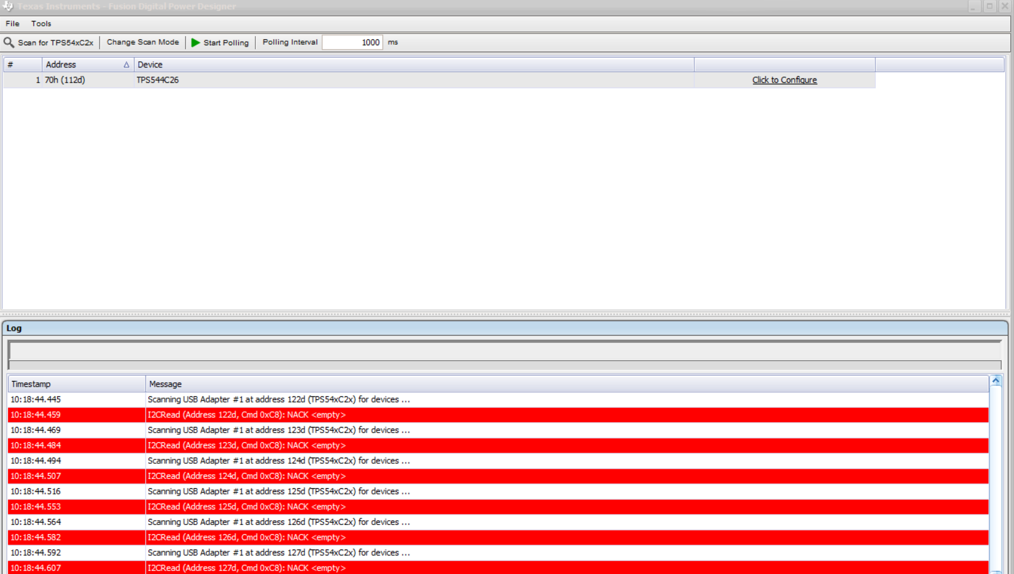

Slide 6
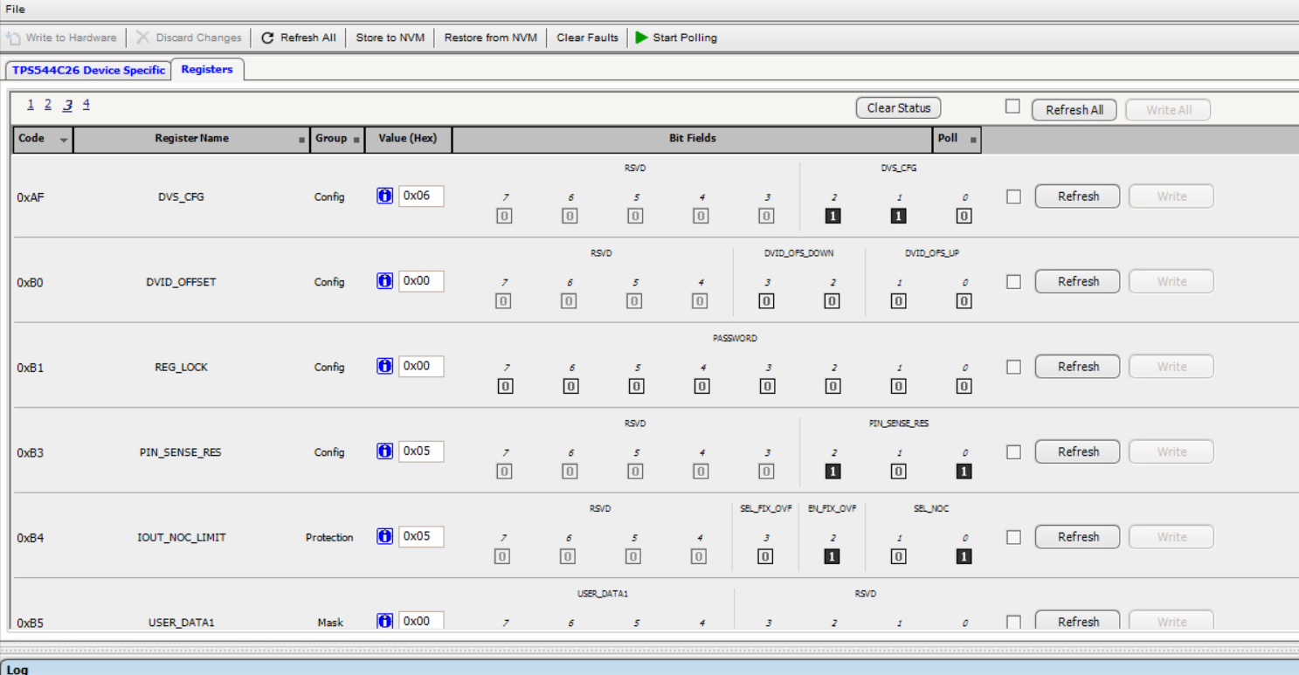
Click Registers tab---click page 3-----See 0xB1 (REG_LOCK)

Slide 7
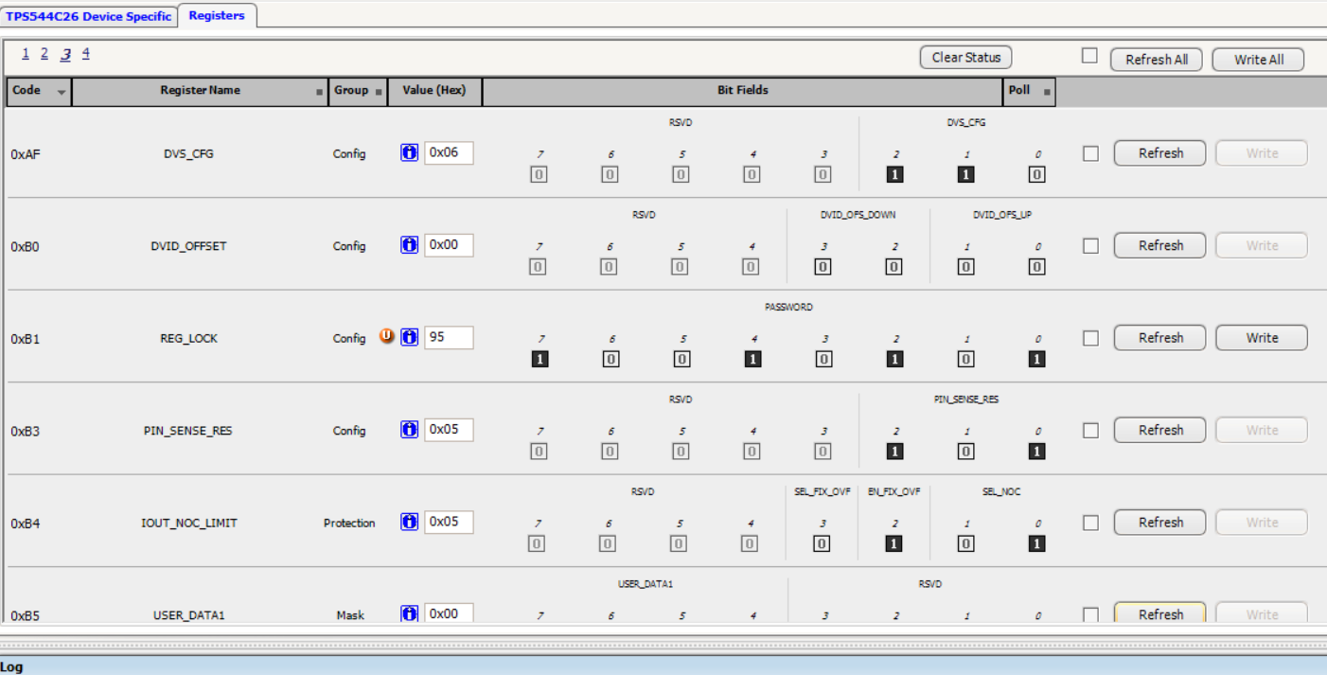
0xB1: enter 95----click “Write”

Slide 8
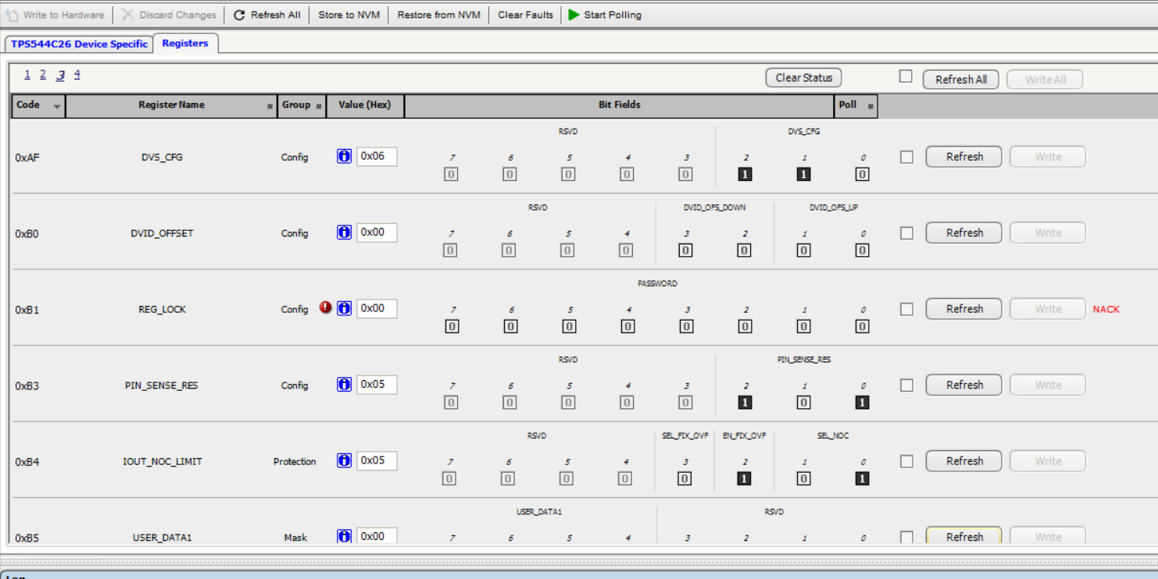
0xB1: automatically changes back to 0x00. Please ignore NACK

Slide 9
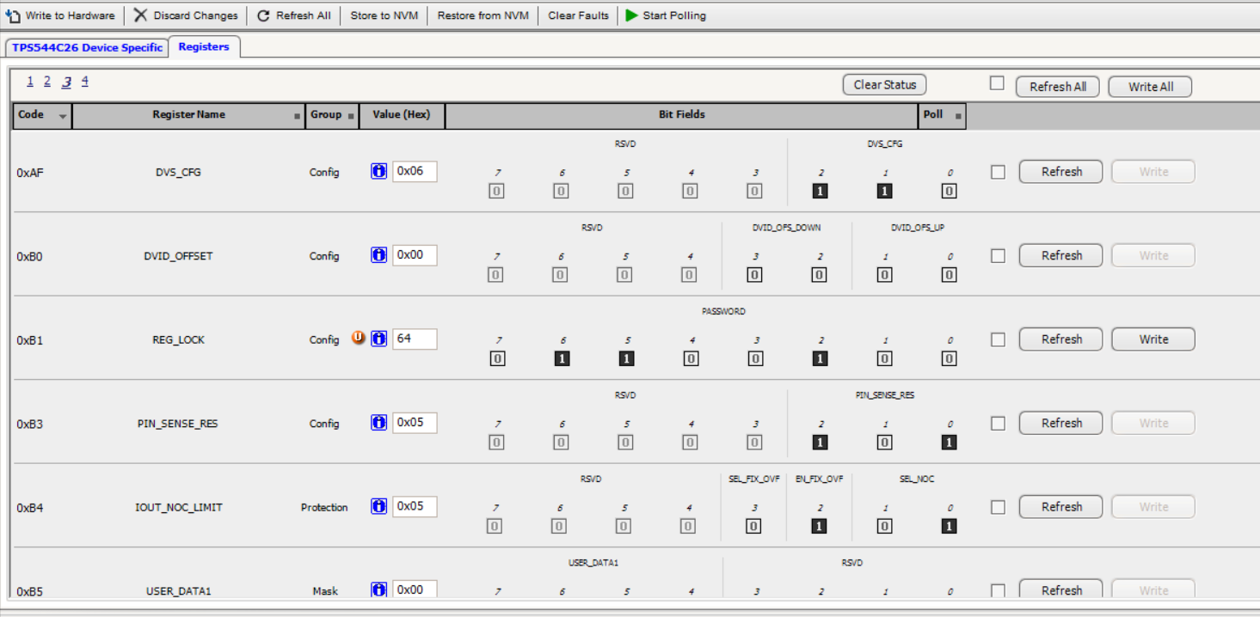
0xB1: enter 64----click “Write”

Slide 10
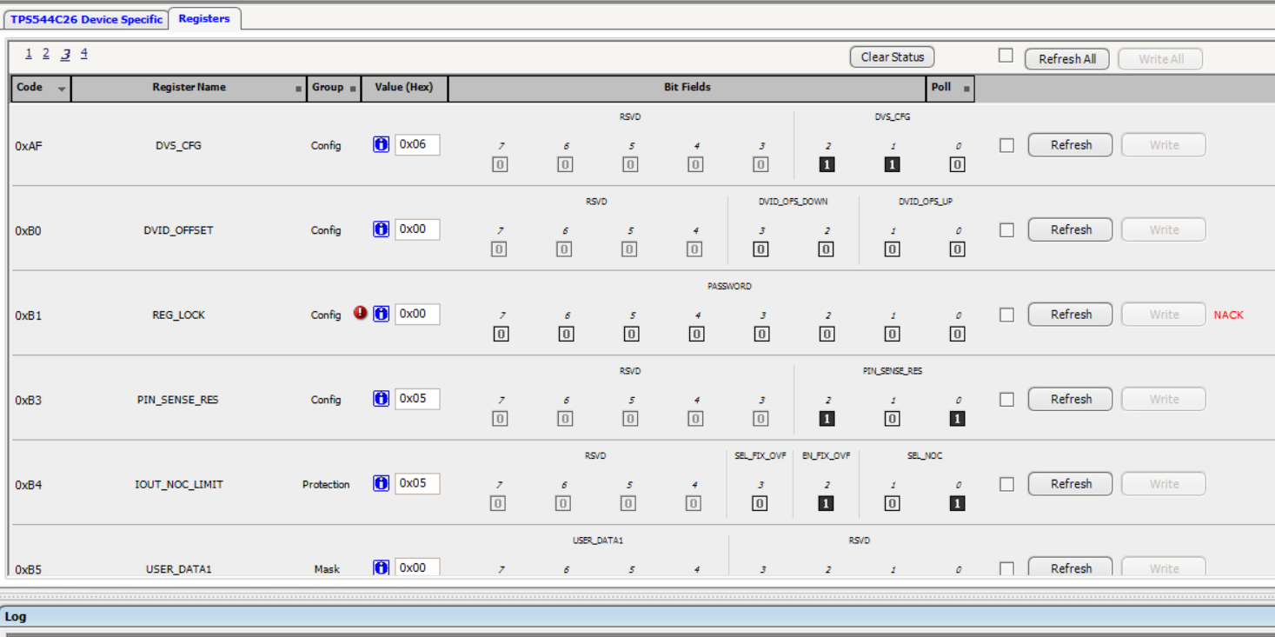
0xB1: automatically changes back to 0x00. Please ignore NACK

Slide 11
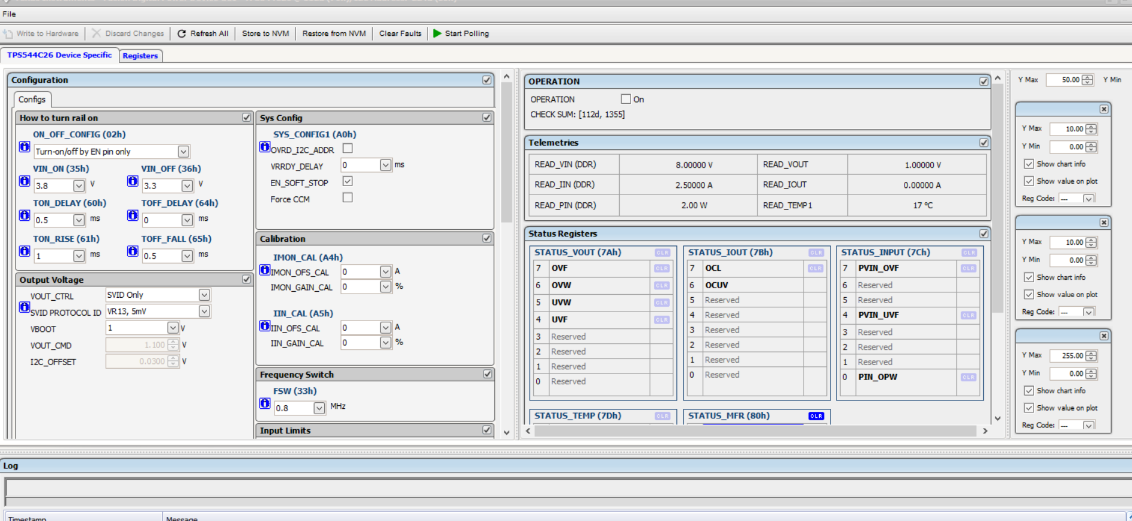
Click “TPS544C26 Device Specific”----do some changes
1. After any changes, click “Write to Hardware” and “Store to NVM”

Slide 12
How to calculate and set the value of VIDO_MAX (BDh[0]+Beh[7:0])?

Slide 13
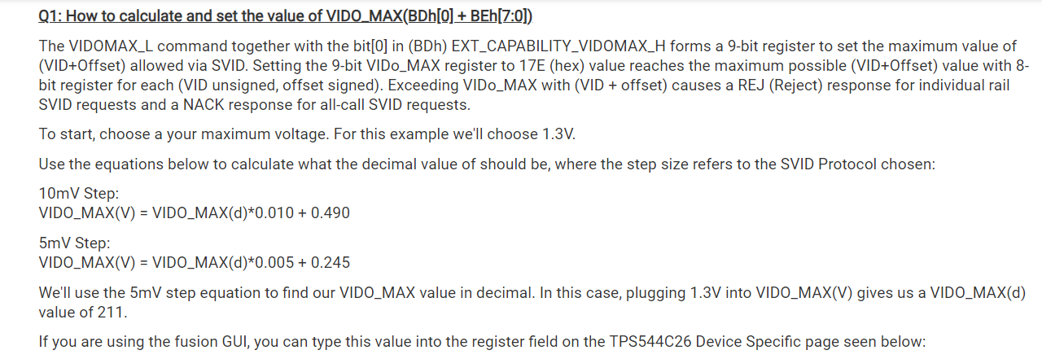
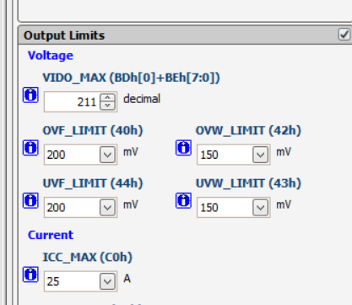
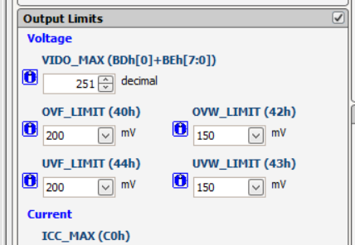
Change VIDO_MAX, must disable device by removing EN jumper on the EVM
Intel PDG didn’t tell max output voltage for each rails. Usually set to 1.5V for 5mV step
EVM default setting is 1.3V max for 5mV step which is 211decimal
If VIDO_MAX(V)=1.5V for 5mV step, then VIDO_MAX(d)=251. to set VIDO_MAX(d) must turn off
device first, otherwise could not change

Slide 14
How to update other parameters?

Slide 15
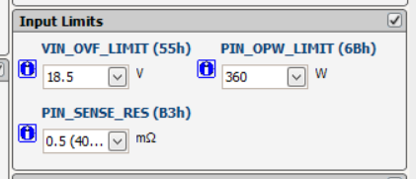
PIN_SENSE_RES(B3h) no need to change as long as no use this feature and externally connecting to P12V
If use PIN sense feature, just select sense resistor value which should be same value on the board

Slide 16
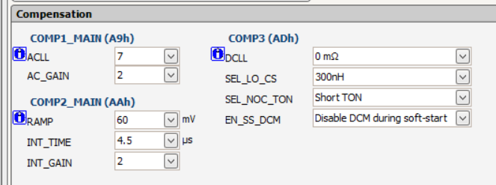
Loop compensation used default setting , no need to change in general,
SEL_LO_CS: used the closed inductor value of the external output inductor
SEL_NOC_TON: Usually select Short TON
EE_SS_DCM: usually select Disable DCM. But refer to customer’s requirement.

Slide 17
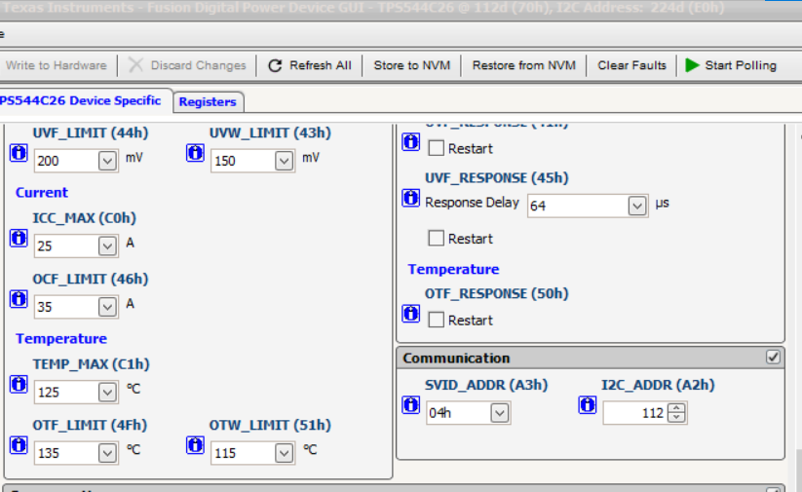
I2C ADDR: should fill in PMBus address 112d(70h) is PMBus address, 224d(E0h) is I2C address. But need to fill 112d
SVID_ADDR: can be changed per application

Slide 18
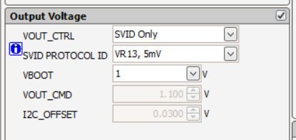
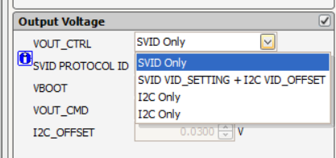
Default setting is SVID only, We don’t recommend add any SVID offset for VBOOT.
The TPS544C26 does not assert ALERT# pin to low after a repeated VID request which causes the CPU to hang. The error occurs when the part is configured to SVID+I2C_OFFSET (VOUT_CTRL=01b) and has an I2C_OFFSET>0b

Slide 19
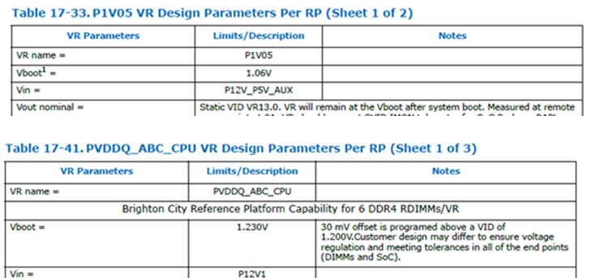
How to set Vboot with 1.06V and 1.23V per Intel PDG?
Can add 10mV offset with SVID+I2C_OFFSET for P1V05.
But don’t recommend add 30mV offset for VDDQ rail since may have a repeated SVID request during CUP bring up

Slide 20
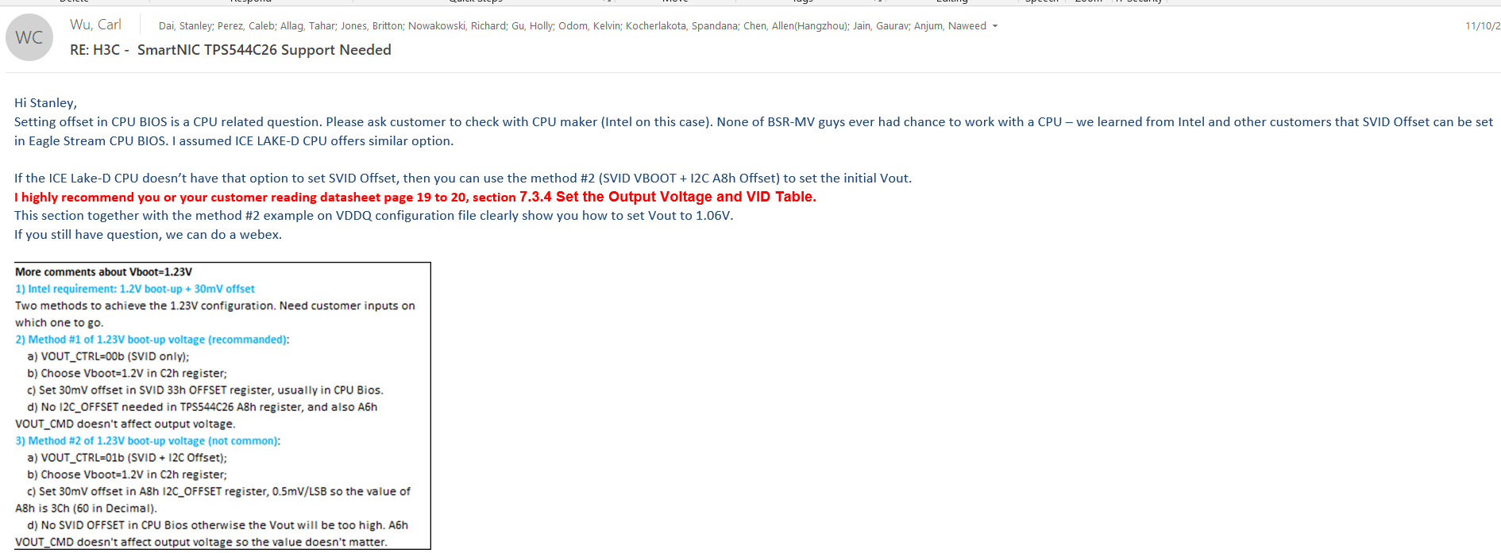
Only can use method#1,
Method#2 will cause change VID with same voltage, the ALERT# not pulling low, thus the system will hangout.

Slide 21
How to export .cvs file?

Slide 22
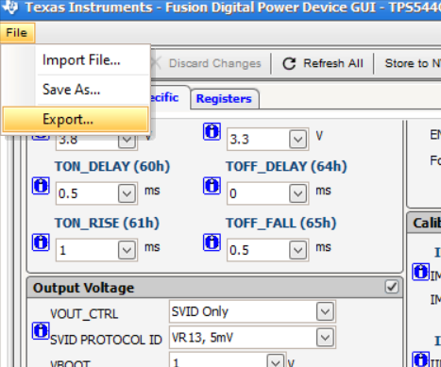
After update all the parameters---Write to Hardware and Store to NVM
File---Export

Slide 23
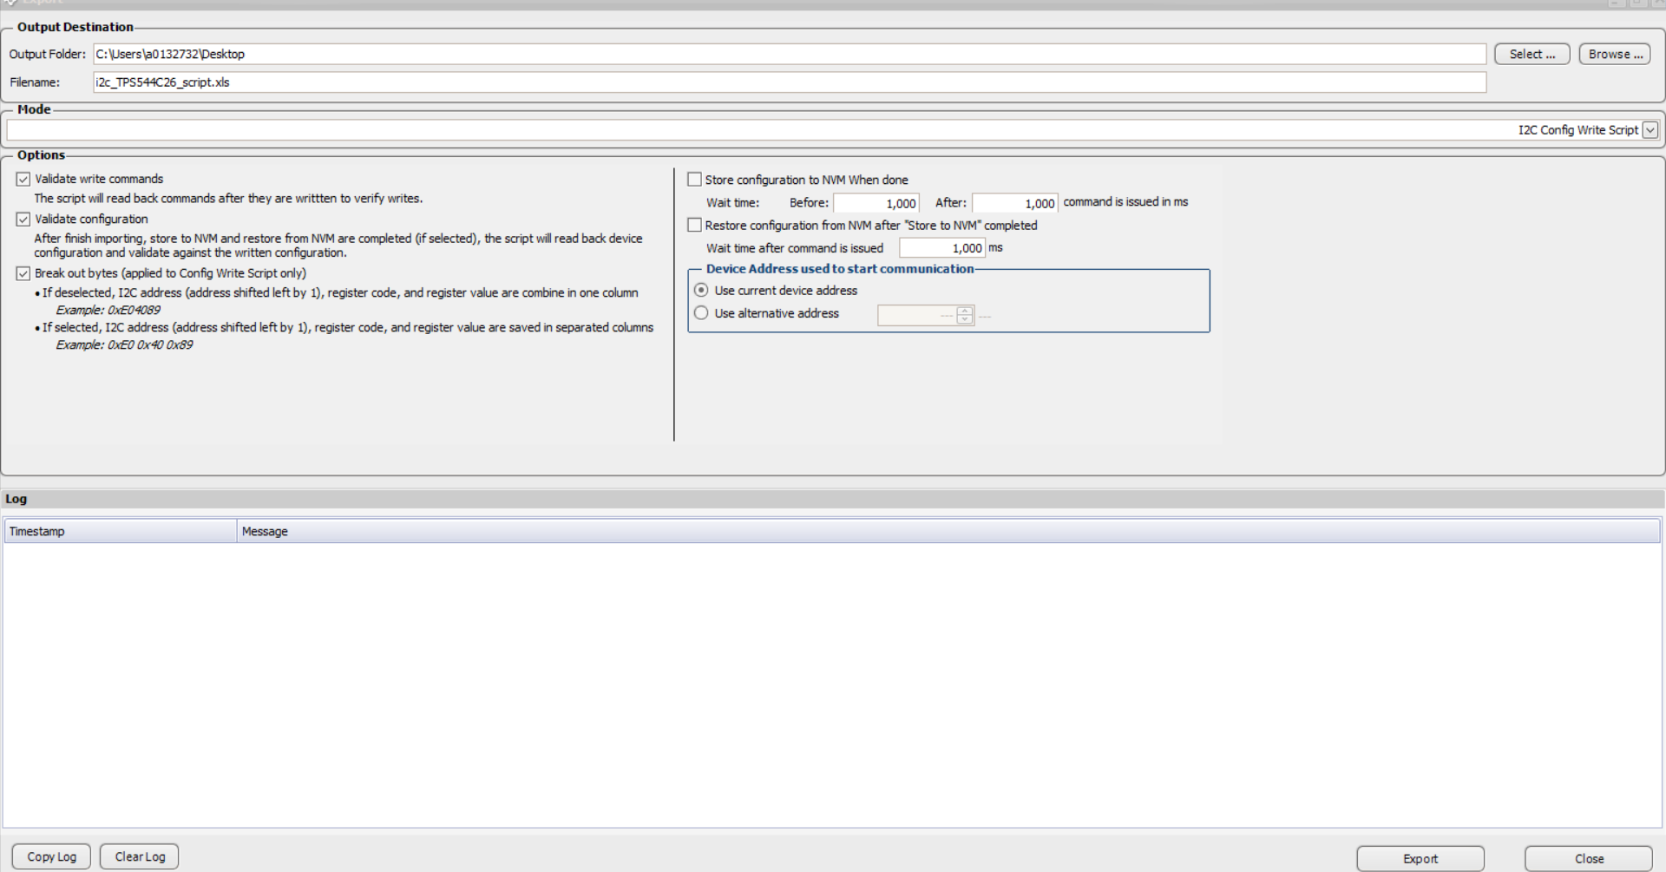
Check all three on the left side
Check to use current device. If use alternative address, the .csv file address is still old one or mess up
Export

Slide 24
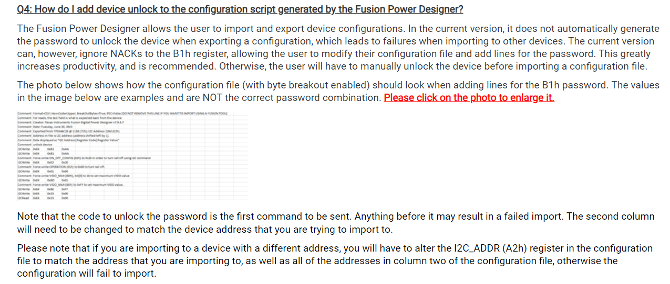
See instruction as below

Slide 25
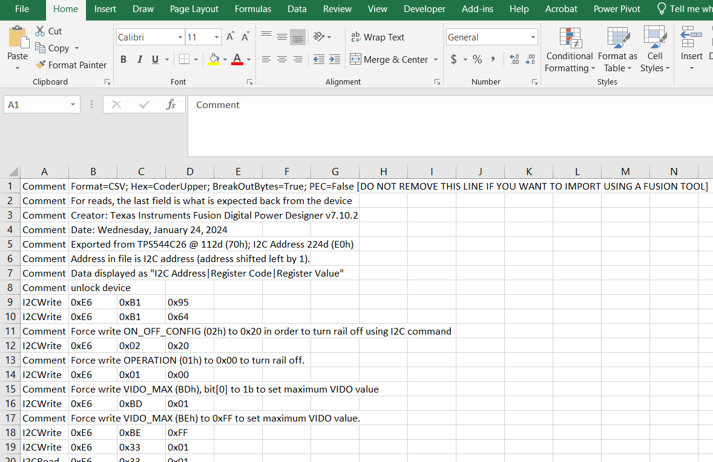
Open xx. Csv file with excel
3 lines after line7 at line8/9/10 as below
Column 2 is I2C address 0xE6h(73d(E6h)), if customer uses different address, must change all the column2

Slide 26


Column 2 is I2C address E6h(73d(E6h)), if customer uses different address, must change all the column2
Also need to change 0xA2 to 73h in three locations (Line 59/60/126) as below

Slide 27
How to import .csv file back to device ?

Slide 28
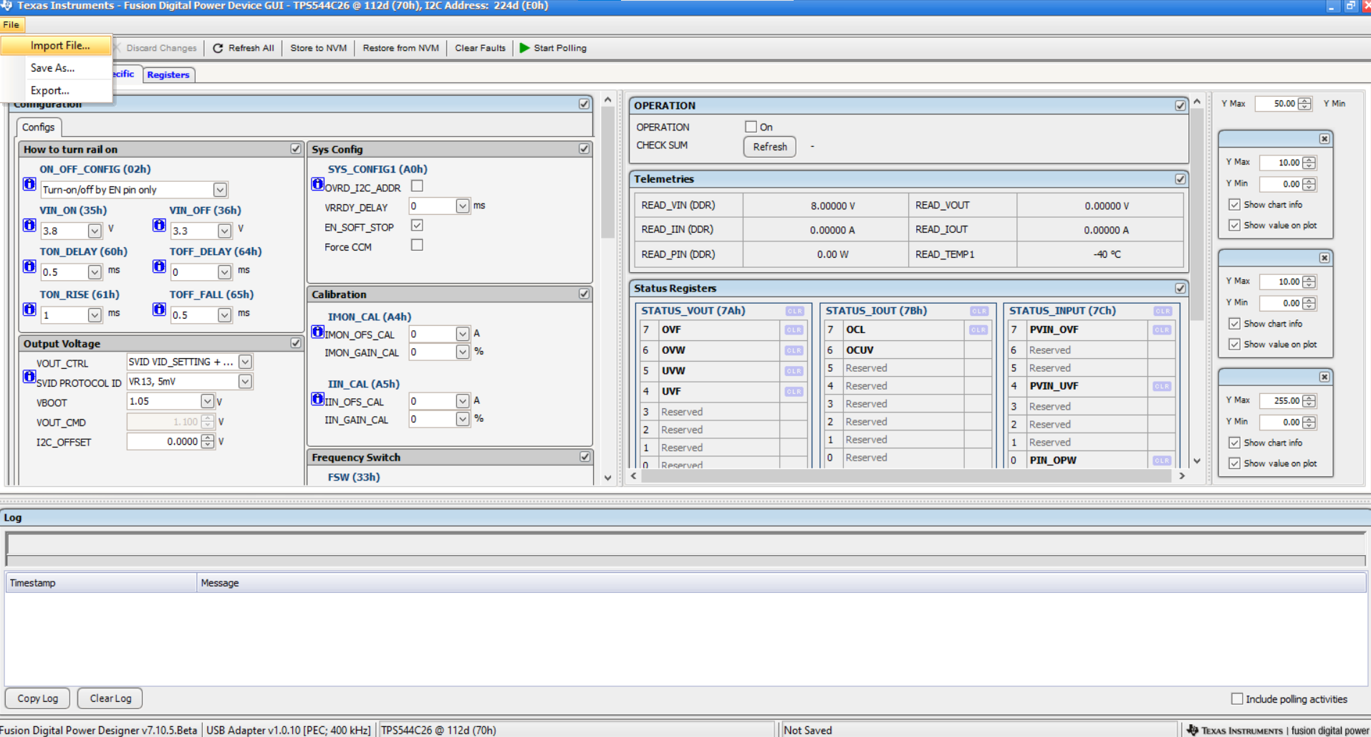
Open I2C GUI in slide 3/4/5
File---Import File

Slide 29
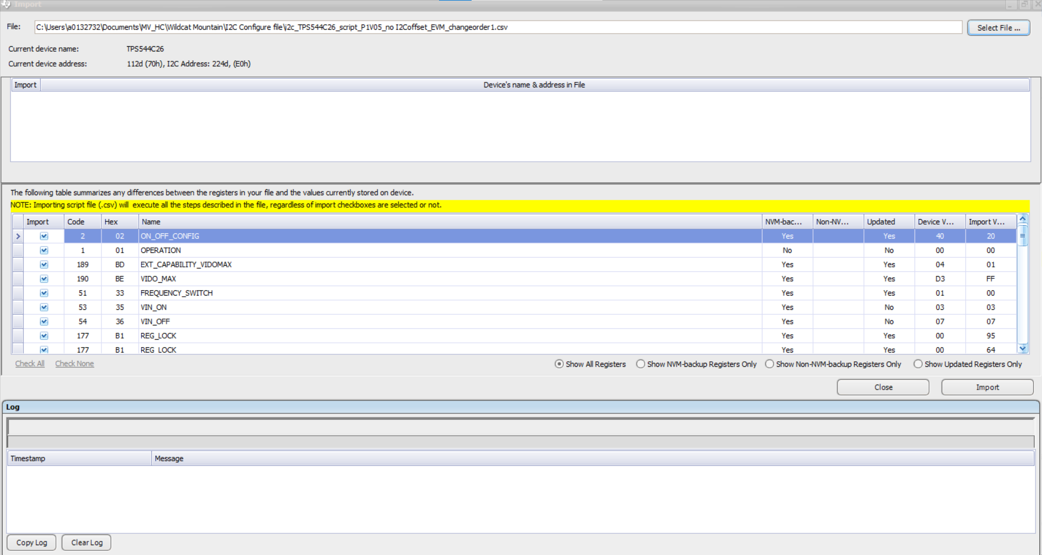
Select File---where saved
Click “Import”

Slide 30
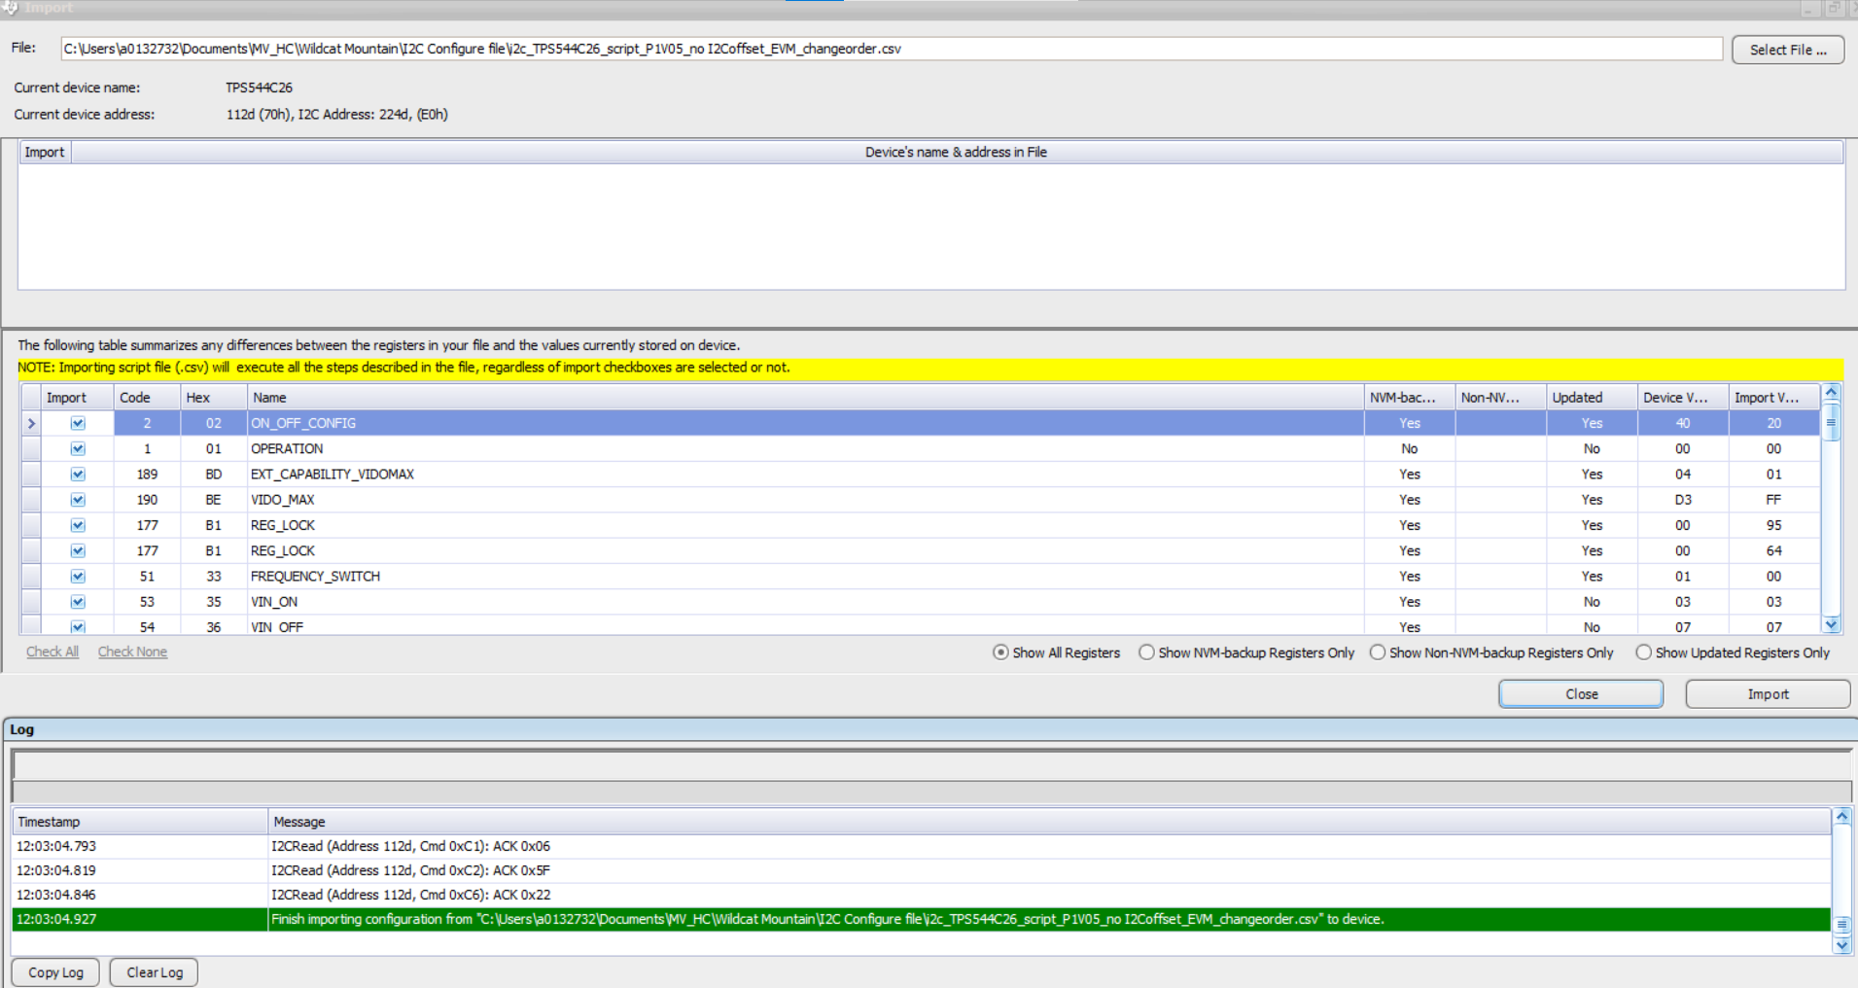
If import is successful, the Finish importing configuration in green shown in Log

Slide 31
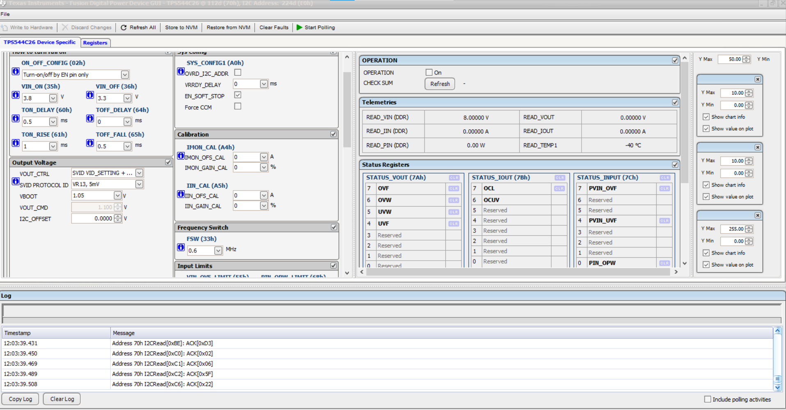
In the TPS544C26 Device Specific tab
Click “Refresh All” and “Store to NVM”
Done

