Slide 1
TPS54550 Slow Start
J. Tucker
19 June, 2018

Slide 2
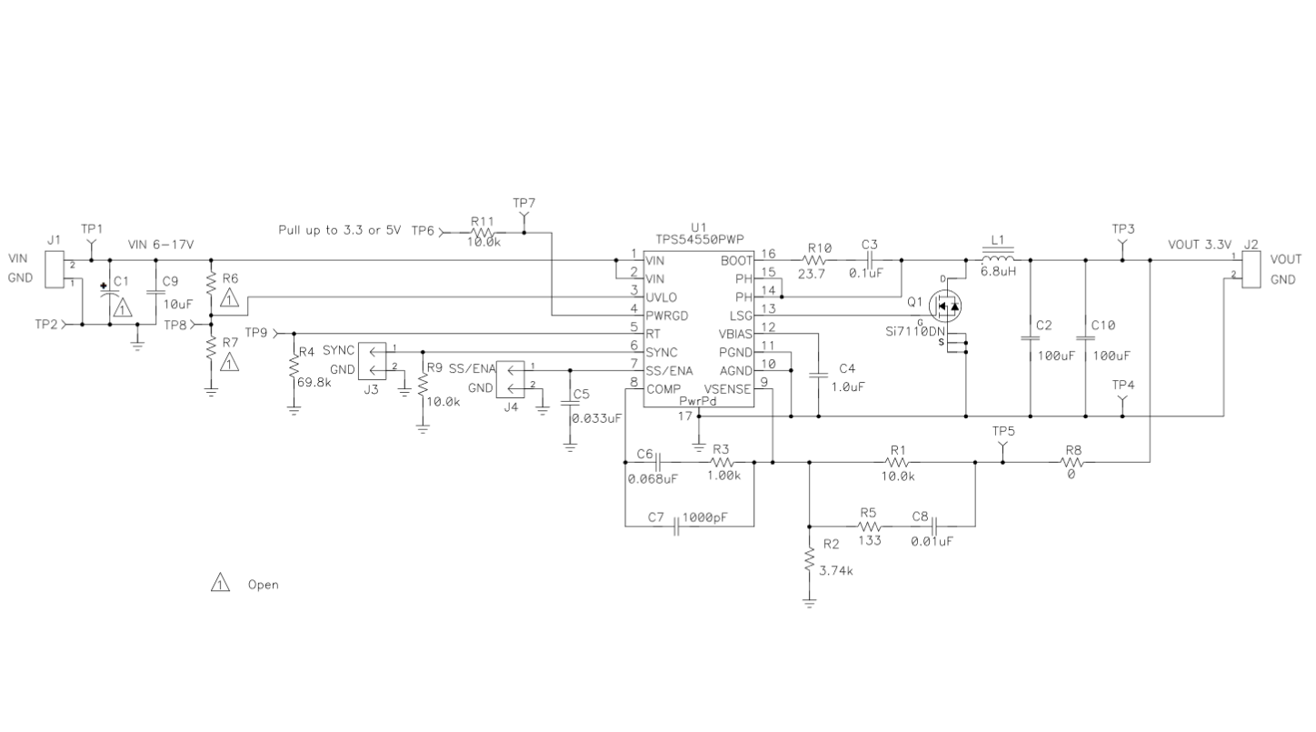
TPS54550 EVM Schematic
Vin = 12 V, Vout = 3.3 V, Fsw = 700 kHz

Slide 3
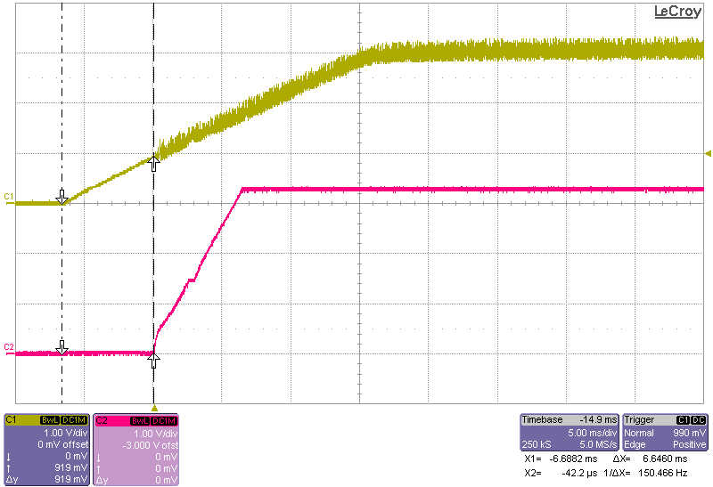
TPS54550 SS Delay
TPS54550 SS/EN held low (short J4- to J4-2) then release.
SS/ENA charges up to approximately 900 mV before switching starts.
Delay is 6.646 msec.

Slide 4
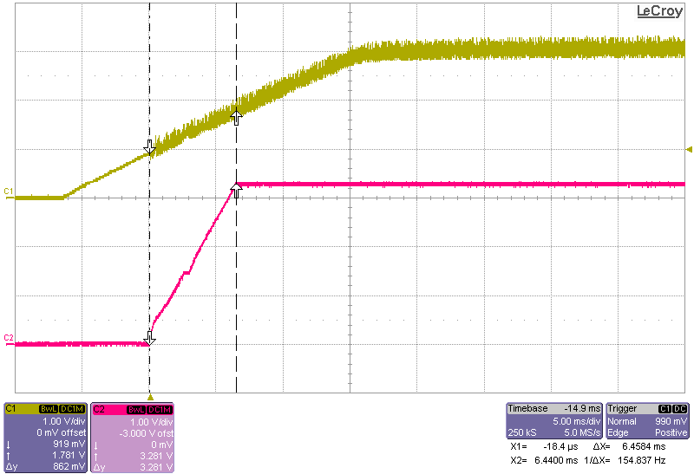
TPS54550 Vout SS time
Vout rise time 0 to 100 % in 6.458 msec.
Calculated SS time is:
Tss (msec) = Css (uF) / 5.55E-3
Tss (msec) = 0.033 / 5.55E-3 = 5.95 msec

Slide 5
SS time is influenced by Iss charge current.
Iss charge current has wide tolerance so SS time is approximate and may vary.

