Slide 1
TPS546D24A Layout Review
SR-MVB
Joseph Conrad
12/27/23

Slide 2
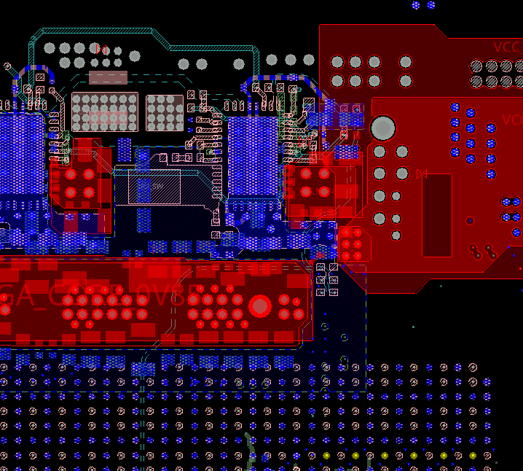
VOSNS/GOSNS
Route further away from the power inductor to avoid noise coupling.
Remove the 10Ohm resistor to local output cap bank.

Slide 3
SW node
Shrink the SW node on both devices.
This will help radiate less noise to sensitive traces.
Move the inductor closer to the IC if design rules allow

Slide 4
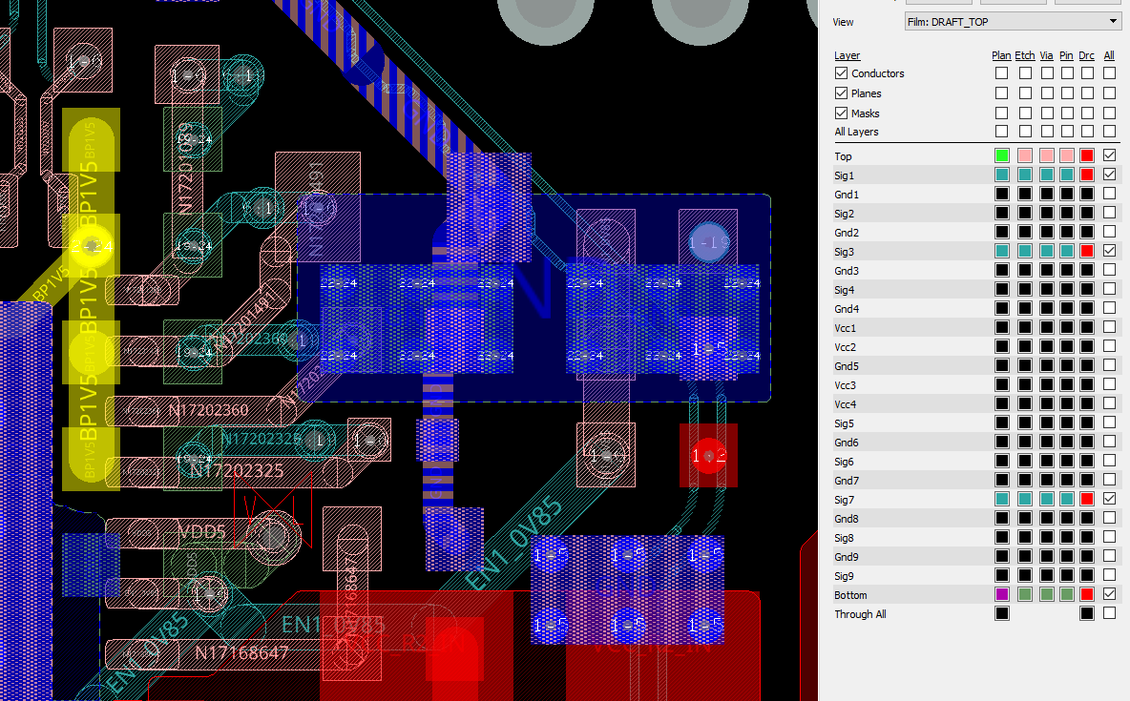
Pin strapping pins (MSEL1,MSEL2, ADRSEL, VSEL,
For high side resistor divider resistors: reduce trace parasitic by removing the transition from SIG7 to SIG3.
Just have one transition from BOT to SIG3 to TOP

Slide 5
SYNC
Try to avoid having SYNC line near sensitive analog traces/pins like VSHARE

Slide 6
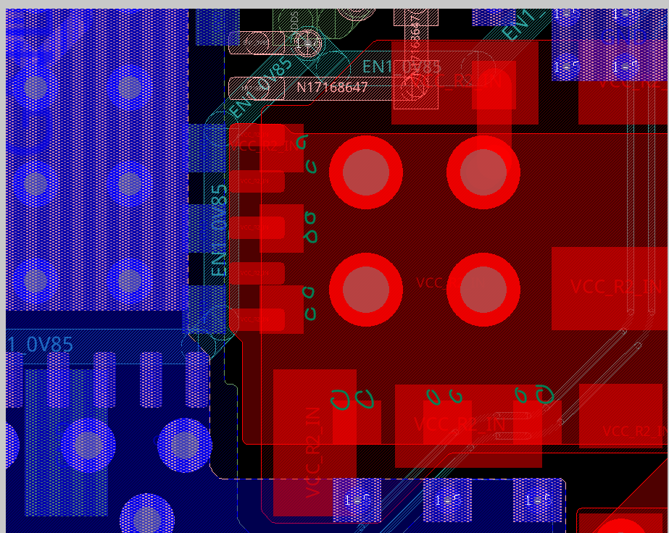
Input/Output Caps
Ensure there are vias at input cap pads to stitch top and bottom layers together.
The ones nearest the IC especially are important for proper decoupling
Output caps should also have vias at every capacitor pad, similar to what is drawn to the right

